Slide 1
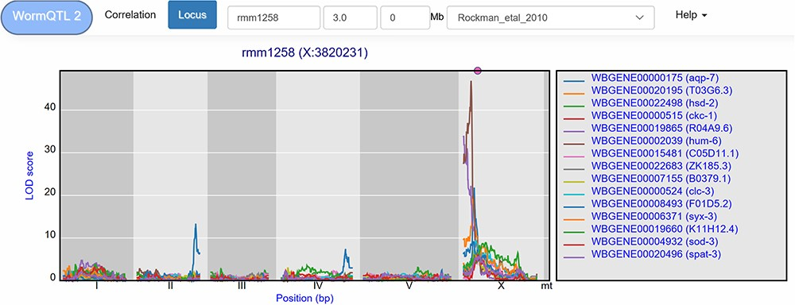
Figure 4 Co-locating eQTL profiles of genes annotated with GO term ‘regulation of cell cycle’. The eQTL profiles of ...
Notes:
Figure 4 Co-locating eQTL profiles of genes annotated with GO term ‘regulation of cell cycle’. The eQTL profiles of the top-15 highest eQTLs are shown as profiles. A histogram of all peaks −log10(p) > 3.5 is shown below the profile plot to detect possible regulatory hotspots, as can be observed here on chromosome I. Genes are shown in different colors. The legend is shown on the right. Chromosomes are indicated by different gray backgrounds and below the x-axis. The web-based plot is interactive; a mouse over provides the exact base pair position of each QTL or other point on the profile.
Unless provided in the caption above, the following copyright applies to the content of this slide: © The Author(s) 2020. Published by Oxford University Press.This is an Open Access article distributed under the terms of the Creative Commons Attribution License (http://creativecommons.org/licenses/by/4.0/), which permits unrestricted reuse, distribution, and reproduction in any medium, provided the original work is properly cited.

