Slide 1
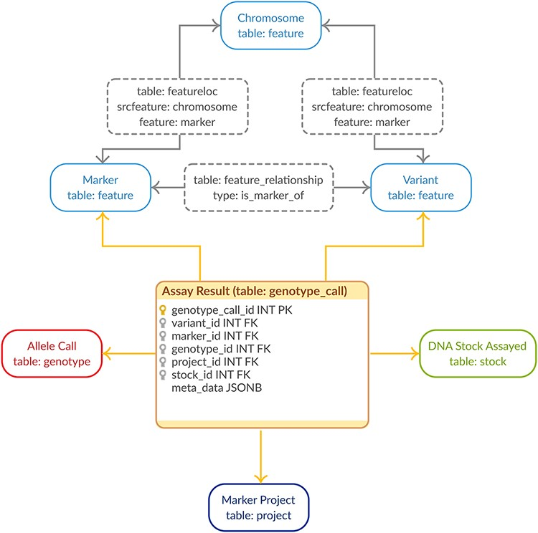
Figure 1. Genotypic Data Model. The entity–relationship diagram describes the relevant sections of the Chado schema for ...
Notes:
Figure 1. Genotypic Data Model. The entity–relationship diagram describes the relevant sections of the Chado schema for storage of genotypic data. The genotype_call table (highlighted in orange) is a backward-compatible enhancement to the Chado schema, whereas all the supporting tables match the generic Chado specification. The genotype_call table gathers together all the metadata for a genotypic data point into a single record through the use of foreign keys.
Unless provided in the caption above, the following copyright applies to the content of this slide: © The Author(s) 2021. Published by Oxford University Press.This is an Open Access article distributed under the terms of the Creative Commons Attribution License (http://creativecommons.org/licenses/by/4.0/), which permits unrestricted reuse, distribution, and reproduction in any medium, provided the original work is properly cited.

