Slide 1
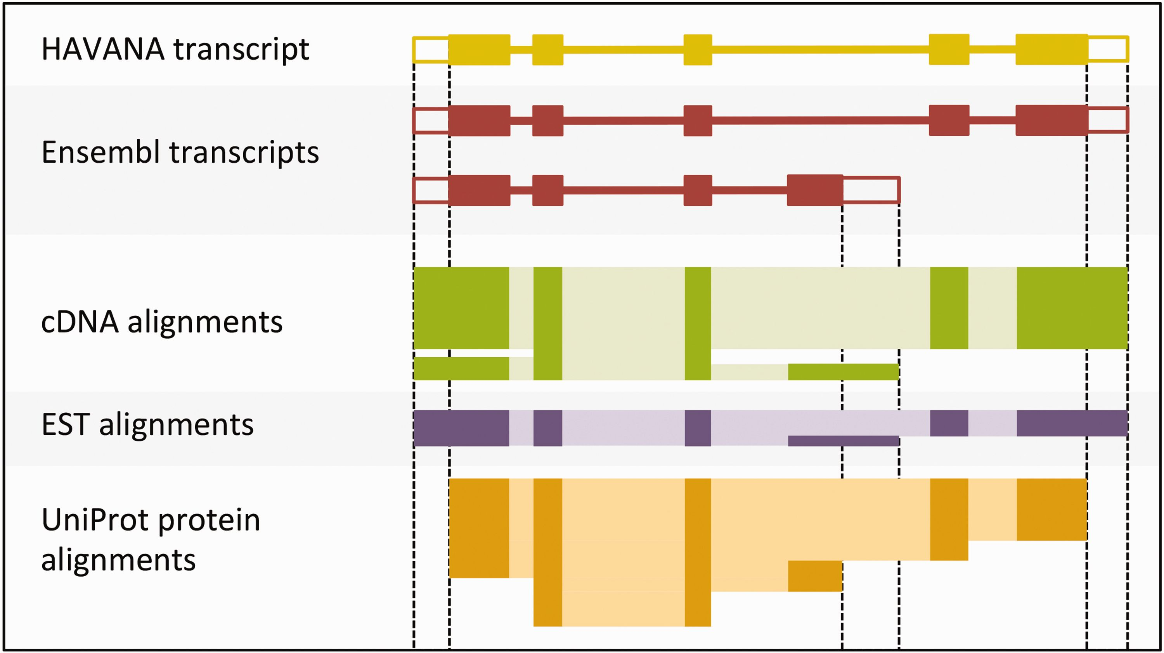
Figure 4. Sample transcript models with supporting evidence for untranslated regions (UTRs). This figure shows sample ...
Notes:
Figure 4. Sample transcript models with supporting evidence for untranslated regions (UTRs). This figure shows sample transcript models from HAVANA (yellow) and Ensembl (red) aligned with supporting evidence from cDNAs (green), ESTs (purple) and proteins (orange). Darker colors in the alignments correspond with exons. Unfilled boxes at the ends of the transcripts represent UTRs. Support for the UTRs comes from the aligned cDNAs and ESTs but not from the proteins.
Unless provided in the caption above, the following copyright applies to the content of this slide: © The Author(s) 2016. Published by Oxford University Press. This is an Open Access article distributed under the terms of the Creative Commons Attribution License ( http://creativecommons.org/licenses/by/4.0/ ), which permits unrestricted reuse, distribution, and reproduction in any medium, provided the original work is properly cited.

