Slide 1
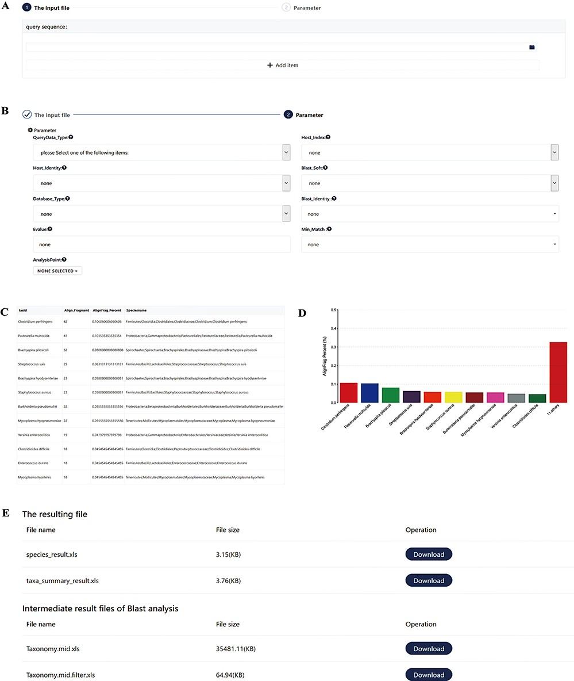
Figure 5 Screenshots of the pathogen screening tool. (A) File upload module. (B) Necessary arguments setting. (C–D) ...
Notes:
Figure 5 Screenshots of the pathogen screening tool. (A) File upload module. (B) Necessary arguments setting. (C–D) Overview of results. The top 10 species are shown in both a table and a histogram format. (E) The resulting files. The generated files can be downloaded. Species_result.xls is the result of species level. Taxa_summary_result.xls shows the result at the genus to phylum levels. Taxonomy.mid.xls contains all analysis records. Taxonomy.mid.filter.xls is the filtered result based on the set parameters and is the source file of Species_result.xls and Taxa_summary_result.xls.
Unless provided in the caption above, the following copyright applies to the content of this slide: © The Author(s) 2020. Published by Oxford University Press.This is an Open Access article distributed under the terms of the Creative Commons Attribution License (http://creativecommons.org/licenses/by/4.0/), which permits unrestricted reuse, distribution, and reproduction in any medium, provided the original work is properly cited.

