Slide 1
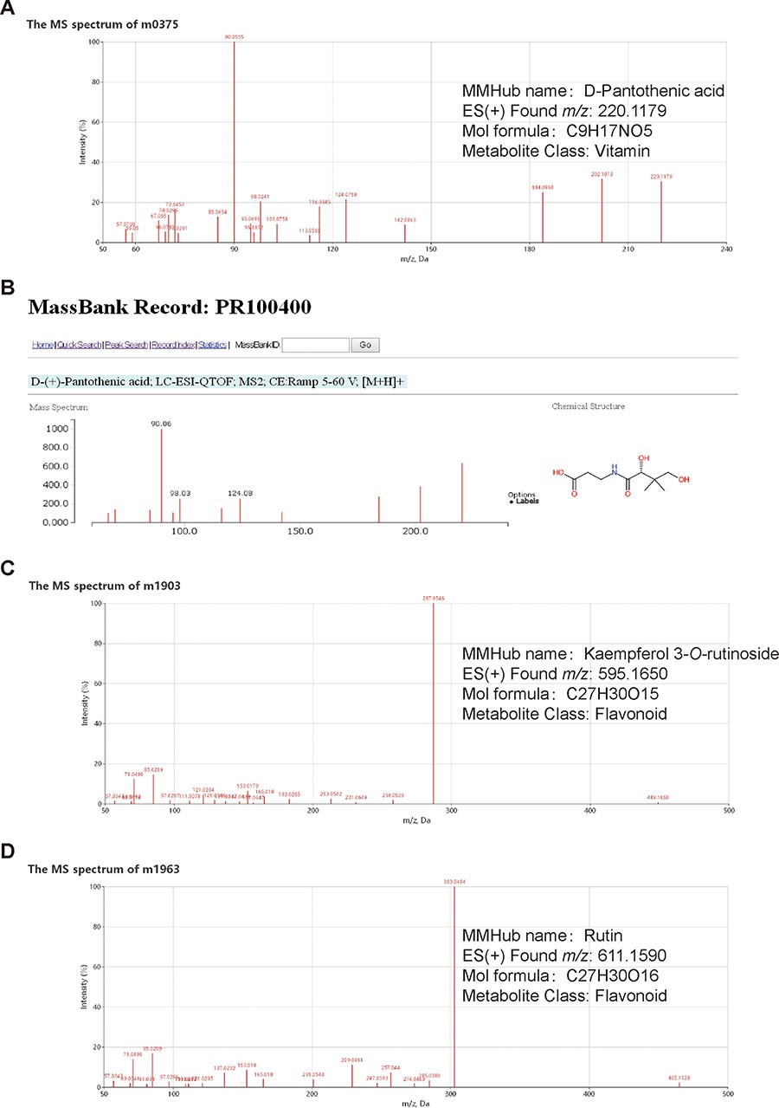
Figure 2 Examples of metabolite identification based on database comparisons and specific fragmentation patterns in ...
Notes:
Figure 2 Examples of metabolite identification based on database comparisons and specific fragmentation patterns in MMHub. Molecular feature m0375 (A) was identified as D-pantothenic acid by comparison with MassBank (B). Two molecular features (m1903 and m1963) were annotated as kaempferol 3-O-rutinoside (C) and rutin (D) based on flavonoid-specific fragmentation patterns. Identities of three metabolites shown in this figure were confirmed by comparison with authentic standards.
Unless provided in the caption above, the following copyright applies to the content of this slide: © The Author(s) 2020. Published by Oxford University Press.This is an Open Access article distributed under the terms of the Creative Commons Attribution License (http://creativecommons.org/licenses/by/4.0/), which permits unrestricted reuse, distribution, and reproduction in any medium, provided the original work is properly cited.

