Slide 1
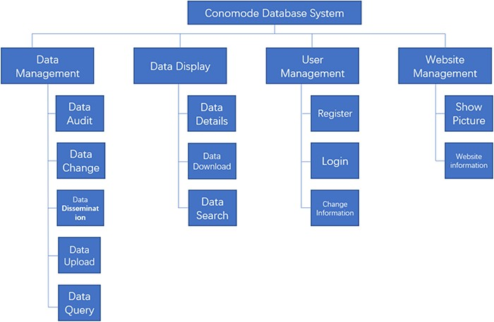
Figure 1. Structure and function of the ConoMode webserver.
Notes:
Figure 1. Structure and function of the ConoMode webserver.
Unless provided in the caption above, the following copyright applies to the content of this slide: © The Author(s) 2020. Published by Oxford University Press.This is an Open Access article distributed under the terms of the Creative Commons Attribution License (http://creativecommons.org/licenses/by/4.0/), which permits unrestricted reuse, distribution, and reproduction in any medium, provided the original work is properly cited.

Slide 2
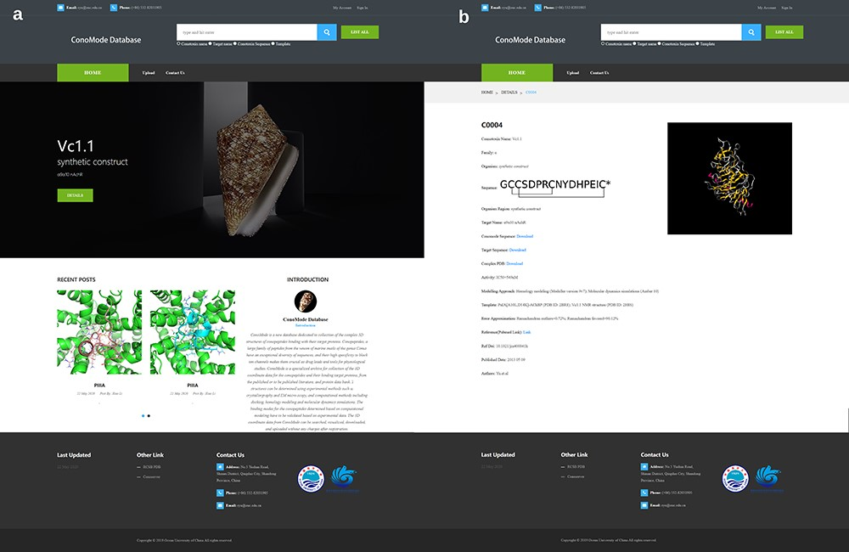
Figure 2. Screenshot of ConoMode website. (a) Interface of the ConoMode database. (b) Detailed page of Vc1.1-α9α9.
Notes:
Figure 2. Screenshot of ConoMode website. (a) Interface of the ConoMode database. (b) Detailed page of Vc1.1-α9α9.
Unless provided in the caption above, the following copyright applies to the content of this slide: © The Author(s) 2020. Published by Oxford University Press.This is an Open Access article distributed under the terms of the Creative Commons Attribution License (http://creativecommons.org/licenses/by/4.0/), which permits unrestricted reuse, distribution, and reproduction in any medium, provided the original work is properly cited.

