Slide 1
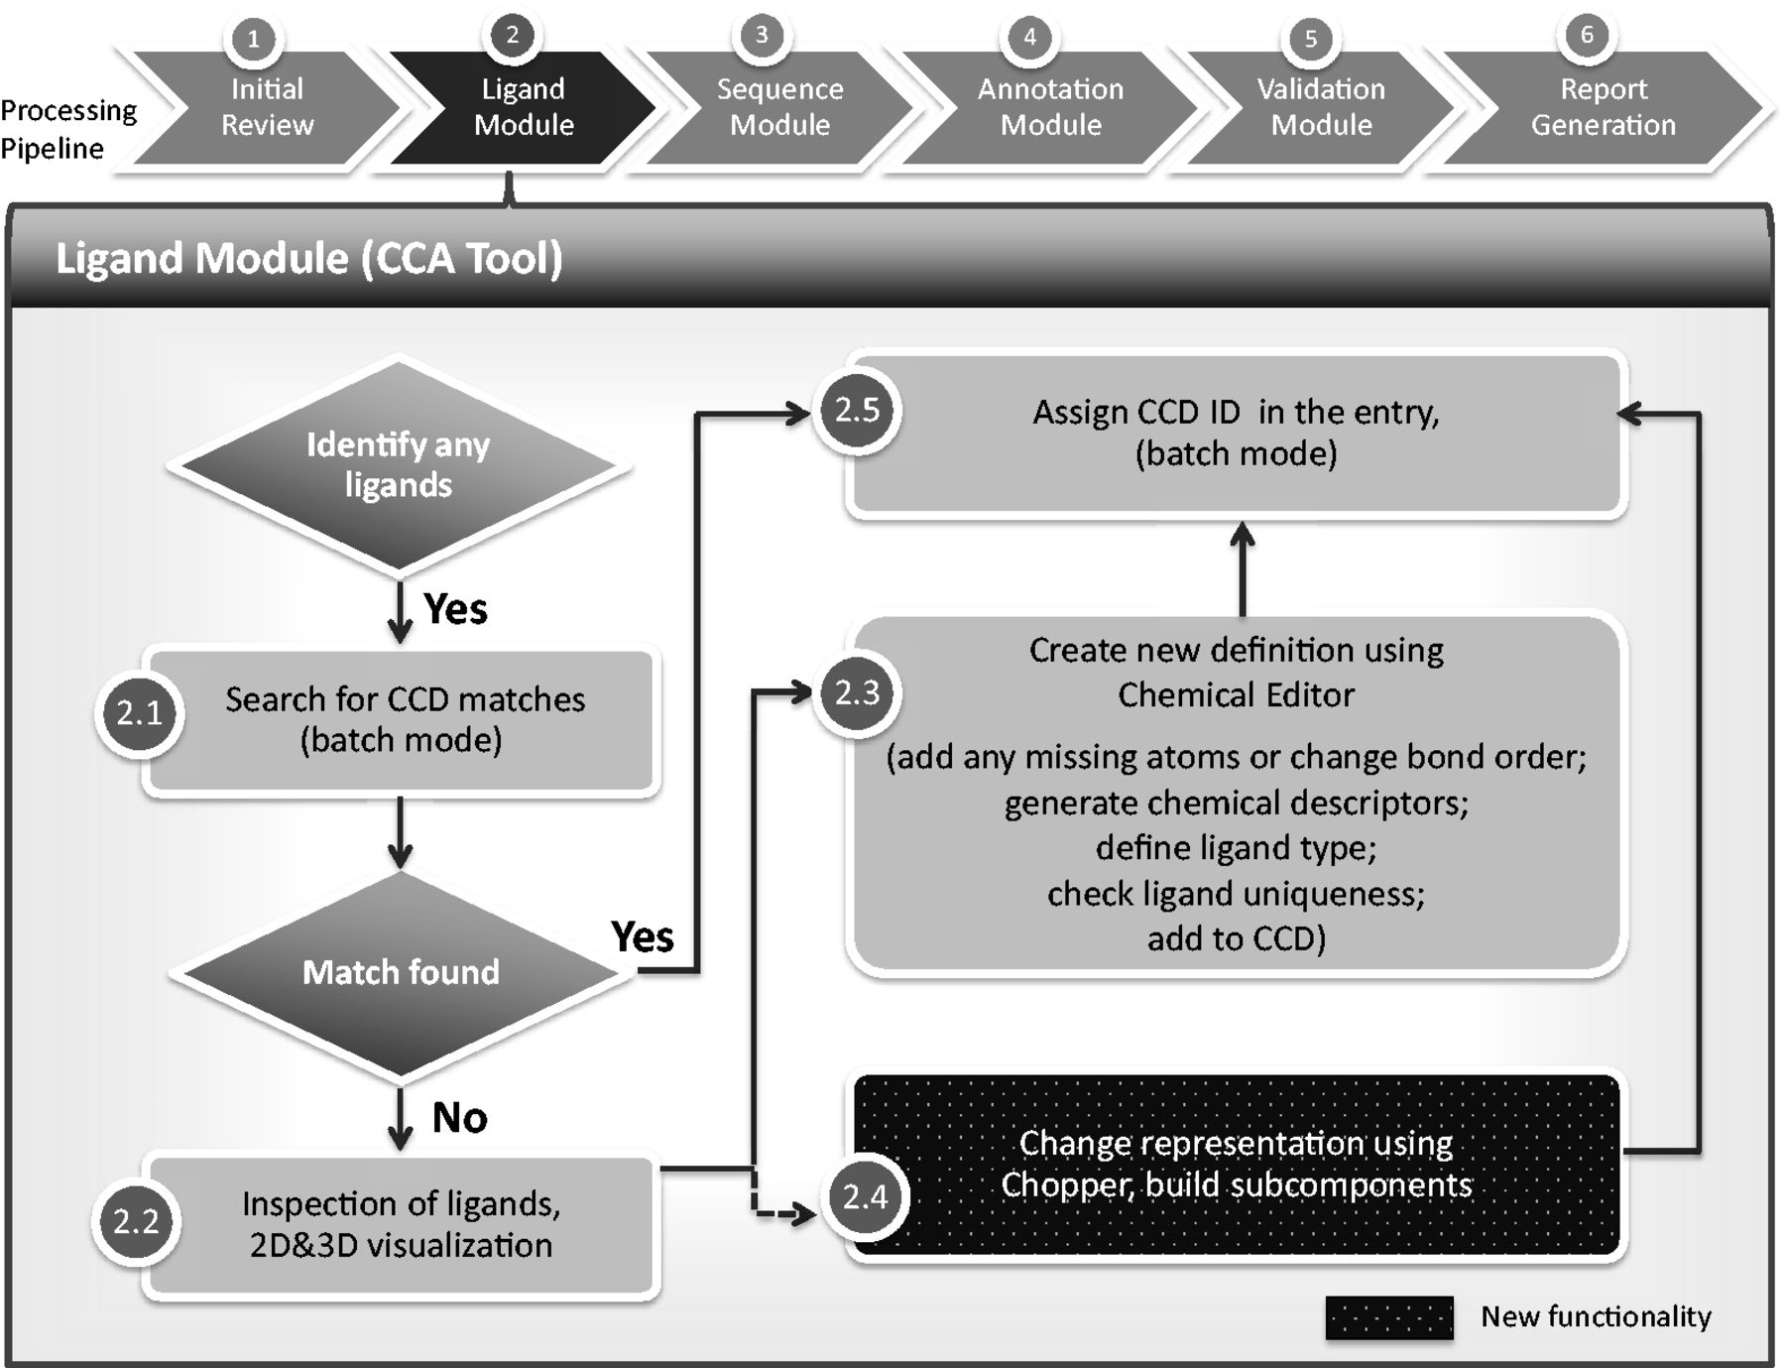
Figure 1. Chemical component annotation. Processing steps are labeled as described in this article. Compared with the ...
Notes:
Figure 1. Chemical component annotation. Processing steps are labeled as described in this article. Compared with the previous method of chemical component processing, the CCA Tool automates and integrates most of the steps, including ‘batch’ functionalities that process multiple components at the same time. The CCA Tool is also fully integrated with the D&A system, whereas the previous pipeline was completely separate from the other annotation processes and tools.
Unless provided in the caption above, the following copyright applies to the content of this slide: © The Author(s) 2013. Published by Oxford University Press.This is an Open Access article distributed under the terms of the Creative Commons Attribution License (http://creativecommons.org/licenses/by/3.0/), which permits unrestricted reuse, distribution, and reproduction in any medium, provided the original work is properly cited.

