Slide 1
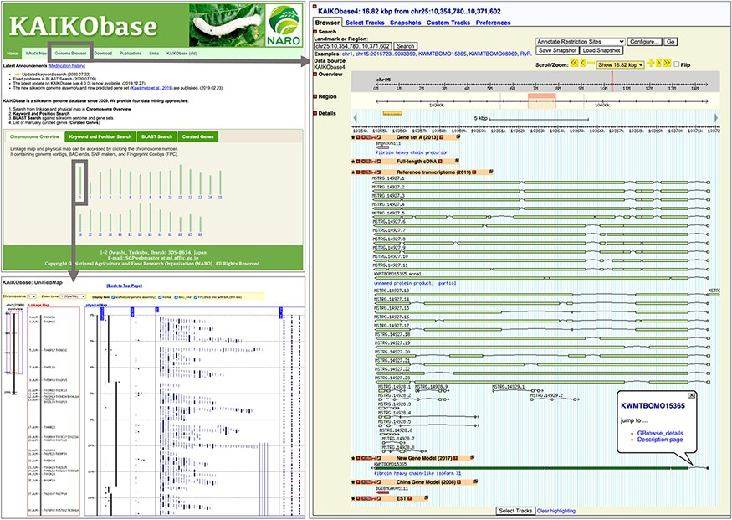
Figure 1. Webpages of KAIKObase. Top left: the homepage of KAIKObase, where genetic maps, keyword and sequence search, ...
Notes:
Figure 1. Webpages of KAIKObase. Top left: the homepage of KAIKObase, where genetic maps, keyword and sequence search, lists of curated genes, as well as the link to the genome browser, are available; bottom left: genetic map with markers and BAC sequences; right: the page of genome browser with an example of predicted, curated and transcribed sequences from fibroin heavy chain.
Unless provided in the caption above, the following copyright applies to the content of this slide: © The Author(s) 2021. Published by Oxford University Press.This is an Open Access article distributed under the terms of the Creative Commons Attribution License (http://creativecommons.org/licenses/by/4.0/), which permits unrestricted reuse, distribution, and reproduction in any medium, provided the original work is properly cited.

