Slide 1
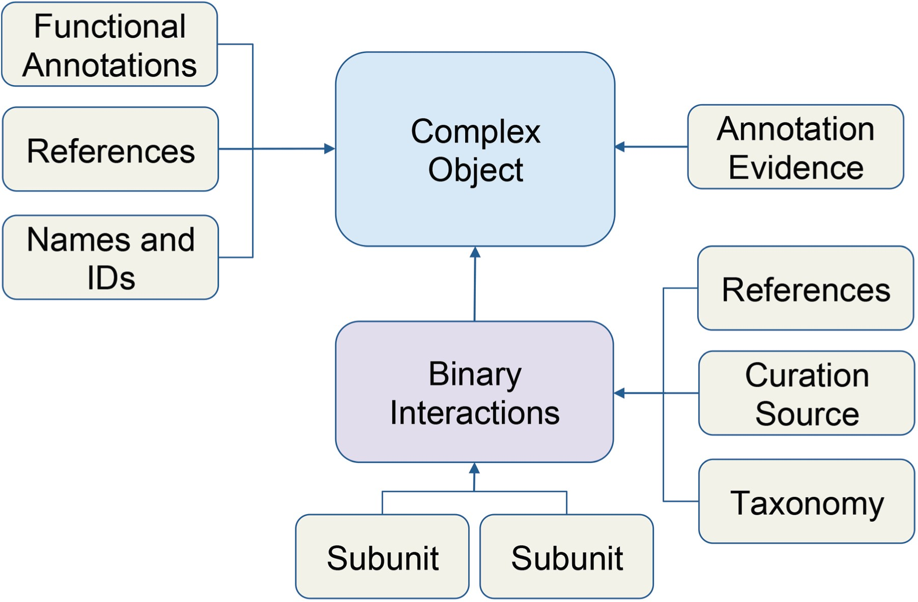
Figure 1 Schematic of macromolecular complex data object. Data for macromolecular complexes were expertly collected ...
Notes:
Figure 1 Schematic of macromolecular complex data object. Data for macromolecular complexes were expertly collected and curated from published literature. Each box represents a data type stored in the database. Arrows indicate how data is related to the complex object.
Unless provided in the caption above, the following copyright applies to the content of this slide: © The Author(s) 2019. Published by Oxford University Press.This is an Open Access article distributed under the terms of the Creative Commons Attribution License (http://creativecommons.org/licenses/by/4.0/), which permits unrestricted reuse, distribution, and reproduction in any medium, provided the original work is properly cited.

