Slide 1
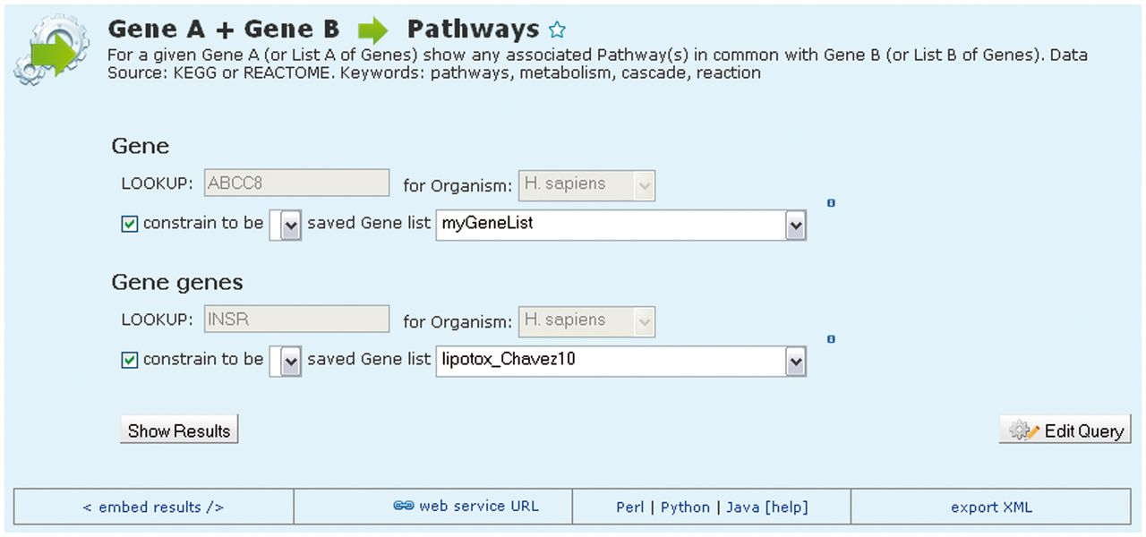
Figure 4. An example template search. MetabolicMine includes a library of template search forms—predefined searches ...
Notes:
Figure 4. An example template search. MetabolicMine includes a library of template search forms—predefined searches designed to perform a particular task. Each one contains a description and a form, with default values, to fill in. In this example, the template compares two lists of genes and shows which genes from the two lists are members of the same pathway(s). Users can also modify templates and create their own using the QueryBuilder.
Unless provided in the caption above, the following copyright applies to the content of this slide: © Crown copyright 2013.

