Slide 1
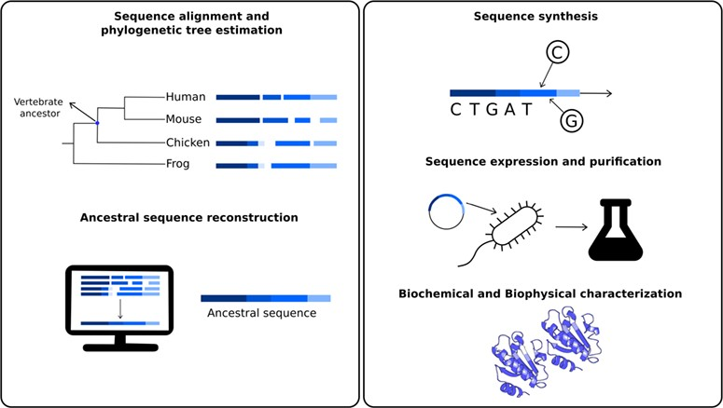
Figure 1 Schematic representation of the different steps to obtain resurrected proteins. The first step involves ...
Notes:
Figure 1 Schematic representation of the different steps to obtain resurrected proteins. The first step involves sequence similarity searches of a given protein to obtain a set of homologous sequences, involving the ancestral nodes to be studied. For example, one could be interested in studying biochemical properties of the studied protein in the last common ancestor for all vertebrates. Using these sequences, it is possible to estimate a phylogenetic tree to define the ancestral node to be reconstructed. In the second step, ancestral sequence reconstruction techniques are applied to estimate most probable sequences in the studied node. The third step involves the ancestral sequence synthesis. This sequence is then inserted into a vector, cloned, expressed and purified (fourth step). The fifth and final step involves a series of biochemical and biophysical characterization.
Unless provided in the caption above, the following copyright applies to the content of this slide: © The Author(s) 2020. Published by Oxford University Press.This is an Open Access article distributed under the terms of the Creative Commons Attribution License (http://creativecommons.org/licenses/by/4.0/), which permits unrestricted reuse, distribution, and reproduction in any medium, provided the original work is properly cited.

Slide 2
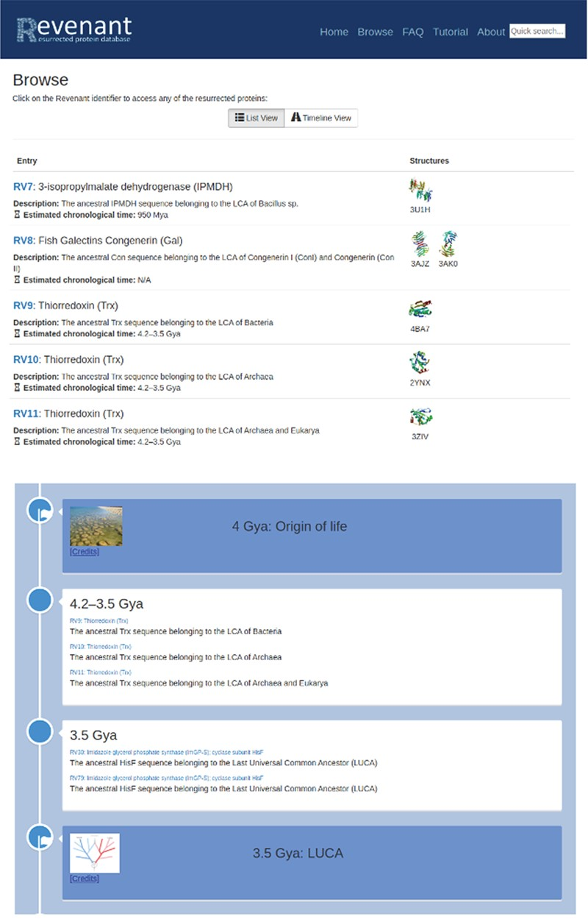
Figure 2 Two different browsing capabilities are available in Revenant. In the first one (top panel) proteins are ...
Notes:
Figure 2 Two different browsing capabilities are available in Revenant. In the first one (top panel) proteins are listed sequentially using their RV codes. In the second browser (bottom panel) we display the Revenant proteins in an Earth’s timeline showing important biological events since the origin of life.
Unless provided in the caption above, the following copyright applies to the content of this slide: © The Author(s) 2020. Published by Oxford University Press.This is an Open Access article distributed under the terms of the Creative Commons Attribution License (http://creativecommons.org/licenses/by/4.0/), which permits unrestricted reuse, distribution, and reproduction in any medium, provided the original work is properly cited.

Slide 3
Figure 3 Screenshot of Revenant web server showing the home page and search utilities.
Notes:
Figure 3 Screenshot of Revenant web server showing the home page and search utilities.
Unless provided in the caption above, the following copyright applies to the content of this slide: © The Author(s) 2020. Published by Oxford University Press.This is an Open Access article distributed under the terms of the Creative Commons Attribution License (http://creativecommons.org/licenses/by/4.0/), which permits unrestricted reuse, distribution, and reproduction in any medium, provided the original work is properly cited.

Slide 4
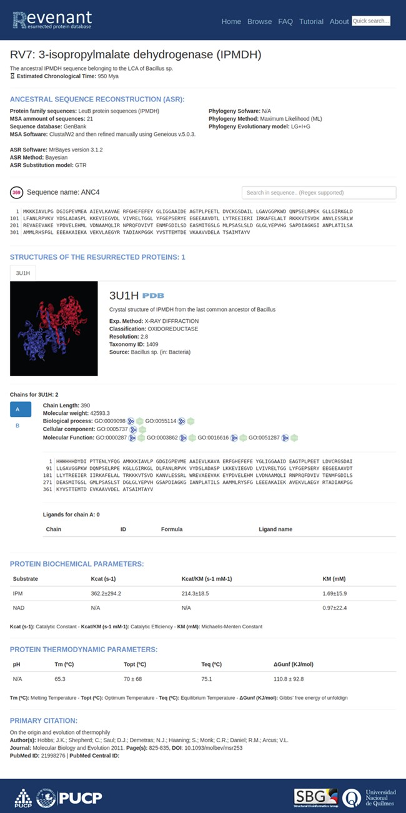
Figure 4 Main entry page. Each entry starts with a title followed by a brief explanation of the biological relevance ...
Notes:
Figure 4 Main entry page. Each entry starts with a title followed by a brief explanation of the biological relevance of the resurrected protein. Additionally, each entry has fields regarding ancestral sequence reconstruction, information about their structures, biochemical and biophysical parameters and, finally, the primary citation.
Unless provided in the caption above, the following copyright applies to the content of this slide: © The Author(s) 2020. Published by Oxford University Press.This is an Open Access article distributed under the terms of the Creative Commons Attribution License (http://creativecommons.org/licenses/by/4.0/), which permits unrestricted reuse, distribution, and reproduction in any medium, provided the original work is properly cited.

