Slide 1
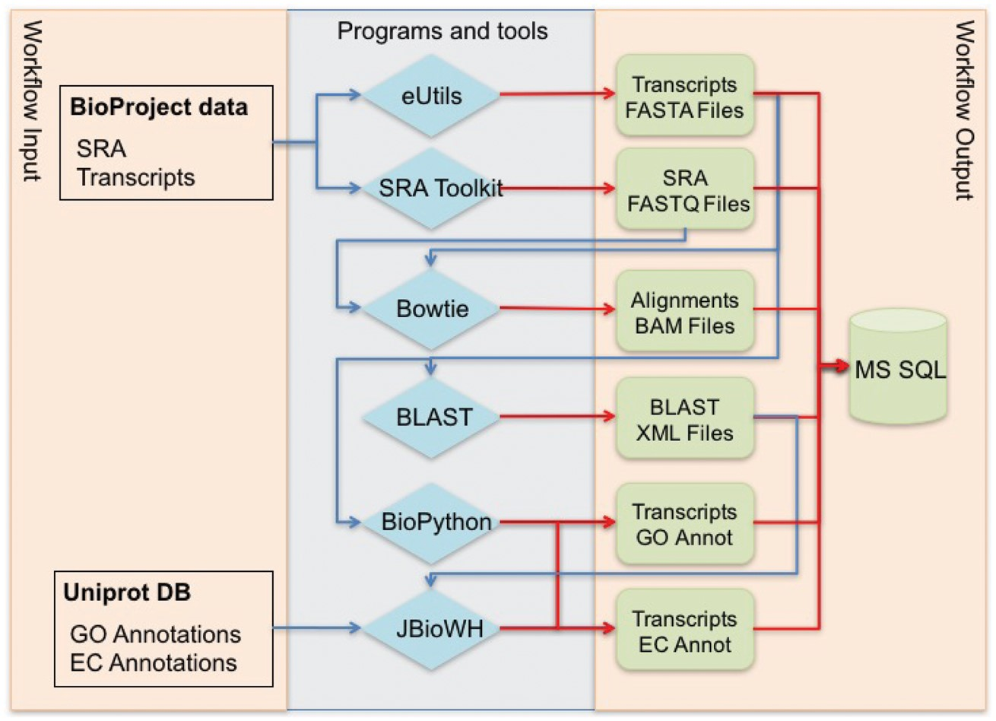
Figure 1. Global workflow for annotating NCBI BioProject transcriptome data.
Notes:
Figure 1. Global workflow for annotating NCBI BioProject transcriptome data.
Unless provided in the caption above, the following copyright applies to the content of this slide: Published by Oxford University Press 2017. This work is written by US Government employees and is in the public domain in the US.

Slide 2
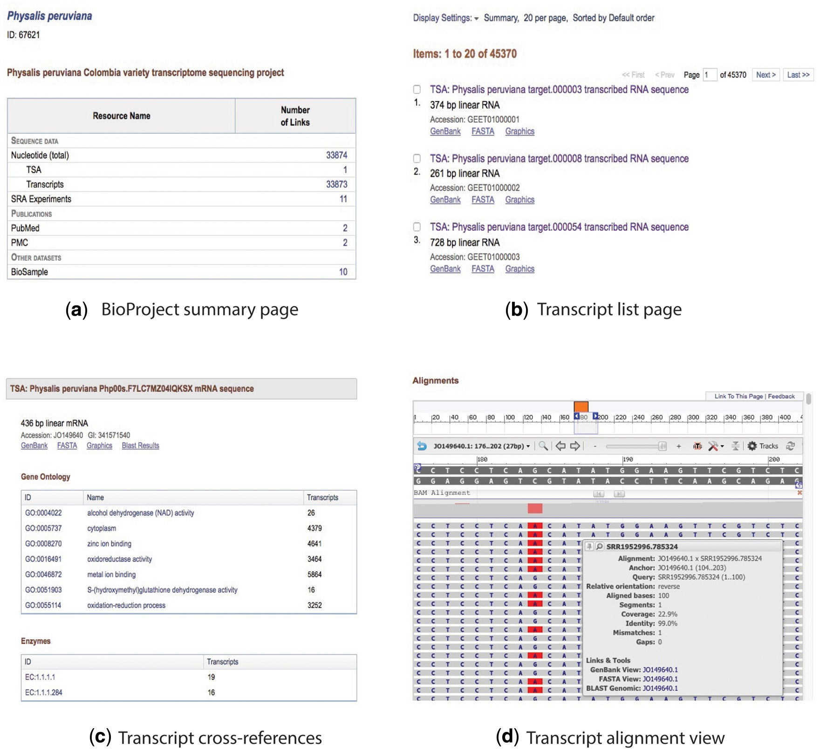
Figure 2. Collage of the content view for the BioProject and transcript pages. (a) BioProject summary page, (b) ...
Notes:
Figure 2. Collage of the content view for the BioProject and transcript pages. (a) BioProject summary page, (b) transcript list page, (c) description and cross-referenced blocks, and (d) alignment view.
Unless provided in the caption above, the following copyright applies to the content of this slide: Published by Oxford University Press 2017. This work is written by US Government employees and is in the public domain in the US.

Slide 3
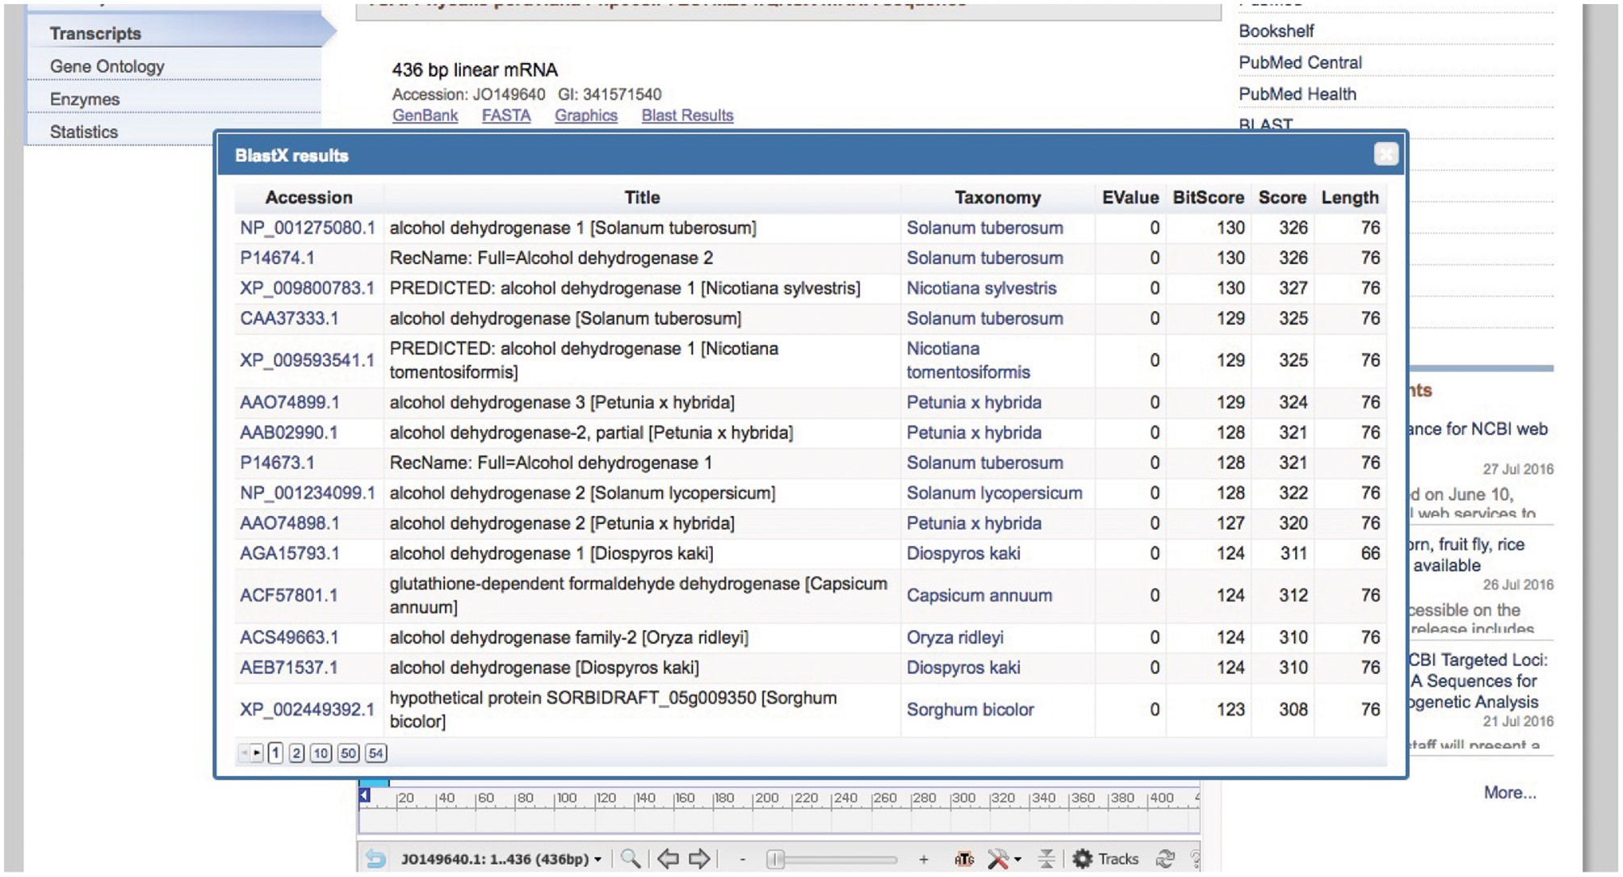
Figure 3. Basic Local Alignment Search Tool summary popup.
Notes:
Figure 3. Basic Local Alignment Search Tool summary popup.
Unless provided in the caption above, the following copyright applies to the content of this slide: Published by Oxford University Press 2017. This work is written by US Government employees and is in the public domain in the US.

Slide 4
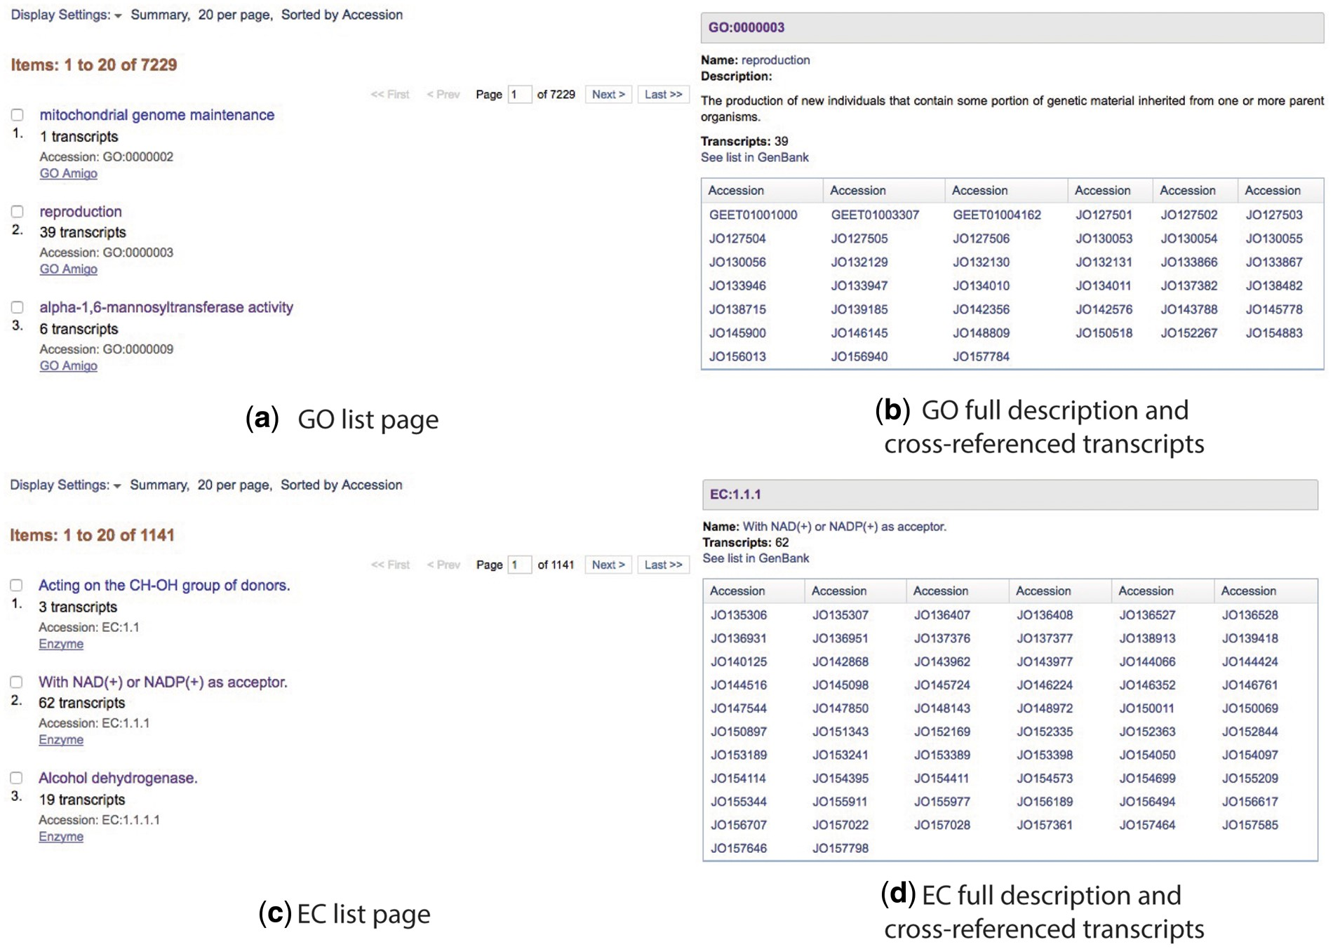
Figure 4. Cross-referenced Gene Ontology and Enzyme Commission lists (a and c) and full descriptions (b and d).
Notes:
Figure 4. Cross-referenced Gene Ontology and Enzyme Commission lists (a and c) and full descriptions (b and d).
Unless provided in the caption above, the following copyright applies to the content of this slide: Published by Oxford University Press 2017. This work is written by US Government employees and is in the public domain in the US.

Slide 5
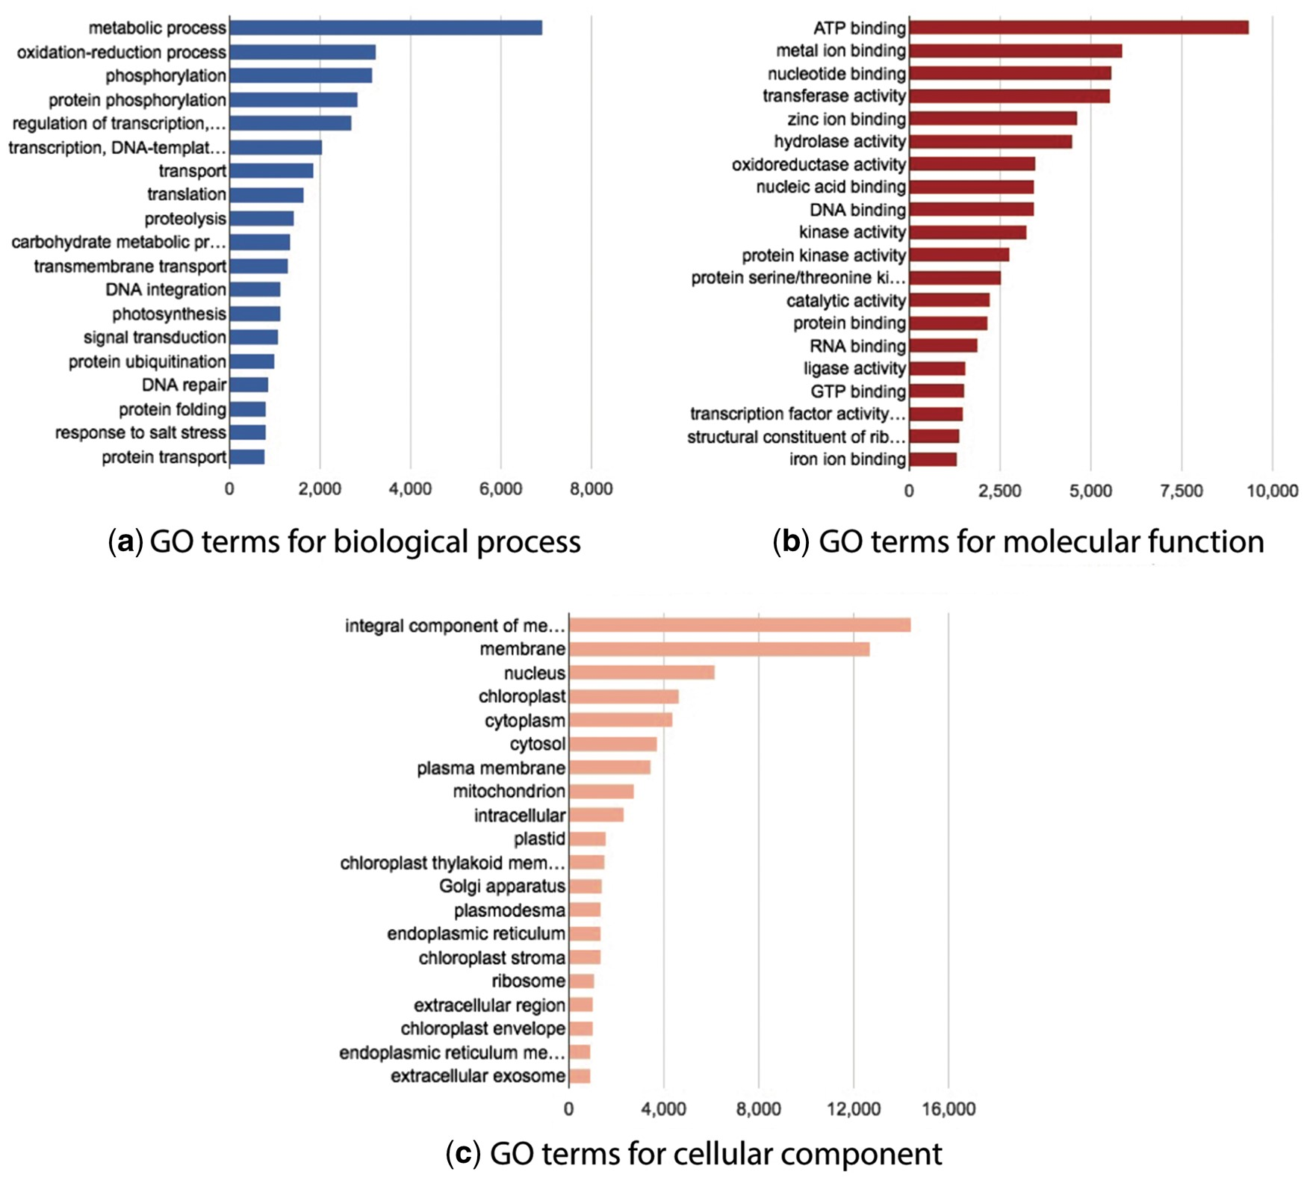
Figure 5. Statistics graphs for Gene Ontology namespace.
Notes:
Figure 5. Statistics graphs for Gene Ontology namespace.
Unless provided in the caption above, the following copyright applies to the content of this slide: Published by Oxford University Press 2017. This work is written by US Government employees and is in the public domain in the US.

Slide 6
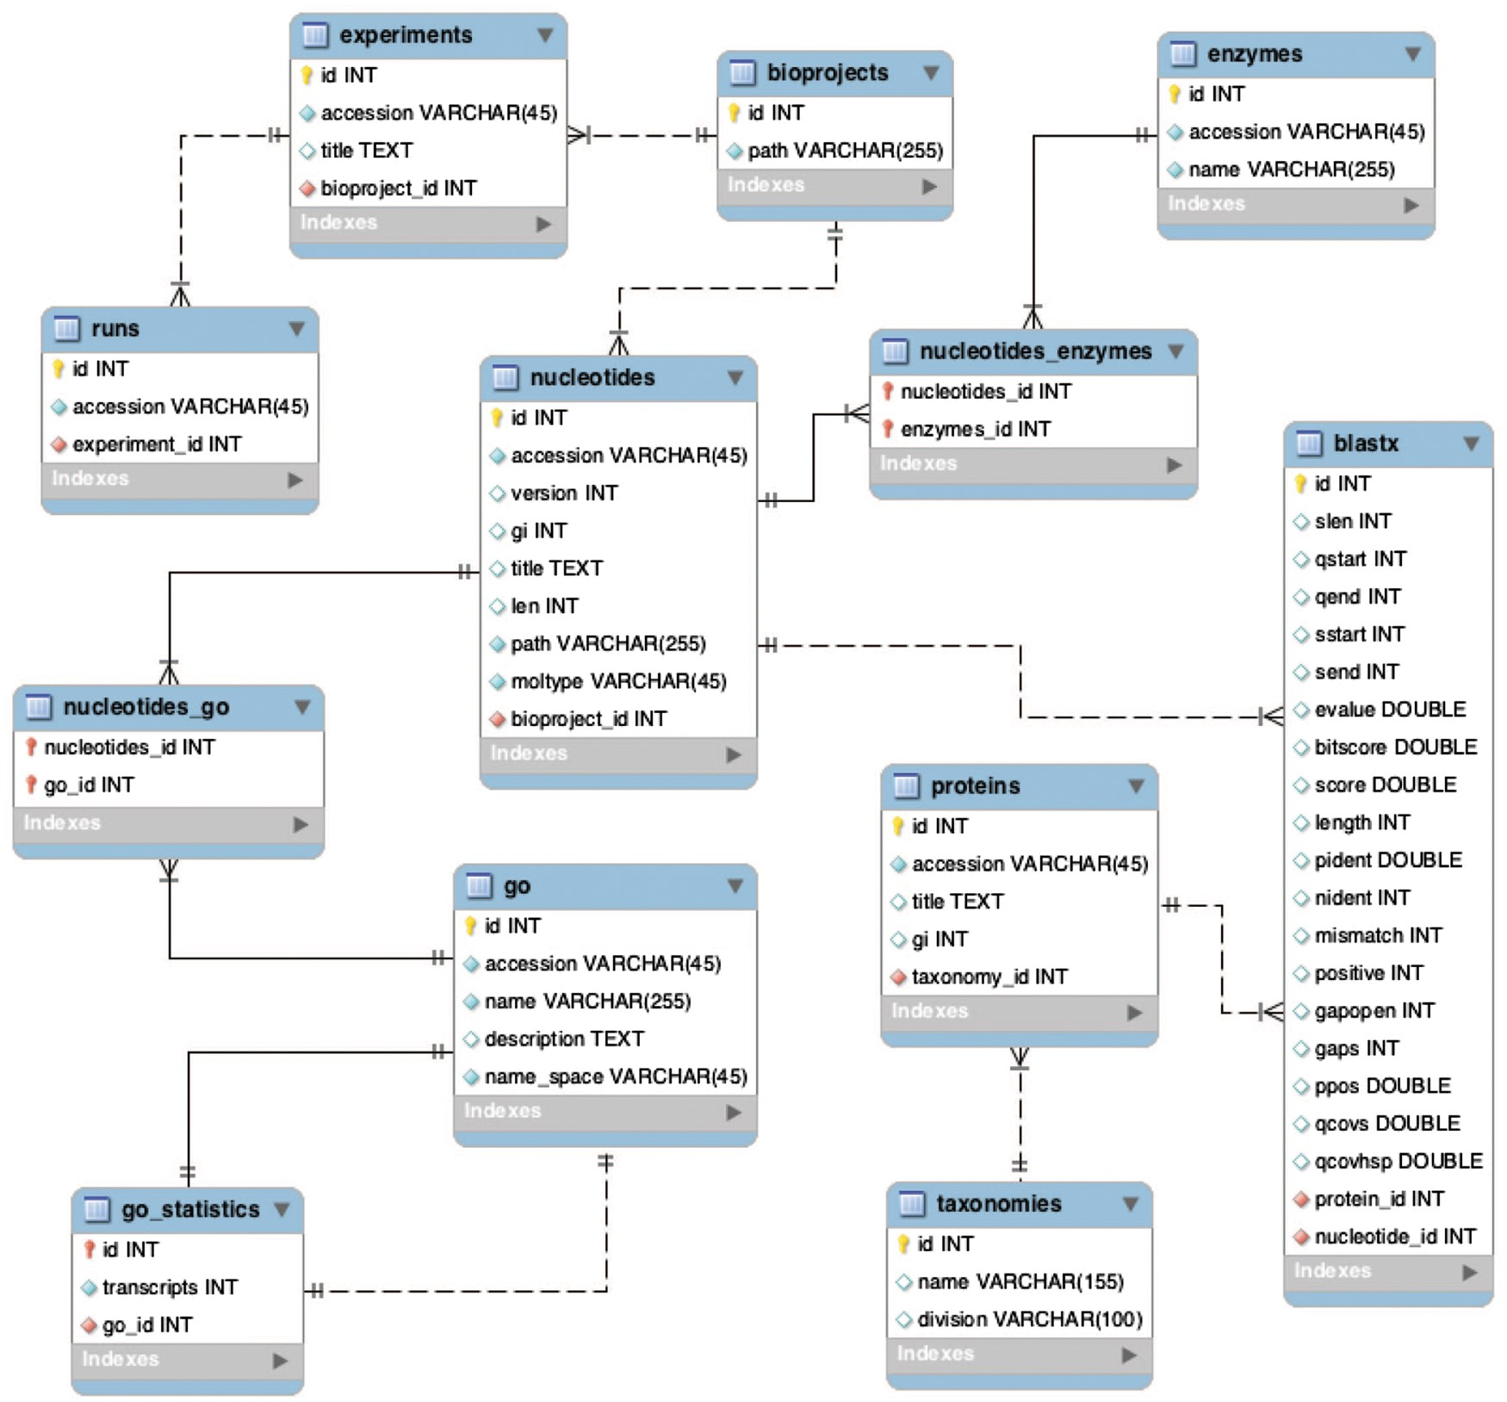
Figure 6. Backend database schema developed to store multiple BioProjects.
Notes:
Figure 6. Backend database schema developed to store multiple BioProjects.
Unless provided in the caption above, the following copyright applies to the content of this slide: Published by Oxford University Press 2017. This work is written by US Government employees and is in the public domain in the US.

