Slide 1
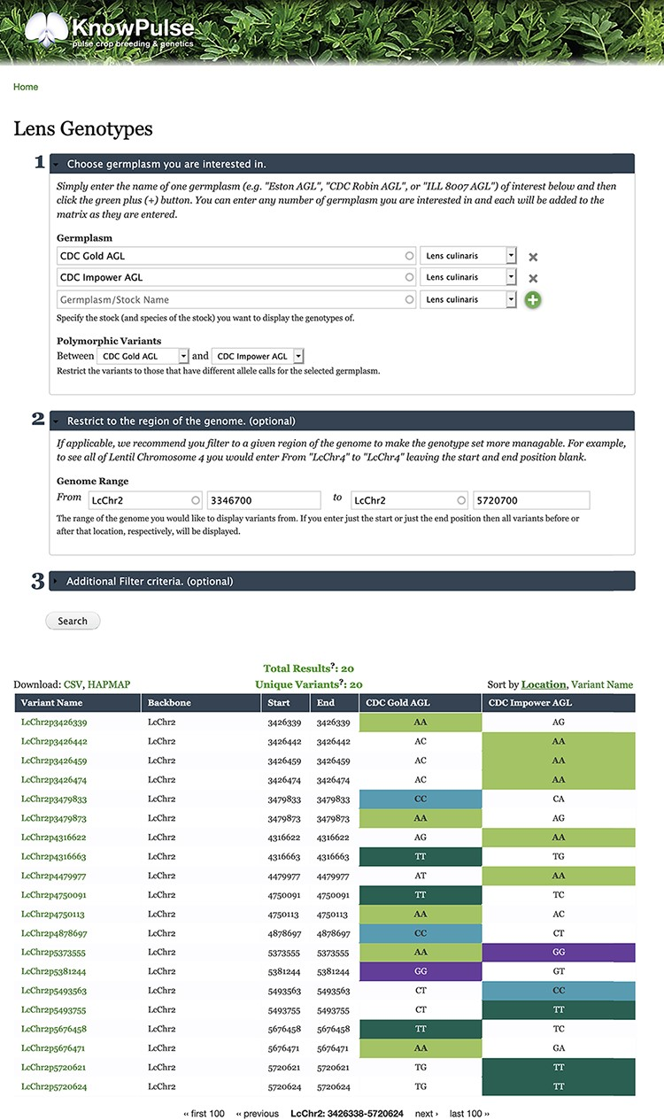
Figure 7. Lentil Genotype Matrix functionality provided by ND Genotypes module. This screenshot shows the listing of ...
Notes:
Figure 7. Lentil Genotype Matrix functionality provided by ND Genotypes module. This screenshot shows the listing of polymorphic genotypic data for CDC Gold AGL and CDC Impower AGL restricted to LcChr2:3346700..5720700. This pre-filtered view can be accessed at https://knowpulse.usask.ca/AGL-Lc1.2-Matrix-Example. Alternatively, the user can access the genotype matrix tool and enter the filter criteria as shown in the screenshot starting with the germplasm names.
Unless provided in the caption above, the following copyright applies to the content of this slide: © The Author(s) 2021. Published by Oxford University Press.This is an Open Access article distributed under the terms of the Creative Commons Attribution License (http://creativecommons.org/licenses/by/4.0/), which permits unrestricted reuse, distribution, and reproduction in any medium, provided the original work is properly cited.

