Slide 1
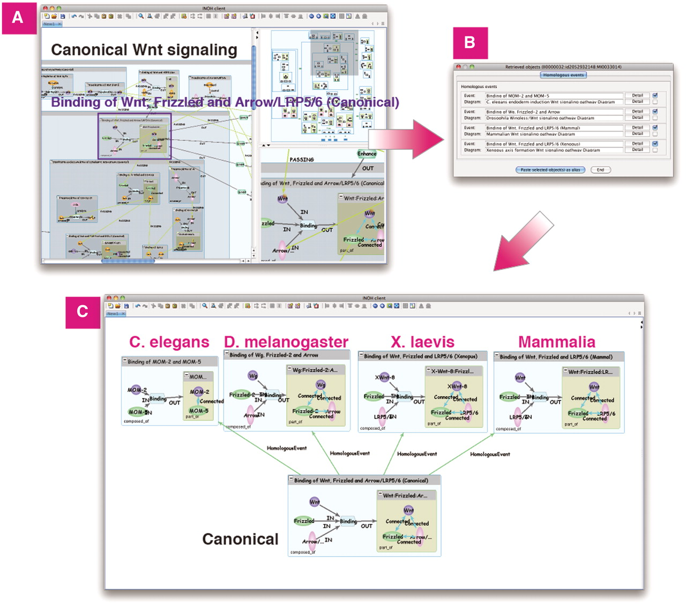
Figure 6. Homologous search in Wnt signaling. (A) Search homologous events of ‘Binding of Wnt, Frizzled and ...
Notes:
Figure 6. Homologous search in Wnt signaling. (A) Search homologous events of ‘Binding of Wnt, Frizzled and Arrow/LRP5/6 (Canonical)’ in Wnt signaling. (B) List of homologous events and its diagrams. (C) Homologous events in C.elegans, D.melanogaster, X.laevis and Mammalia can be pasted on same canvas for comparison.
Unless provided in the caption above, the following copyright applies to the content of this slide: © The Author(s) 2011. Published by Oxford University Press.This is an Open Access article distributed under the terms of the Creative Commons Attribution Non-Commercial License (http://creativecommons.org/licenses/by-nc/3.0), which permits unrestricted non-commercial use, distribution, and reproduction in any medium, provided the original work is properly cited.

