Slide 1
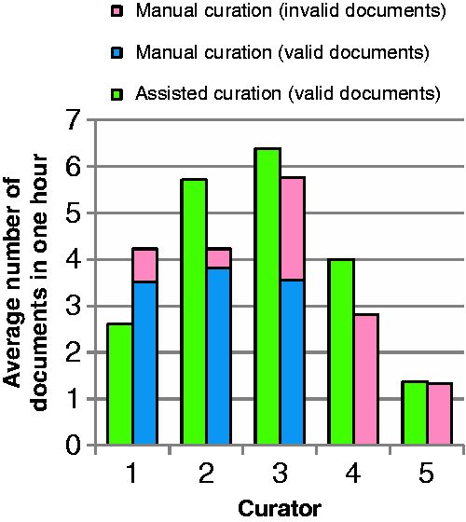
Figure 7 Average number of documents curated by curators in 1 h through assited curation using BELIEF Dashboard and ...
Notes:
Figure 7 Average number of documents curated by curators in 1 h through assited curation using BELIEF Dashboard and through manual curation. The documents with BEL syntax errors are shown here as invalid. The curators are ordered according to their experience of BEL curation.
Unless provided in the caption above, the following copyright applies to the content of this slide: © The Author(s) 2016. Published by Oxford University Press. All rights reserved. For permissions, please e-mail: journals.permissions@oup.com This is an Open Access article distributed under the terms of the Creative Commons Attribution License ( http://creativecommons.org/licenses/by/4.0/ ), which permits unrestricted reuse, distribution, and reproduction in any medium, provided the original work is properly cited.

