Slide 1
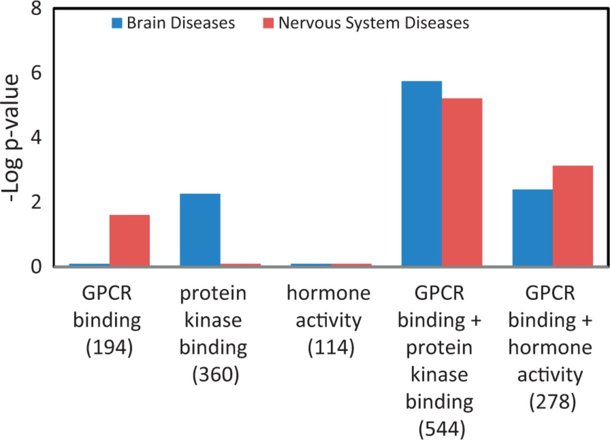
Figure 6. Enhanced enrichment of neurological diseases by combining MF term–annotated gene lists. The ‘GPCR binding’ ...
Notes:
Figure 6. Enhanced enrichment of neurological diseases by combining MF term–annotated gene lists. The ‘GPCR binding’ gene list was combined with the ‘protein kinase binding’ gene list or the ‘hormone activity’ gene list. The enrichment P-values for these two diseases, shown as ‘–Log P-value’ were compared before and after combination. The gene count of each list is shown in parenthesis.
Unless provided in the caption above, the following copyright applies to the content of this slide: © The Author(s) 2013. Published by Oxford University Press.This is an Open Access article distributed under the terms of the Creative Commons Attribution License (http://creativecommons.org/licenses/by/3.0/), which permits unrestricted reuse, distribution, and reproduction in any medium, provided the original work is properly cited.

