Slide 1
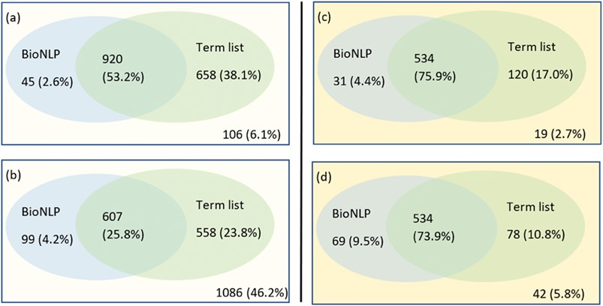
Figure 8 A Venn representation on number of documents have been identified having mutations using a combination of ...
Notes:
Figure 8 A Venn representation on number of documents have been identified having mutations using a combination of BioNLP tools and term lists. The left side shows the results on the training set: (a) for relevant documents and (b) for non-relevant documents; the right side (c) and (d) shows the results for relevant documents and non-relevant documents respectively in the testing set.
Unless provided in the caption above, the following copyright applies to the content of this slide: © The Author(s) 2018. Published by Oxford University Press.This is an Open Access article distributed under the terms of the Creative Commons Attribution License (http://creativecommons.org/licenses/by/4.0/), which permits unrestricted reuse, distribution, and reproduction in any medium, provided the original work is properly cited.

