Slide 1
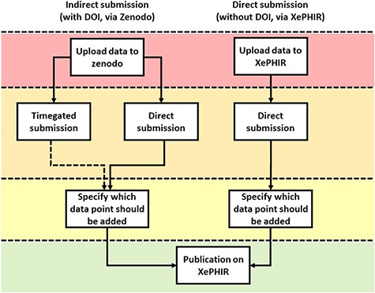
Figure 5. Methods of data submission to XePHIR. Indirect submission through Zenodo, allowing uploading of whole data ...
Notes:
Figure 5. Methods of data submission to XePHIR. Indirect submission through Zenodo, allowing uploading of whole data sets (after acceptation of publication) will allow for enhanced transparency and reusability of data and will provide the user with a DOI-enabling citation of the data set. Uploading to Zenodo will automatically place the data under a CC license. Direct submission to XePHIR will not provide the user with a DOI and will require the user to place the data under a CC license.
Unless provided in the caption above, the following copyright applies to the content of this slide: © The Author(s) 2022. Published by Oxford University Press.This is an Open Access article distributed under the terms of the Creative Commons Attribution-NonCommercial License (https://creativecommons.org/licenses/by-nc/4.0/), which permits non-commercial re-use, distribution, and reproduction in any medium, provided the original work is properly cited. For commercial re-use, please contact journals.permissions@oup.com

