Slide 1
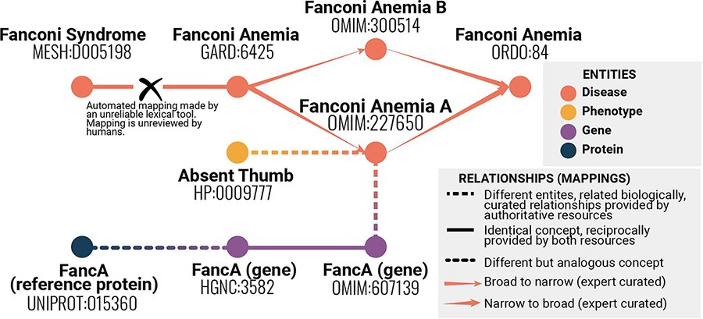
Figure 1. Example of mappings between different identifiers representing statements about similarity or identity of ...
Notes:
Figure 1. Example of mappings between different identifiers representing statements about similarity or identity of concepts across resources and vocabularies. Even with this simplified example, it is possible to see a range of mapping types, and that providing information about each mapping is crucial to understanding the bigger picture. This information helps avoid errors such as mistakenly conflating two variants of a disease.
Unless provided in the caption above, the following copyright applies to the content of this slide: © The Author(s) 2022. Published by Oxford University Press.This is an Open Access article distributed under the terms of the Creative Commons Attribution License (https://creativecommons.org/licenses/by/4.0/), which permits unrestricted reuse, distribution, and reproduction in any medium, provided the original work is properly cited.

