Slide 1
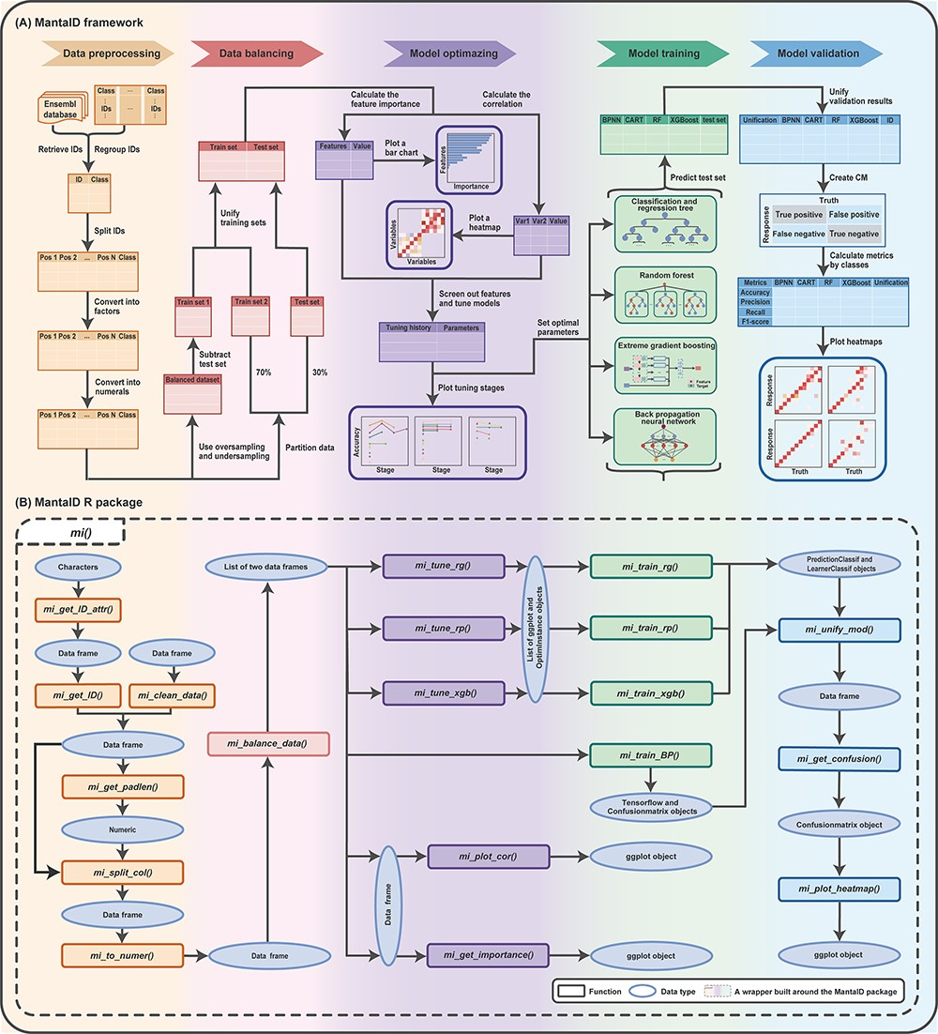
Figure 1. Schematic overview of the MantaID tool. (A) The theoretical framework MantaID. (B) The R package functions of ...
Notes:
Figure 1. Schematic overview of the MantaID tool. (A) The theoretical framework MantaID. (B) The R package functions of MantaID. The wrapper function created by MantaID; a wrapper function ‘mi()’ is created that is used to group the functionalities of MantaID and can be executed to carry out all the steps of the MantaID workflow in a lazy fashion.
Unless provided in the caption above, the following copyright applies to the content of this slide: © The Author(s) 2023. Published by Oxford University Press.This is an Open Access article distributed under the terms of the Creative Commons Attribution License (https://creativecommons.org/licenses/by/4.0/), which permits unrestricted reuse, distribution, and reproduction in any medium, provided the original work is properly cited.

Slide 2
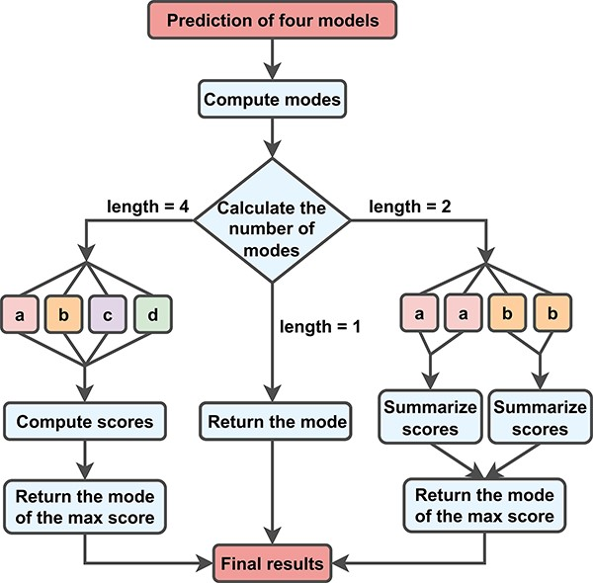
Figure 2. New metrics for aggregating MantaID models. To incorporate the information, we multiply the model’s F1 score ...
Notes:
Figure 2. New metrics for aggregating MantaID models. To incorporate the information, we multiply the model’s F1 score metrics by the mismatch rates of other models to calculate the submodel’s score. When the submodels disagree, we assign a score to each result and select the best one.
Unless provided in the caption above, the following copyright applies to the content of this slide: © The Author(s) 2023. Published by Oxford University Press.This is an Open Access article distributed under the terms of the Creative Commons Attribution License (https://creativecommons.org/licenses/by/4.0/), which permits unrestricted reuse, distribution, and reproduction in any medium, provided the original work is properly cited.

Slide 3
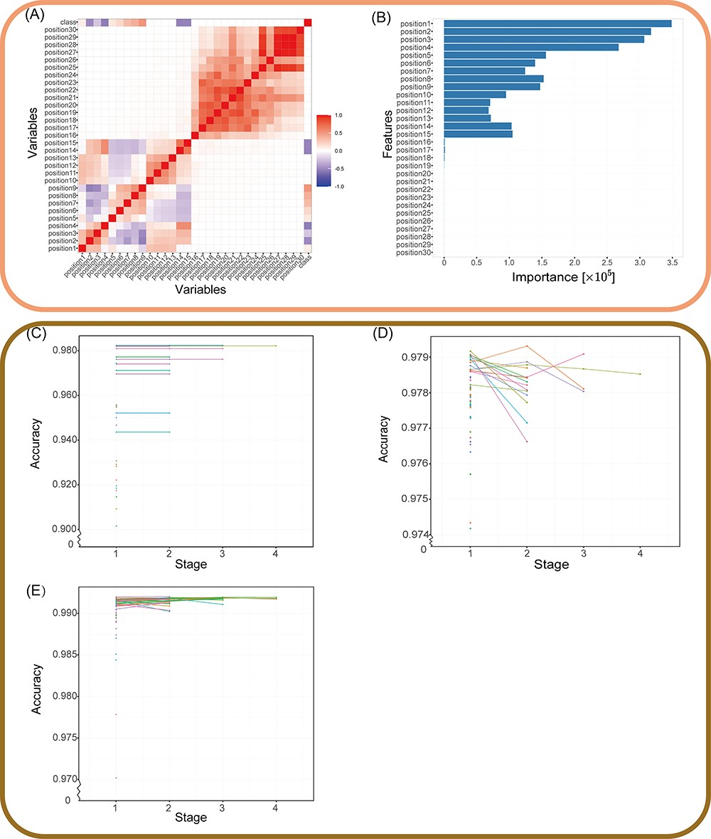
Figure 3. Validation of the MantaID model performance. (A and B) The result of features selection. (A) Correlation heat ...
Notes:
Figure 3. Validation of the MantaID model performance. (A and B) The result of features selection. (A) Correlation heat map. Positive values mean positive correlation; negative values mean negative correlation, as evaluated by Pearson's correlation test. (B) Features importance computed by RF. The horizontal coordinate is the Gini impurity, an indicator for evaluating importance, and the vertical coordinate is the feature. Stage plot for Hyperband tuning of (C) CART, (D) RF and (E) XGBoost. Each line or point represents a set of related parameters, and Hyperband algorithm discards configurations with a percentage of ${\rm{\;}}\frac{1}{\eta }$ to cut training time. Notably, the cart model’s polygon line appears to be stagnating as a result of the minimal accuracy change between stages when compared to the span.
Unless provided in the caption above, the following copyright applies to the content of this slide: © The Author(s) 2023. Published by Oxford University Press.This is an Open Access article distributed under the terms of the Creative Commons Attribution License (https://creativecommons.org/licenses/by/4.0/), which permits unrestricted reuse, distribution, and reproduction in any medium, provided the original work is properly cited.

Slide 4
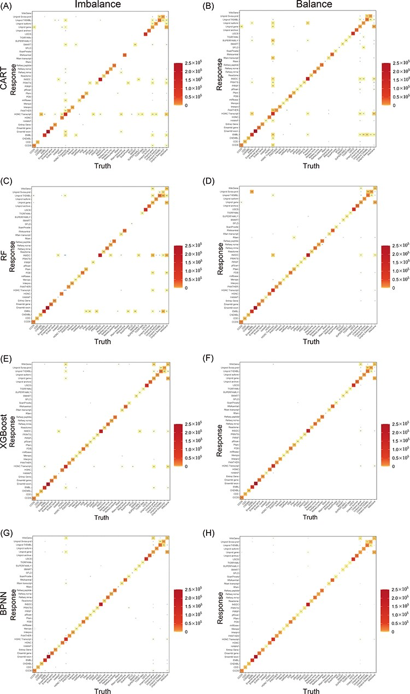
Figure 4. Heat maps of the CMs for models. CART, RF, XGBoost and BPNN, which were trained on both balanced and ...
Notes:
Figure 4. Heat maps of the CMs for models. CART, RF, XGBoost and BPNN, which were trained on both balanced and unbalanced data, are included. The number of truth-prediction pairs is shown by the value in the box. The more the model is accurate, the more the values are concentrated on the diagonal. Through comparing models with and without balancing samples, we discovered that while accuracy did not noticeably improve as a result of balancing datasets, the models performed better for minor classes.
Unless provided in the caption above, the following copyright applies to the content of this slide: © The Author(s) 2023. Published by Oxford University Press.This is an Open Access article distributed under the terms of the Creative Commons Attribution License (https://creativecommons.org/licenses/by/4.0/), which permits unrestricted reuse, distribution, and reproduction in any medium, provided the original work is properly cited.

Slide 5
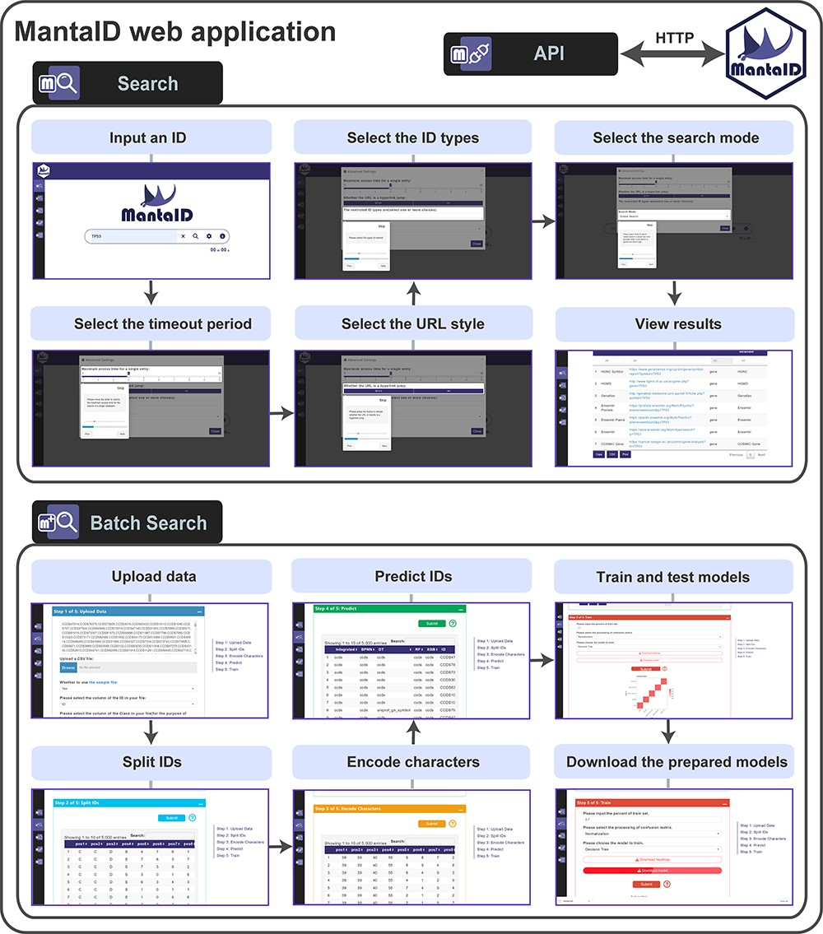
Figure 5. The features of the MantaID web application. The setting panels allow users to configure the basic and ...
Notes:
Figure 5. The features of the MantaID web application. The setting panels allow users to configure the basic and advanced settings; basic settings populate settings panels by default, whereas advanced settings enable a more granular control.
Unless provided in the caption above, the following copyright applies to the content of this slide: © The Author(s) 2023. Published by Oxford University Press.This is an Open Access article distributed under the terms of the Creative Commons Attribution License (https://creativecommons.org/licenses/by/4.0/), which permits unrestricted reuse, distribution, and reproduction in any medium, provided the original work is properly cited.

