Slide 1
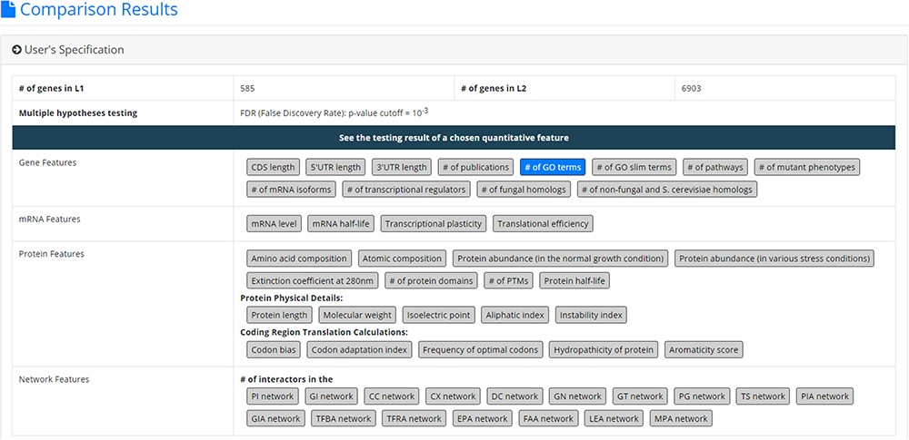
Figure 3. The result page (the first part). The first part contains the information of the user’s settings (i.e. the ...
Notes:
Figure 3. The result page (the first part). The first part contains the information of the user’s settings (i.e. the number of genes in L1, the number of genes in L2, the selected quantitative features, the selected multiple hypotheses correction method, and the selected p-value threshold).
Unless provided in the caption above, the following copyright applies to the content of this slide: © The Author(s) 2020. Published by Oxford University Press.This is an Open Access article distributed under the terms of the Creative Commons Attribution License (http://creativecommons.org/licenses/by/4.0/), which permits unrestricted reuse, distribution, and reproduction in any medium, provided the original work is properly cited.

