Slide 1
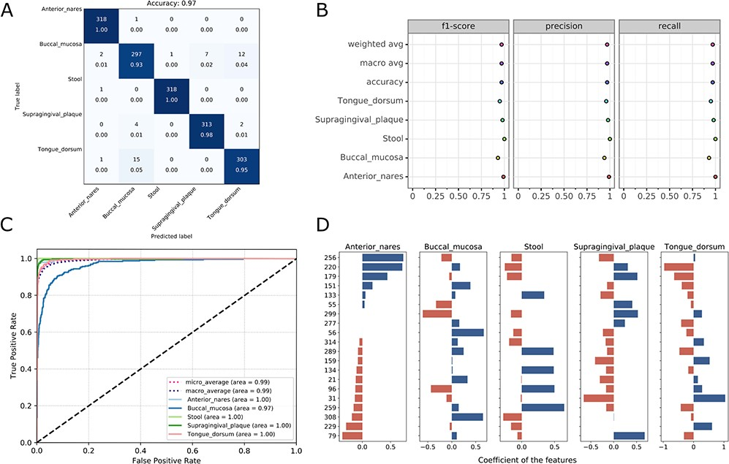
Figure 4 Visualizations for the optimized model: the heatmap for confusing matrix (A), the classification report (B), ...
Notes:
Figure 4 Visualizations for the optimized model: the heatmap for confusing matrix (A), the classification report (B), ROC curve (C) and the histogram for top features (D, default: 20). Note that, in the case of tree-based models, the feature importance will be provided instead of the feature’s coefficient in the histogram.
Unless provided in the caption above, the following copyright applies to the content of this slide: © The Author(s) 2020. Published by Oxford University Press.This is an Open Access article distributed under the terms of the Creative Commons Attribution License (http://creativecommons.org/licenses/by/4.0/), which permits unrestricted reuse, distribution, and reproduction in any medium, provided the original work is properly cited.

