Slide 1
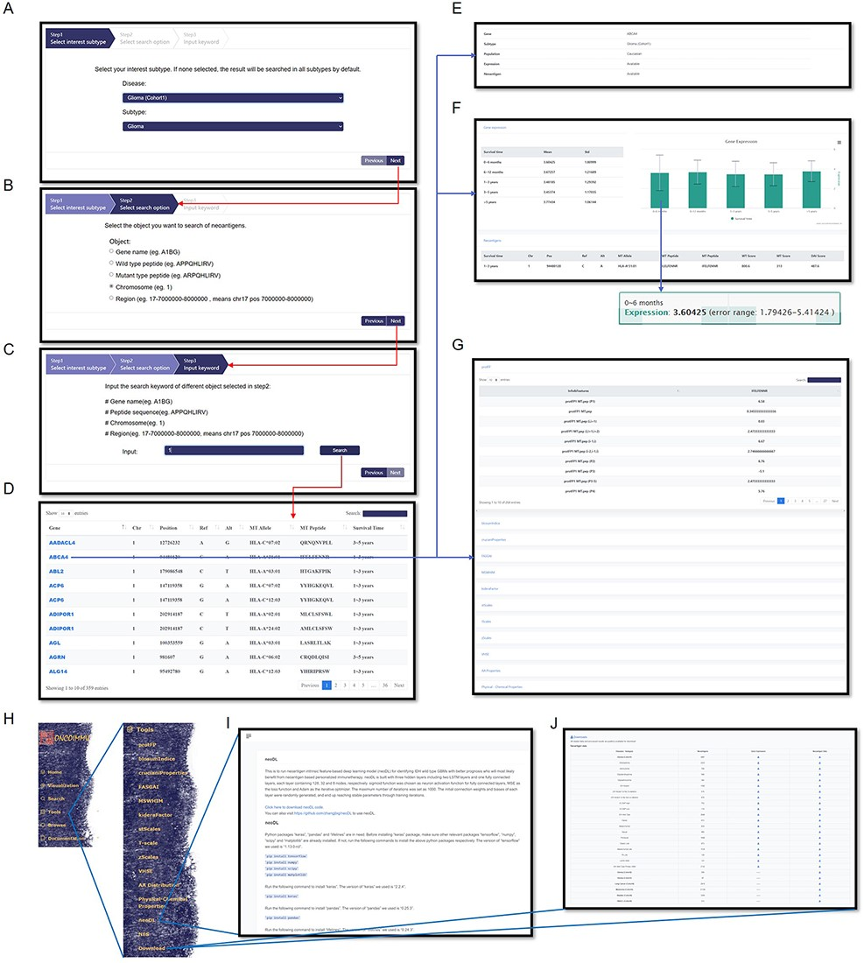
Figure 4. Information query and tools in GNIFdb. An example demonstrates that querying glioma (Cohort 1) (A), ...
Notes:
Figure 4. Information query and tools in GNIFdb. An example demonstrates that querying glioma (Cohort 1) (A), chromosome category (B) and chromosome 1 (C) generates the list of information associated gene, mutation, neoantigen, corresponding HLA-I subtype and survival time period (D) in the genomic region of interests. The query results also provide the summary of information availability (E) and detailed gene expression (F) and the full list of neoantigen intrinsic features (G). (H) Tools provide codes for calculating neoantigen intrinsic feature calculations, neoDL (I) and downloading of neoantigen and gene expression data for all cohorts (J).
Unless provided in the caption above, the following copyright applies to the content of this slide: © The Author(s) 2022. Published by Oxford University Press.This is an Open Access article distributed under the terms of the Creative Commons Attribution License (https://creativecommons.org/licenses/by/4.0/), which permits unrestricted reuse, distribution, and reproduction in any medium, provided the original work is properly cited.

Slide 2
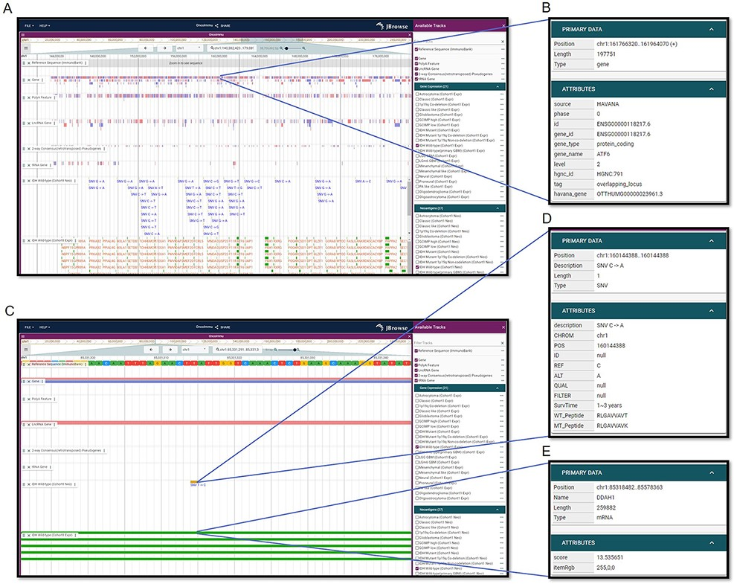
Figure 3. Visualization interfaces in GNIFdb. (A) Overview of the tracks corresponding to gene, mutation and ...
Notes:
Figure 3. Visualization interfaces in GNIFdb. (A) Overview of the tracks corresponding to gene, mutation and neoantigens in a specified glioma subtype (IDH wild-type, Cohort 1 in this example). (B) The gene information includes gene symbol, gene length, location and gene type. (C) Zoomed-in tracks of mutation and gene expression shows the details of mutations and corresponding neoantigens (D) and gene expression (E).
Unless provided in the caption above, the following copyright applies to the content of this slide: © The Author(s) 2022. Published by Oxford University Press.This is an Open Access article distributed under the terms of the Creative Commons Attribution License (https://creativecommons.org/licenses/by/4.0/), which permits unrestricted reuse, distribution, and reproduction in any medium, provided the original work is properly cited.

Slide 3
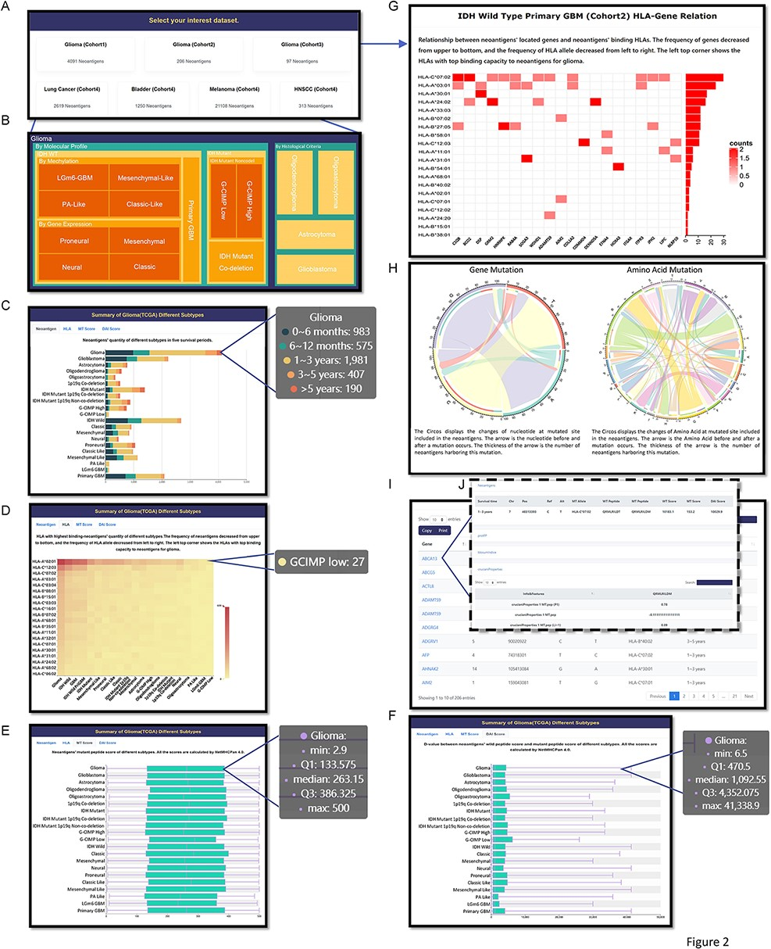
Figure 2. Browse page in GNIFdb showing information of neoantigens and their intrinsic features. (A) All cohorts. (B) ...
Notes:
Figure 2. Browse page in GNIFdb showing information of neoantigens and their intrinsic features. (A) All cohorts. (B) The glioma subtypes in Cohort 1. (C) Neoantigens’ quantity of different glioma subtypes with five survival periods in Cohort 1. (D) The frequency of neoantigens and their corresponding HLA-I subtypes in different glioma subtypes of Cohort 1. (E) The distribution of neoantigens’ binding affinity score with their corresponding HLA-I subtypes in different glioma subtypes of Cohort 1. (F) The distribution of neoantigens’ DAI score in different glioma subtypes of Cohort 1. (G) The relationship between genes generating neoantigens and the HLA-I interacting with neoantigens. (H) The distribution of nucleotide or amino acid changes at mutated site in the neoantigens. (I) The list of genes harboring neoantigens, associated mutation site, the corresponding HLA-I subtypes interacting with the neoantigens and the survival time periods. (J) The intrinsic features of neoantigens associated with each gene.
Unless provided in the caption above, the following copyright applies to the content of this slide: © The Author(s) 2022. Published by Oxford University Press.This is an Open Access article distributed under the terms of the Creative Commons Attribution License (https://creativecommons.org/licenses/by/4.0/), which permits unrestricted reuse, distribution, and reproduction in any medium, provided the original work is properly cited.

Slide 4
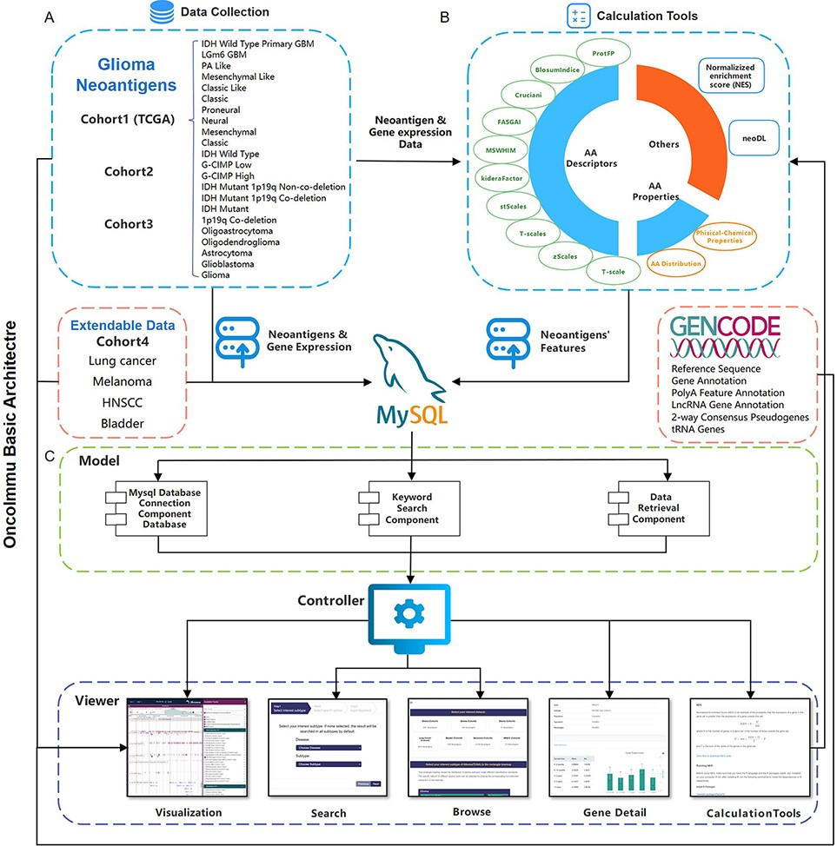
Figure 1. Schematic overview of data collection, data processing and key functionality of GNIFdb. (A) GNIFdb collects ...
Notes:
Figure 1. Schematic overview of data collection, data processing and key functionality of GNIFdb. (A) GNIFdb collects neoantigens from three independent glioma cohorts including 20 pathological or molecular subtypes in Cohort 1 from TCGA, 46 GBMs in Cohort 2 and 13 GBMs in Cohort 3. Cohort 4 includes four other solid tumors (lung cancer, melanoma, HNSCC and bladder cancer) as extendable data. (B) Intrinsic features of neoantigens in all the four cohorts were calculated using amino acid descriptors of protFP (28, 29), blosum Indice (30), crucianiProperties (31), FASGAI (32), MS-WHIM (28, 29), kideraFactor (33), stScales (34), T-scale (32), zScales (35), and VHSE (36), physical-chemical properties (37) of Tiny, Small, Aliphatic, Aromatic, Non-polar, Polar, Basic, Acidic, auto-correlation, auto-covariance, Boman index, crosscovariance, hydrophobic moment, hydrophobicity, theoretical net charge, instability, and molecular weight and AA properties. NES method and neoDL we previously developed are also included. (C) We implemented the GNIFdb following the Model-View-Controller architecture. The Model component handles data derived from multiple sources in MySQL databases and flat experimental data files, calculating the intrinsic features of neoantigens, performing statistical analysis and generating visualization plots. The View component provides heterogeneous and synchronized views to present the information and interact with the users. The front-end template engine of Bootstrap combined with HTML and JavaScript provide better visibility and usability of our functionality. The Controller component, a mediator between the Model and View components, deals with the application logic.
Unless provided in the caption above, the following copyright applies to the content of this slide: © The Author(s) 2022. Published by Oxford University Press.This is an Open Access article distributed under the terms of the Creative Commons Attribution License (https://creativecommons.org/licenses/by/4.0/), which permits unrestricted reuse, distribution, and reproduction in any medium, provided the original work is properly cited.

