Slide 1
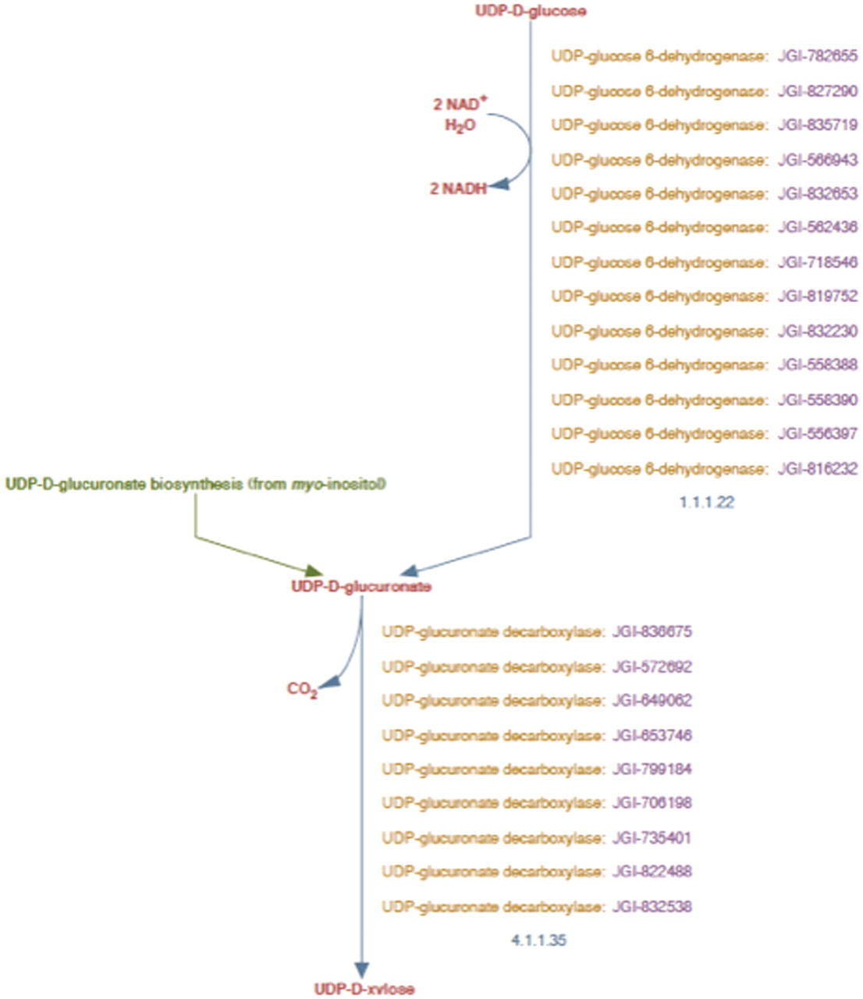
Figure 2. UDP-d-xylose biosynthesis pathway representation in PoplarCyc 1.0. Note that the pathway does not distinguish ...
Notes:
Figure 2. UDP-d-xylose biosynthesis pathway representation in PoplarCyc 1.0. Note that the pathway does not distinguish cytosolic reaction with EC # 4.1.1.35 from the corresponding reaction catalyzed by membrane-bound and Golgi-localized enzymes.
Unless provided in the caption above, the following copyright applies to the content of this slide: © The Author(s) 2012. Published by Oxford University Press.This is an Open Access article distributed under the terms of the Creative Commons Attribution Non-Commercial License (http://creativecommons.org/licenses/by-nc/3.0), which permits unrestricted non-commercial use, distribution, and reproduction in any medium, provided the original work is properly cited.

