Slide 1
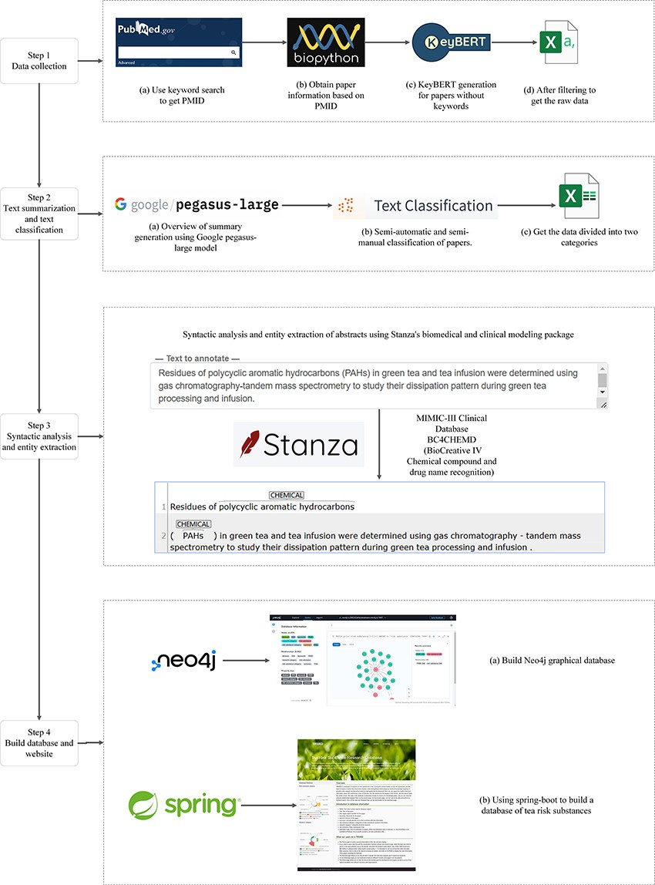
Figure 1. The Neo4j database construction process.
Notes:
Figure 1. The Neo4j database construction process.
Unless provided in the caption above, the following copyright applies to the content of this slide: © The Author(s) 2023. Published by Oxford University Press.This is an Open Access article distributed under the terms of the Creative Commons Attribution License (https://creativecommons.org/licenses/by/4.0/), which permits unrestricted reuse, distribution, and reproduction in any medium, provided the original work is properly cited.

Slide 2
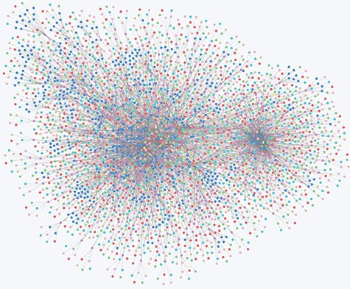
Figure 2. Overview of all node relationships in the Neo4j database.
Notes:
Figure 2. Overview of all node relationships in the Neo4j database.
Unless provided in the caption above, the following copyright applies to the content of this slide: © The Author(s) 2023. Published by Oxford University Press.This is an Open Access article distributed under the terms of the Creative Commons Attribution License (https://creativecommons.org/licenses/by/4.0/), which permits unrestricted reuse, distribution, and reproduction in any medium, provided the original work is properly cited.

Slide 3
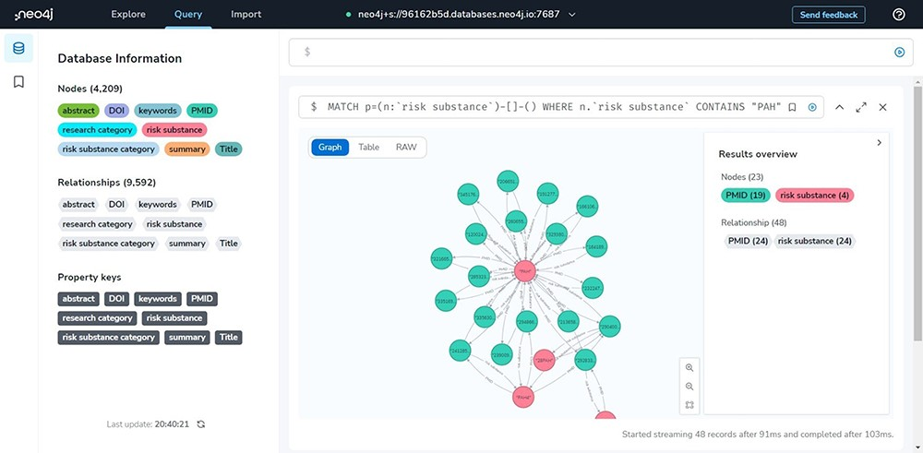
Figure 3. Neo4j database management site showcase.
Notes:
Figure 3. Neo4j database management site showcase.
Unless provided in the caption above, the following copyright applies to the content of this slide: © The Author(s) 2023. Published by Oxford University Press.This is an Open Access article distributed under the terms of the Creative Commons Attribution License (https://creativecommons.org/licenses/by/4.0/), which permits unrestricted reuse, distribution, and reproduction in any medium, provided the original work is properly cited.

Slide 4
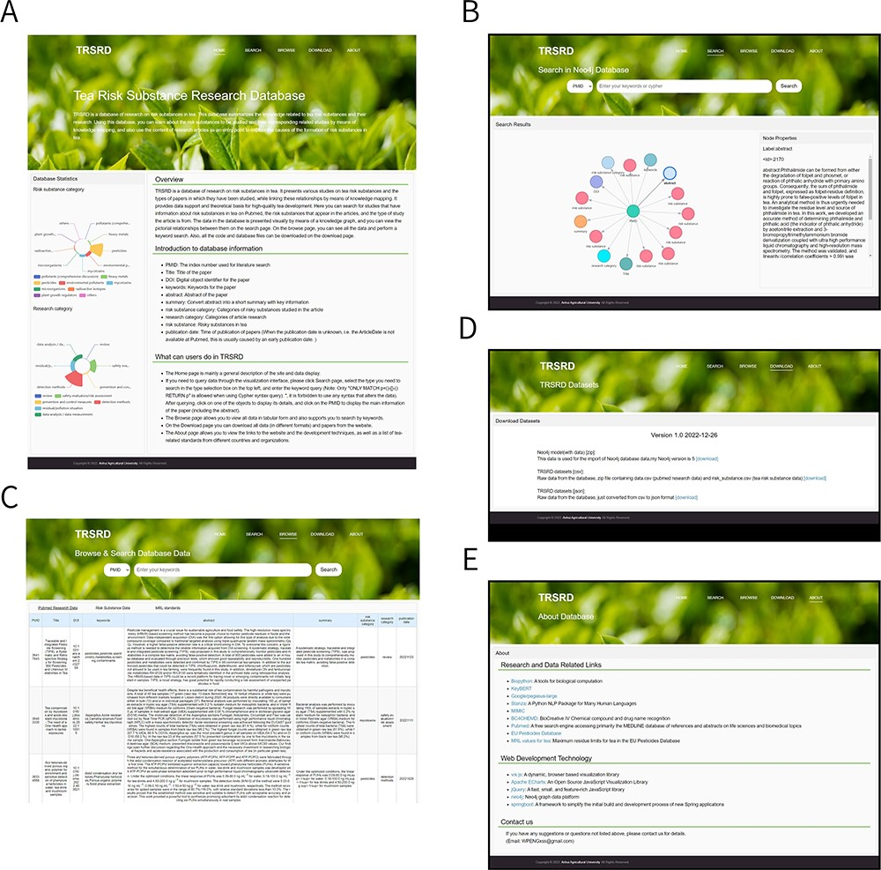
Figure 4. All pages of the TRSRD are displayed. (A) The homepage of the website provides a brief introduction of the ...
Notes:
Figure 4. All pages of the TRSRD are displayed. (A) The homepage of the website provides a brief introduction of the website content and presents data statistics. (B) The knowledge graph search page of the website allows for visual exploration of the data. (C) The data browsing page of the website enables viewing and searching of the data in tabular format. (D) The download page of the website allows for direct downloading of the database data. (E) The about page of the website lists the data sources and other related database links.
Unless provided in the caption above, the following copyright applies to the content of this slide: © The Author(s) 2023. Published by Oxford University Press.This is an Open Access article distributed under the terms of the Creative Commons Attribution License (https://creativecommons.org/licenses/by/4.0/), which permits unrestricted reuse, distribution, and reproduction in any medium, provided the original work is properly cited.

