Slide 1
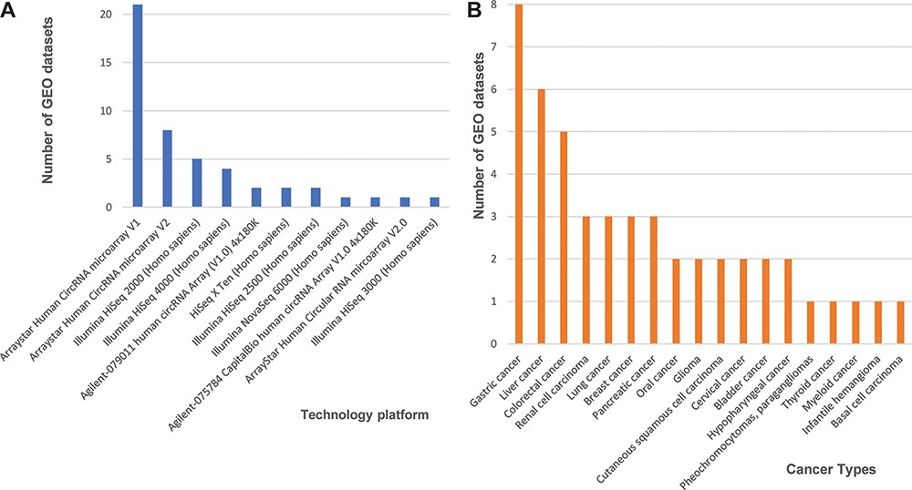
Figure 1. Statistics of 48 curated GEO data sets of circRNA expression in cancers. (A) The number of data sets from ...
Notes:
Figure 1. Statistics of 48 curated GEO data sets of circRNA expression in cancers. (A) The number of data sets from various technology platforms. (B) The number of data sets for curated cancer types.
Unless provided in the caption above, the following copyright applies to the content of this slide: © The Author(s) 2021. Published by Oxford University Press.This is an Open Access article distributed under the terms of the Creative Commons Attribution License (http://creativecommons.org/licenses/by/4.0/), which permits unrestricted reuse, distribution, and reproduction in any medium, provided the original work is properly cited.

