Slide 1
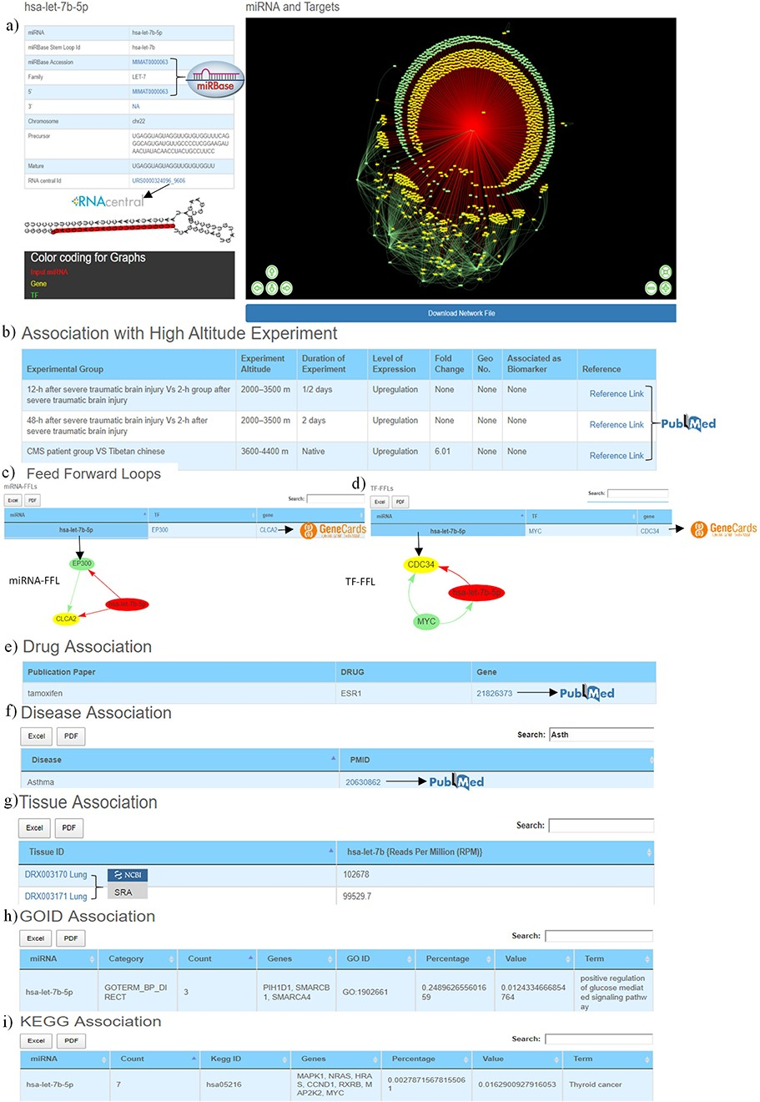
Figure 3. Web image of the miRNA information page. (a) The first section of hsa-let-7b-5p miRNA information page with ...
Notes:
Figure 3. Web image of the miRNA information page. (a) The first section of hsa-let-7b-5p miRNA information page with details about the miRNA and hyperlinking to external databases like miRBase and RNAcentral. (b) The second section shows information related to experimental details of DE human miRNA under HA conditions in published literature. (c) The web image of the miRNA–FFL in tabular format. (d) The web image of the TF–FFL in tabular format. (e) miRNA associations with drug. (f) miRNA associations with different disease. (g) miRNA expression level in different tissues. (h) GO functional enrichment of the miRNA targets. (i) KEGG pathway enrichment of the miRNA targets. The lengthy tables can be searched through ‘search’ box and information in table can be download in both Excel and PDF formats.
Unless provided in the caption above, the following copyright applies to the content of this slide: © The Author(s) 2020. Published by Oxford University Press.This is an Open Access article distributed under the terms of the Creative Commons Attribution License (http://creativecommons.org/licenses/by/4.0/), which permits unrestricted reuse, distribution, and reproduction in any medium, provided the original work is properly cited.

