Slide 1
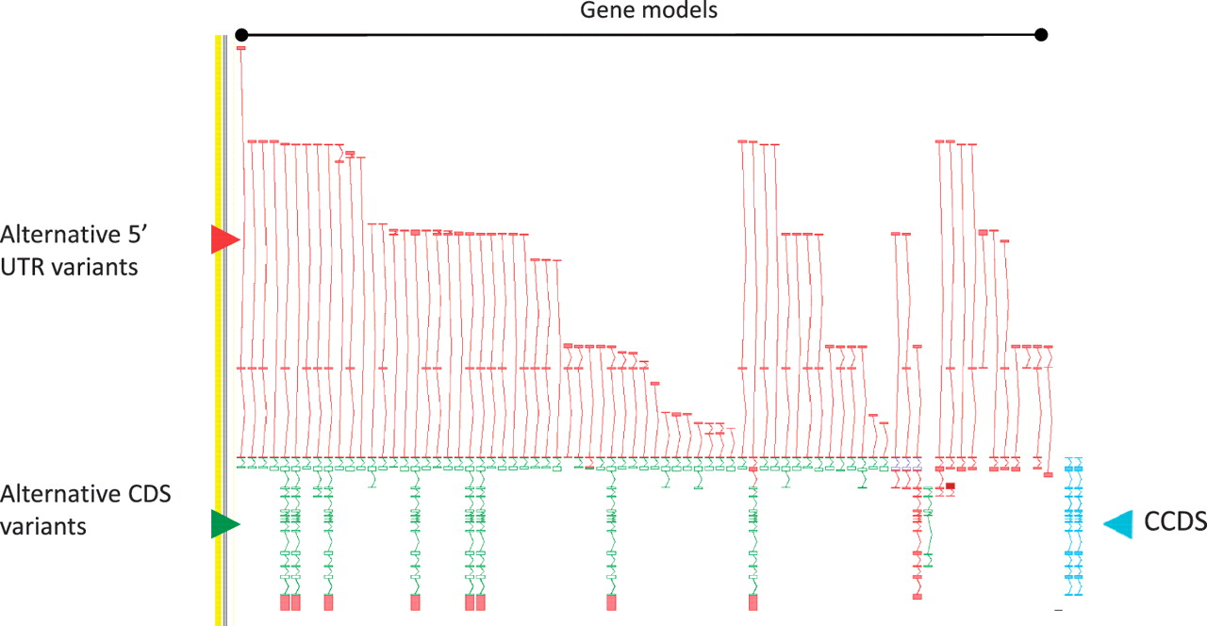
Figure 2 Zmap screenshot of the GPCR56 locus encoding human G protein-coupled receptor 56. This locus has 76 ...
Notes:
Figure 2 Zmap screenshot of the GPCR56 locus encoding human G protein-coupled receptor 56. This locus has 76 non-redundant AS transcripts, the majority of which are EST based, 3′ truncated and show variation in the 5′ UTR. Red arrowhead indicates 5′ UTR, green arrowhead indicates CDS and blue arrowhead indicate the two CCDS variants annotated at this locus.
Unless provided in the caption above, the following copyright applies to the content of this slide: © The Author(s) 2012. Published by Oxford University Press.This is an Open Access article distributed under the terms of the Creative Commons Attribution Non-Commercial License (http://creativecommons.org/licenses/by-nc/3.0), which permits unrestricted non-commercial use, distribution, and reproduction in any medium, provided the original work is properly cited.

