Slide 1
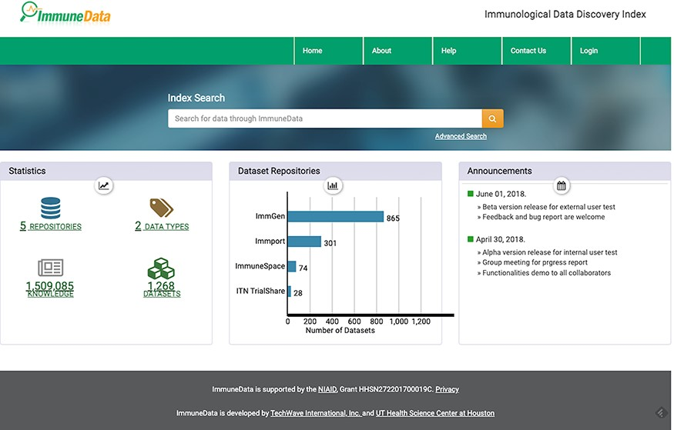
Figure 2. The landing page of ImmuneData.org.
Notes:
Figure 2. The landing page of ImmuneData.org.
Unless provided in the caption above, the following copyright applies to the content of this slide: Published by Oxford University Press 2022. This work is written by (a) US Government employee(s) and is in the public domain in the US.This work is written by (a) US Government employee(s) and is in the public domain in the US.

