Slide 1
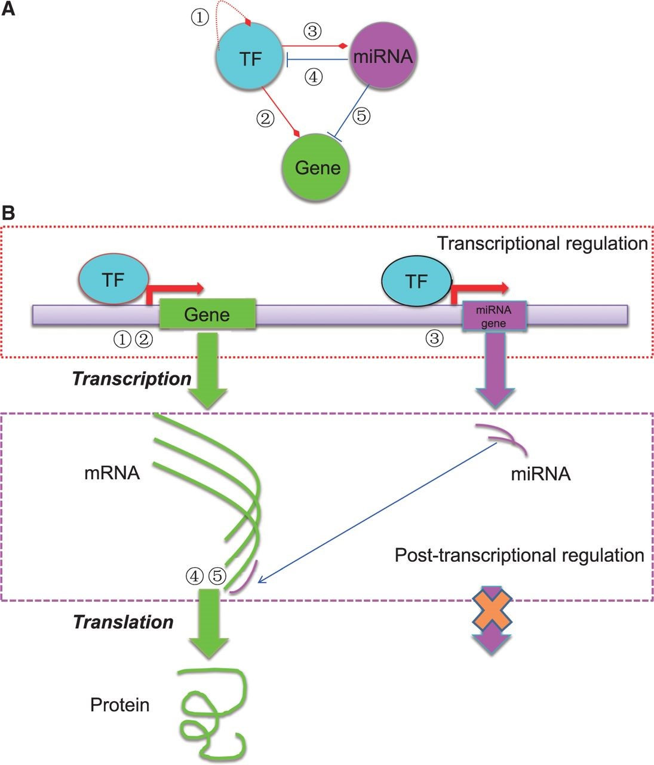
Figure 1. The basic regulatory circuit involving TF, miRNA and target gene ( A ) and the schematic illustration of the ...
Notes:
Figure 1. The basic regulatory circuit involving TF, miRNA and target gene ( A ) and the schematic illustration of the mechanisms of transcriptional and post-transcriptional regulation of gene expression ( B ). In total, five types of regulatory relationships are considered among TF, miRNA and target gene.
Unless provided in the caption above, the following copyright applies to the content of this slide: © The Author(s) 2015. Published by Oxford University Press. This is an Open Access article distributed under the terms of the Creative Commons Attribution License ( http://creativecommons.org/licenses/by/4.0/ ), which permits unrestricted reuse, distribution, and reproduction in any medium, provided the original work is properly cited.

