Slide 1
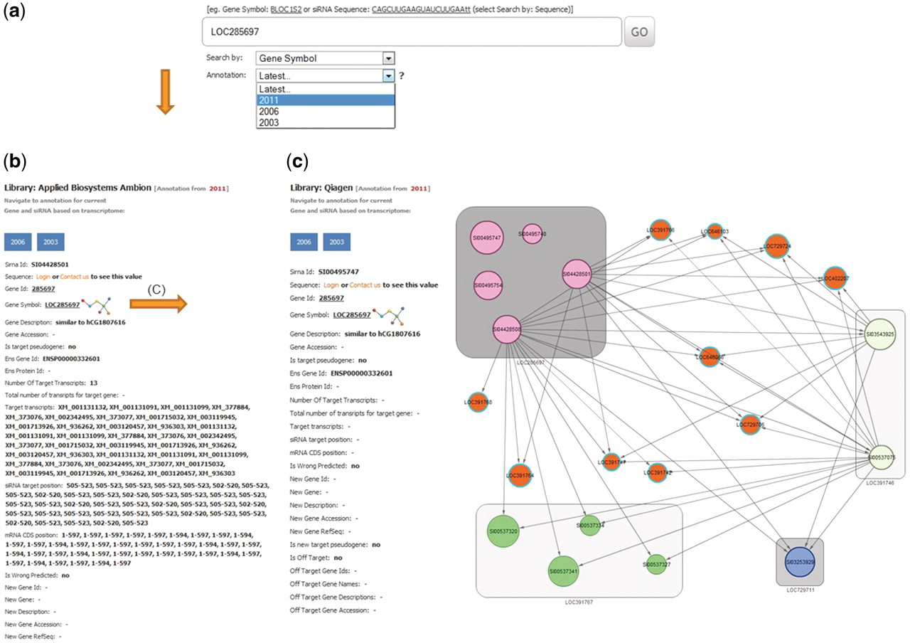
Figure 3 Example of a database search for gene LOC285697. (a) The search page allows for gene, siRNA sequence or siRNA ...
Notes:
Figure 3 Example of a database search for gene LOC285697. (a) The search page allows for gene, siRNA sequence or siRNA ID. The search page provides a combo-box with selection possibility for the year of RefSeq database used for on-target analysis. Here LOC285697 as gene symbol was queried with the selected year of 2011 for RefSeq annotation. (b) Results card showing siRNAs, annotation for the queried gene and specificity parameters. (c) An example of the off-target network view in RNAiAtlas, centered on the query siRNA AGGCAGCAACAAGGATGGGAT (SI00495747) of gene ‘LOC285697’ from Qiagen human genome wide library (Network URL: http://rnaiatlas.ethz.ch/index/network/gene/LOC285697/library/3). Nodes in square (eg. gray squares) are individual siRNAs of same gene. Each node may have connection to off-target gene (represented again by three or four siRNAs). If off-targets genes are not existing in RNAiAtlas (e.g. pseudogenes, discontinued genes) siRNAs are having one edge to off-target gene (orange nodes).
Unless provided in the caption above, the following copyright applies to the content of this slide: © The Author(s) 2012. Published by Oxford University Press.This is an Open Access article distributed under the terms of the Creative Commons Attribution Non-Commercial License (http://creativecommons.org/licenses/by-nc/3.0), which permits unrestricted non-commercial use, distribution, and reproduction in any medium, provided the original work is properly cited.

