Slide 1
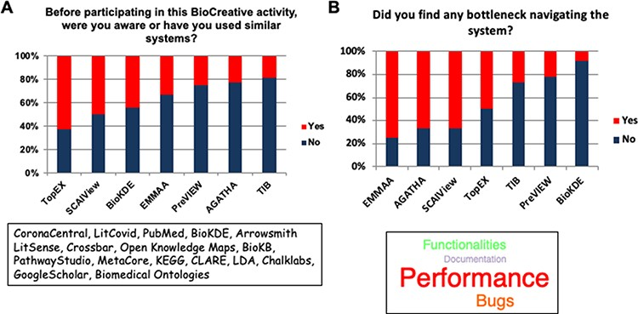
Figure 4. The two bar plots display the familiarity of the users with systems similar to the ones participating in ...
Notes:
Figure 4. The two bar plots display the familiarity of the users with systems similar to the ones participating in Track IV (A) and the most common bottlenecks encountered in the evaluation of the systems (B).
Unless provided in the caption above, the following copyright applies to the content of this slide: © The Author(s) 2022. Published by Oxford University Press.This is an Open Access article distributed under the terms of the Creative Commons Attribution-NonCommercial License (https://creativecommons.org/licenses/by-nc/4.0/), which permits non-commercial re-use, distribution, and reproduction in any medium, provided the original work is properly cited. For commercial re-use, please contact journals.permissions@oup.com

