Slide 1
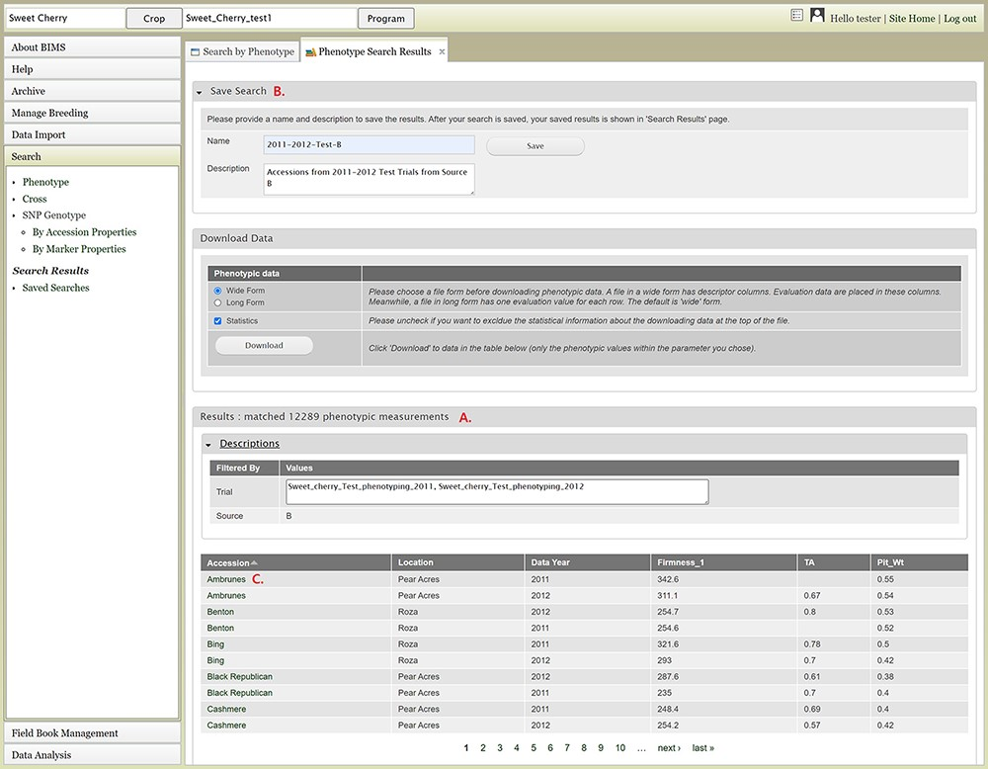
Figure 11. Lower section of the Phenotype search results tab. A. Result table section. B. Save Search and Download Data ...
Notes:
Figure 11. Lower section of the Phenotype search results tab. A. Result table section. B. Save Search and Download Data section. C. Any data under Accession column of the result table has hyperlinks to open a new tab to view the phenotype details of the specific sample.
Unless provided in the caption above, the following copyright applies to the content of this slide: © The Author(s) 2021. Published by Oxford University Press.This is an Open Access article distributed under the terms of the Creative Commons Attribution License (http://creativecommons.org/licenses/by/4.0/), which permits unrestricted reuse, distribution, and reproduction in any medium, provided the original work is properly cited.

