Slide 1
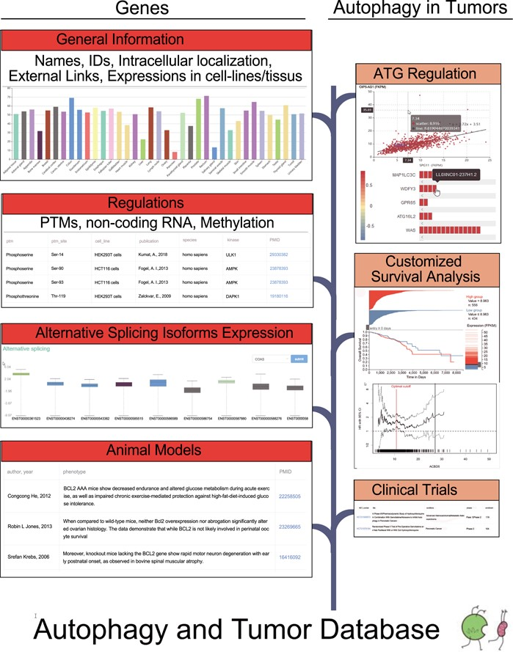
Figure 1 The flow diagram of the database construction. Gene-specific information was collected from Human Protein ...
Notes:
Figure 1 The flow diagram of the database construction. Gene-specific information was collected from Human Protein Atlas, HGNC, UniProt and Ensembl. Experiments identified regulators was searched in the PubMed. RNA sequencing data from TCGA were used to carry out correlation analysis and differential expression analysis. TCGA survival data and phenotype data were used to customize survival analysis.
Unless provided in the caption above, the following copyright applies to the content of this slide: © The Author(s) 2020. Published by Oxford University Press.This is an Open Access article distributed under the terms of the Creative Commons Attribution License (http://creativecommons.org/licenses/by/4.0/), which permits unrestricted reuse, distribution, and reproduction in any medium, provided the original work is properly cited.

