Slide 1
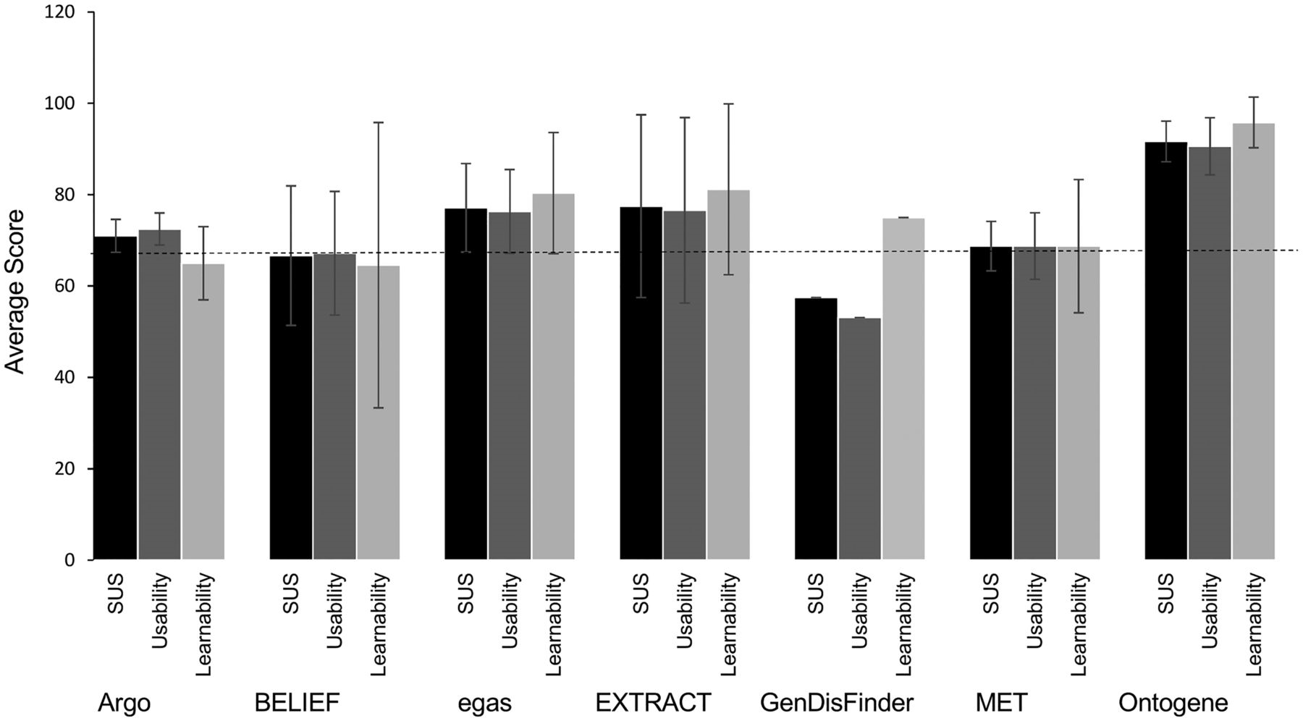
Figure 4. Scores for usability and learnability for each system. SUS score (black) encompasses 10 standard questions, ...
Notes:
Figure 4. Scores for usability and learnability for each system. SUS score (black) encompasses 10 standard questions, question 4 and 10 are related to learnability (light grey) where the others to usability (dark grey). Standard deviations are shown. The dashed line indicates the average SUS 68.
Unless provided in the caption above, the following copyright applies to the content of this slide: Published by Oxford University Press 2016. This work is written by US Government employees and is in the public domain in the US.

