Slide 1
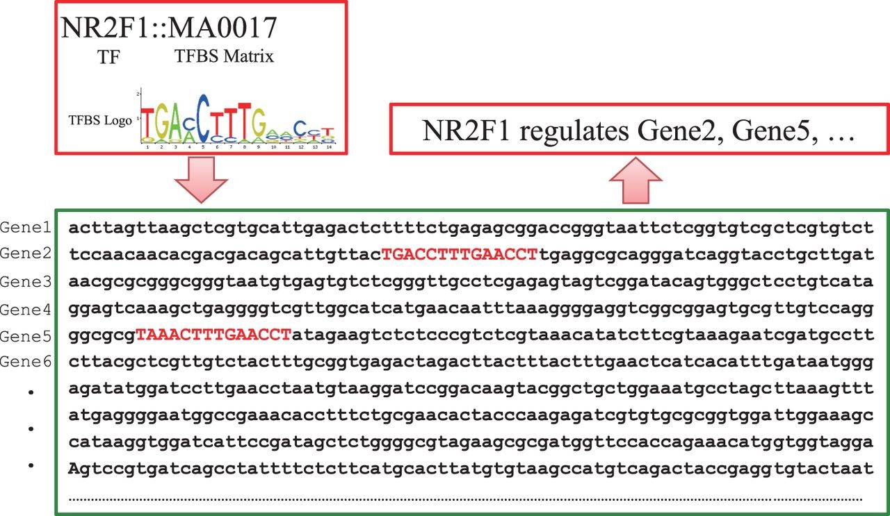
Figure 3. Schematic illustration of pairing TF and genes by TFBSs. When the documented TFBS ‘MA0017’ is found in the ...
Notes:
Figure 3. Schematic illustration of pairing TF and genes by TFBSs. When the documented TFBS ‘MA0017’ is found in the promoter regions of ‘Gene2’ and ‘Gene 5’, TF NR2F1 is predicted to have a potential to regulate the two genes accordingly.
Unless provided in the caption above, the following copyright applies to the content of this slide: © The Author(s) 2015. Published by Oxford University Press. This is an Open Access article distributed under the terms of the Creative Commons Attribution License ( http://creativecommons.org/licenses/by/4.0/ ), which permits unrestricted reuse, distribution, and reproduction in any medium, provided the original work is properly cited.

