Slide 1
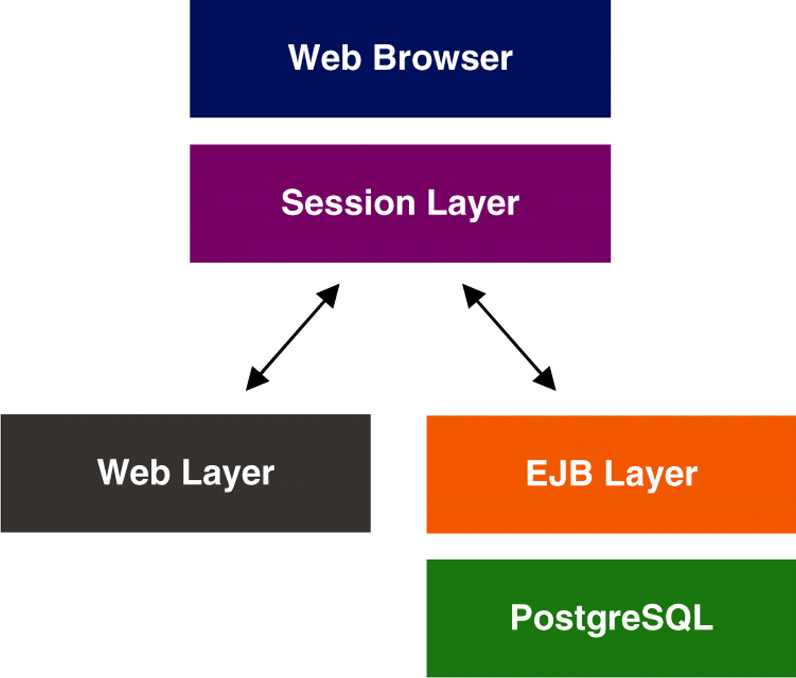
Figure 1. Schematic representation of MRB architecture.
Notes:
Figure 1. Schematic representation of MRB architecture.
Unless provided in the caption above, the following copyright applies to the content of this slide: © The Author(s) 2010. Published by Oxford University Press.This is Open Access article distributed under the terms of the Creative Commons Attribution Non-Commercial License (http://creativecommons.org/licenses/by-nc/2.5), which permits unrestricted non-commercial use, distribution, and reproduction in any medium, provided the original work is properly cited.

Slide 2
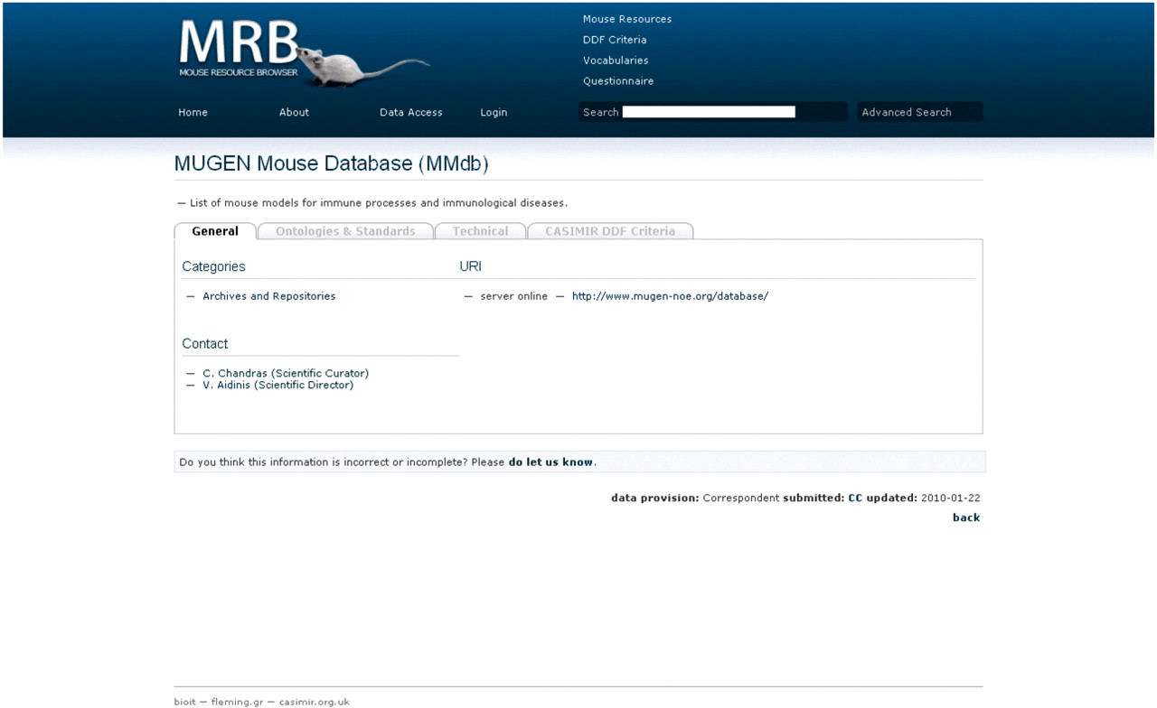
Figure 2. Screen shot of MRB; the view of a mouse resource demonstrating the use of tabs per data set section. Here the ...
Notes:
Figure 2. Screen shot of MRB; the view of a mouse resource demonstrating the use of tabs per data set section. Here the ‘General’ tab is on display, which includes a short description of the resource, the categories under which the particular resource is assigned, the URL(s) of the particular database with an interactive link provided and an interactive contact for users to get in touch with the personnel of the particular resource.
Unless provided in the caption above, the following copyright applies to the content of this slide: © The Author(s) 2010. Published by Oxford University Press.This is Open Access article distributed under the terms of the Creative Commons Attribution Non-Commercial License (http://creativecommons.org/licenses/by-nc/2.5), which permits unrestricted non-commercial use, distribution, and reproduction in any medium, provided the original work is properly cited.

Slide 3
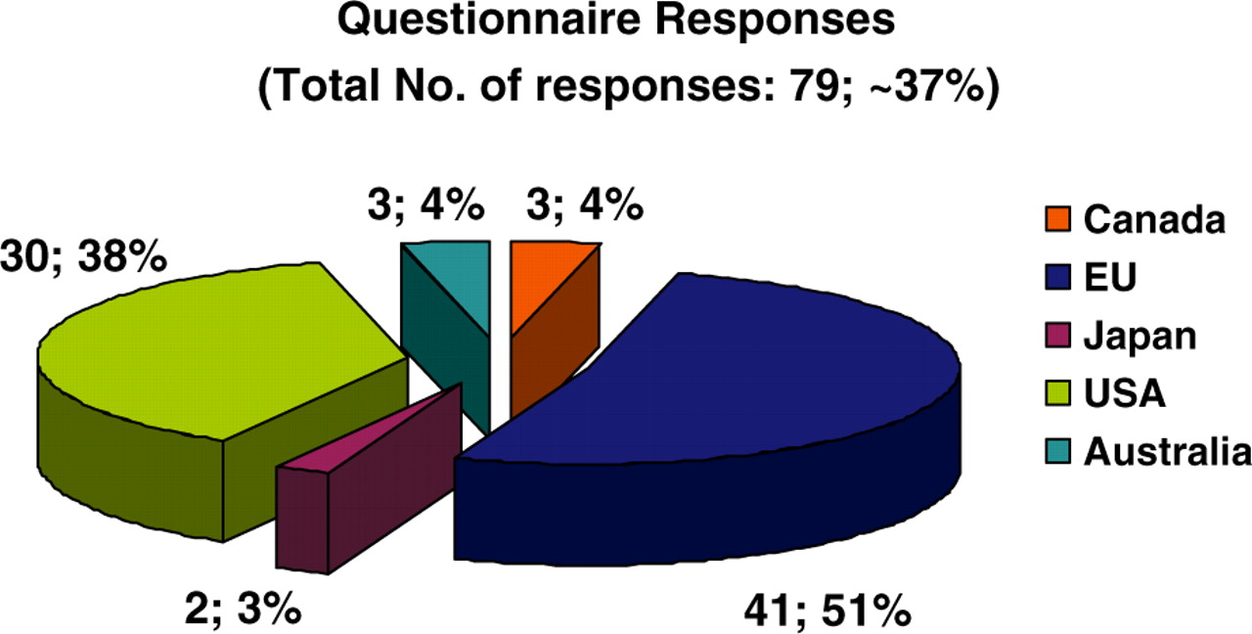
Figure 3. Pie chart depicting the overall online questionnaire responses obtained. Fifty-one percent of responses ...
Notes:
Figure 3. Pie chart depicting the overall online questionnaire responses obtained. Fifty-one percent of responses originated from European countries, 38% from the USA, 3% from Japan and finally 4% each from Canada and Australia.
Unless provided in the caption above, the following copyright applies to the content of this slide: © The Author(s) 2010. Published by Oxford University Press.This is Open Access article distributed under the terms of the Creative Commons Attribution Non-Commercial License (http://creativecommons.org/licenses/by-nc/2.5), which permits unrestricted non-commercial use, distribution, and reproduction in any medium, provided the original work is properly cited.

Slide 4
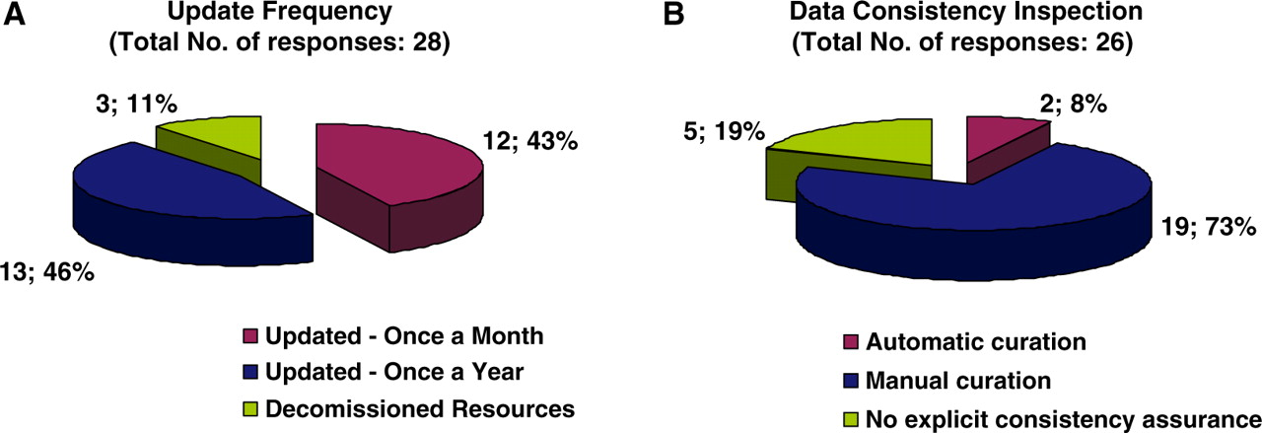
Figure 4. Pie charts representing the curatorial information for each biological database and resource. Forty-three ...
Notes:
Figure 4. Pie charts representing the curatorial information for each biological database and resource. Forty-three percent of resources are updated on a monthly basis, 46% annually and the remaining 11% corresponds to resources that have become decommissioned (A). Seventy-three percent of resources are curated manually, 8% use an automatic curation system, and 19% of resources have no explicit way of assuring data consistency with regard to the displayed information (B).
Unless provided in the caption above, the following copyright applies to the content of this slide: © The Author(s) 2010. Published by Oxford University Press.This is Open Access article distributed under the terms of the Creative Commons Attribution Non-Commercial License (http://creativecommons.org/licenses/by-nc/2.5), which permits unrestricted non-commercial use, distribution, and reproduction in any medium, provided the original work is properly cited.

Slide 5
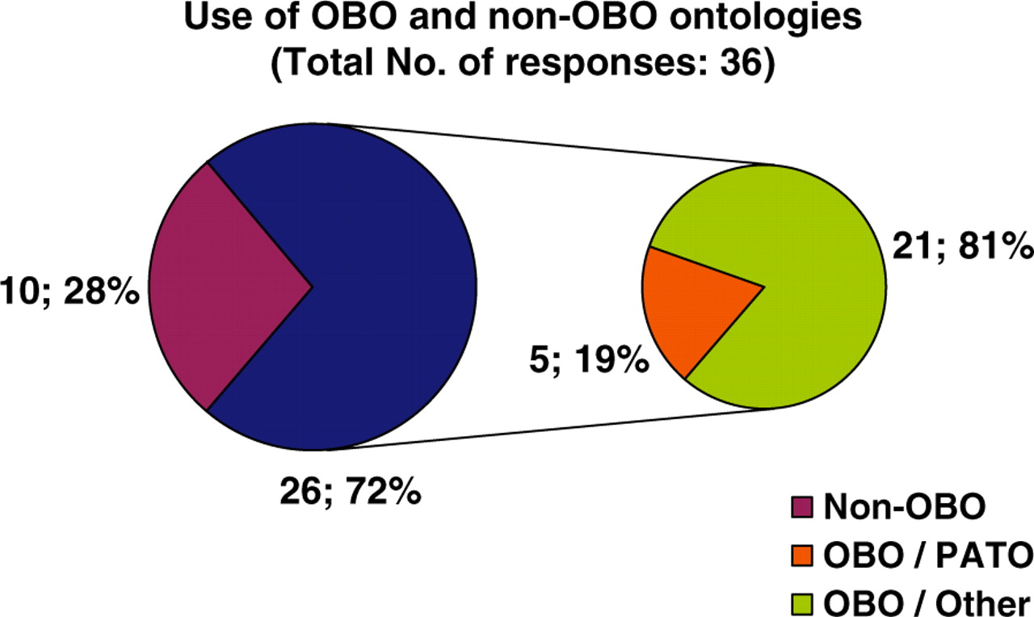
Figure 5. Pie chart illustrating the use of ontologies by biological databases. Twenty-eight percent of resources do ...
Notes:
Figure 5. Pie chart illustrating the use of ontologies by biological databases. Twenty-eight percent of resources do not use any ontology for their data description. Seventy-two percent of resources use an ontology developed by the OBO foundry, of which 19% use PATO and 81% another OBO ontology.
Unless provided in the caption above, the following copyright applies to the content of this slide: © The Author(s) 2010. Published by Oxford University Press.This is Open Access article distributed under the terms of the Creative Commons Attribution Non-Commercial License (http://creativecommons.org/licenses/by-nc/2.5), which permits unrestricted non-commercial use, distribution, and reproduction in any medium, provided the original work is properly cited.

Slide 6
Figure 6. Pie chart representing database accessibility. Fifty-two percent of resource data may be obtained via both a ...
Notes:
Figure 6. Pie chart representing database accessibility. Fifty-two percent of resource data may be obtained via both a web browser interface in addition to another programmatic access (i.e. WebServices, Biomart, etc.), 16% of resources have their data accessed via a web browser interface and public data dumps, while the remaining 32% of databases allow data access simply on web Browser access (A). Of the databases that provide additional programmatic access, other than a web browser interface, 42% of resources have developed WebServices and 25% show preference on using BioMart (B).
Unless provided in the caption above, the following copyright applies to the content of this slide: © The Author(s) 2010. Published by Oxford University Press.This is Open Access article distributed under the terms of the Creative Commons Attribution Non-Commercial License (http://creativecommons.org/licenses/by-nc/2.5), which permits unrestricted non-commercial use, distribution, and reproduction in any medium, provided the original work is properly cited.

