Slide 1
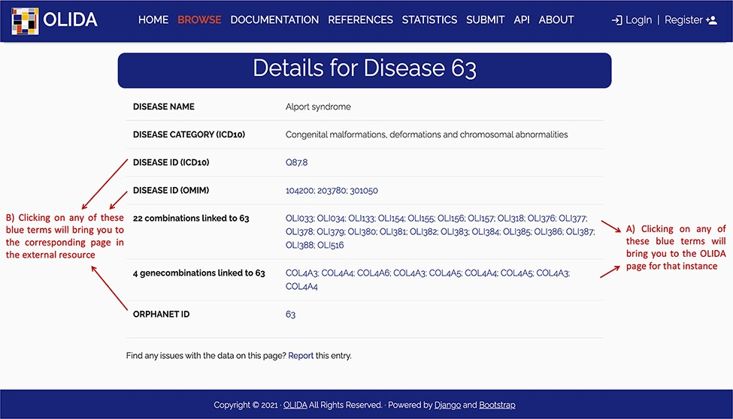
Figure 5. Screenshot of the detailed page for Alport syndrome. This page allows the user to visualize in more detail ...
Notes:
Figure 5. Screenshot of the detailed page for Alport syndrome. This page allows the user to visualize in more detail any instance of the database. It provides (A) links between this instance and the other entities of the database, as well as (B) clickable links towards corresponding pages in external databases where information about this entity was retrieved.
Unless provided in the caption above, the following copyright applies to the content of this slide: © The Author(s) 2022. Published by Oxford University Press.This is an Open Access article distributed under the terms of the Creative Commons Attribution License (https://creativecommons.org/licenses/by/4.0/), which permits unrestricted reuse, distribution, and reproduction in any medium, provided the original work is properly cited.

