Slide 1
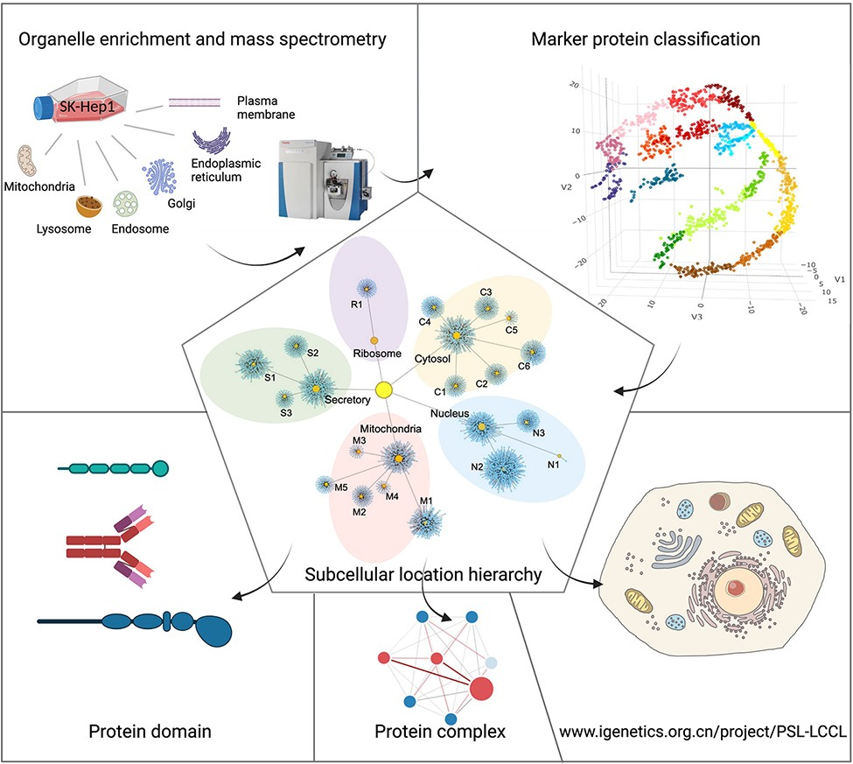
Figure 1. A graphical abstract for the present study. Six cytosolic membrane-bound organelles were isolated and ...
Notes:
Figure 1. A graphical abstract for the present study. Six cytosolic membrane-bound organelles were isolated and enriched from SK_HEP1, and proteins in each organelle were quantified by MS. A compiled list of marker proteins was clustered and trained using a machine-learning-based algorithm. All proteins were localized at the cluster and neighborhood levels, respectively, as shown in a hierarchical structure. The localization of protein domains and complexes was further investigated. The proteome for subcellular organelles was available at www.igenetics.org.cn/PSL-LCCL.
Unless provided in the caption above, the following copyright applies to the content of this slide: © The Author(s) 2022. Published by Oxford University Press.This is an Open Access article distributed under the terms of the Creative Commons Attribution License (https://creativecommons.org/licenses/by/4.0/), which permits unrestricted reuse, distribution, and reproduction in any medium, provided the original work is properly cited.

Slide 2
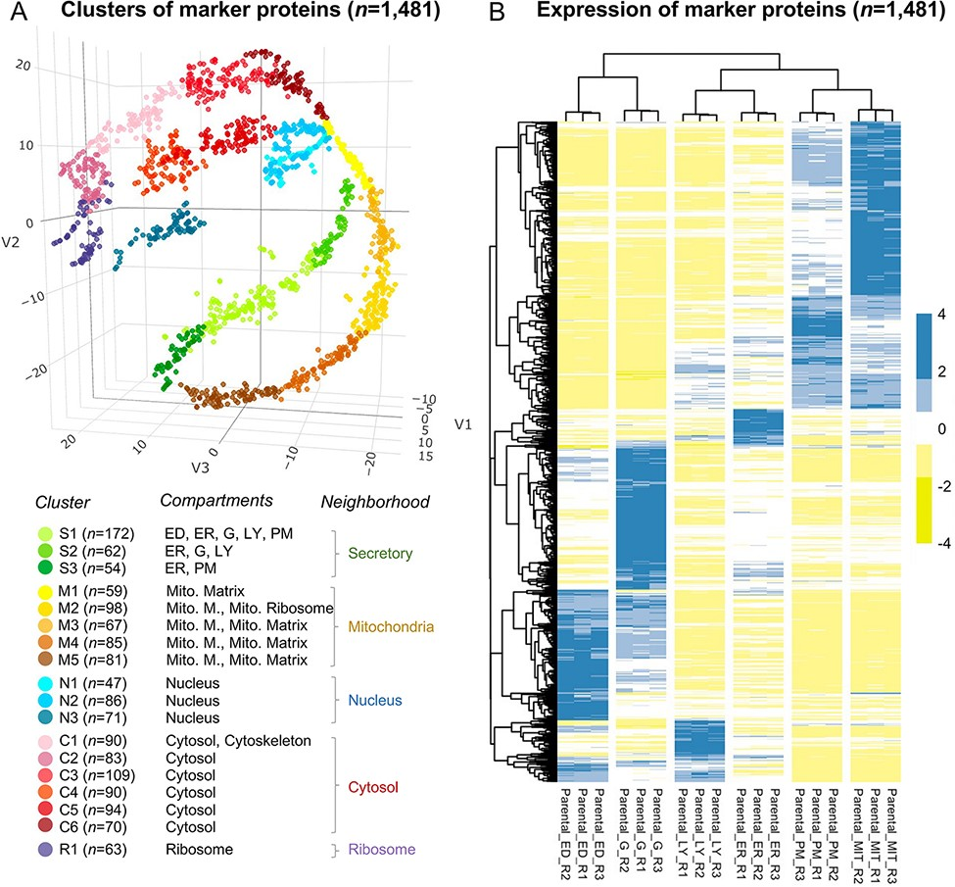
Figure 2. The annotation of the selected 1481 marker proteins. (A) A three-dimensional visualization for 18 clusters of ...
Notes:
Figure 2. The annotation of the selected 1481 marker proteins. (A) A three-dimensional visualization for 18 clusters of marker proteins. Different colors represent clusters or neighborhoods. The number of marker proteins classified in each cluster was shown in brackets. Annotation for the subcellular compartments/organelles and their corresponding neighborhoods was present. ED, endosome; ER, endoplasmic reticulum, G, golgi apparatus; LY, lysosome; PM, plasma membrane; Mito, mitochondria; Mito. M., mitochondria membrane. (B) Differential expression of the selected marker proteins in organelles. R, replicate.
Unless provided in the caption above, the following copyright applies to the content of this slide: © The Author(s) 2022. Published by Oxford University Press.This is an Open Access article distributed under the terms of the Creative Commons Attribution License (https://creativecommons.org/licenses/by/4.0/), which permits unrestricted reuse, distribution, and reproduction in any medium, provided the original work is properly cited.

Slide 3
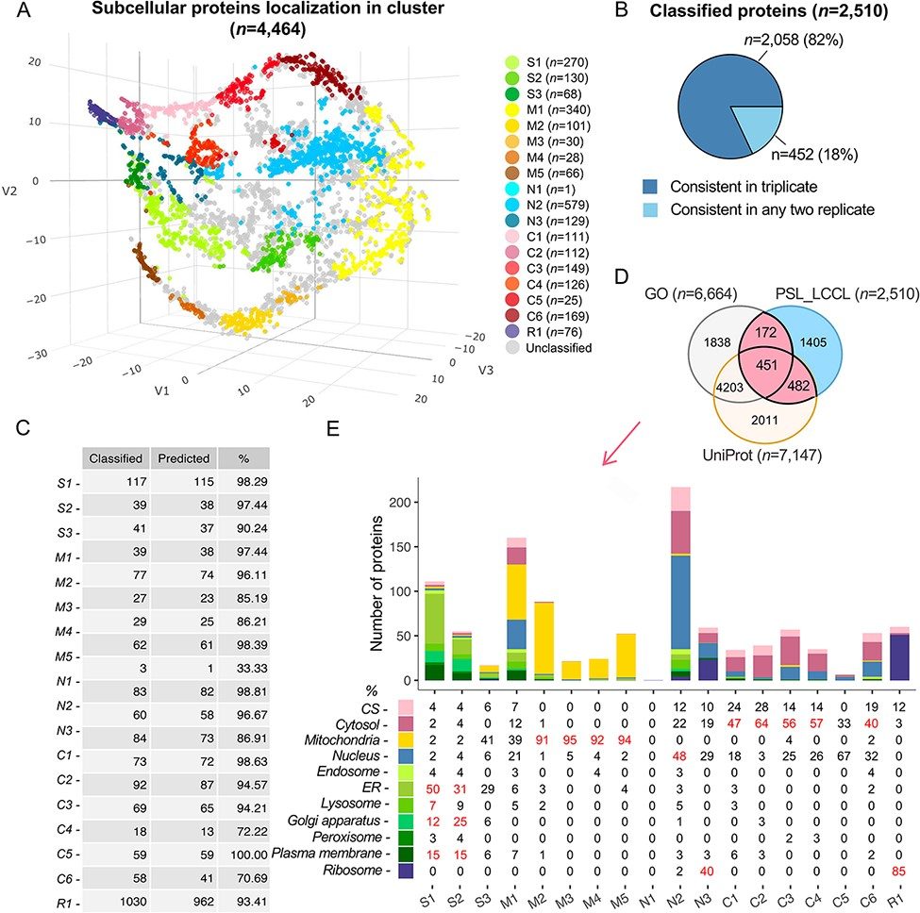
Figure 3. Subcellular localization of all identified proteins (n = 4464) at the cluster level. (A) The t-SNE ...
Notes:
Figure 3. Subcellular localization of all identified proteins (n = 4464) at the cluster level. (A) The t-SNE classification for all proteins in a three-dimensional space. (B) The consistency of the classified proteins in replicate. (C) The classification accuracy of marker proteins at the cluster level. Classified: the number of marker proteins retained at each cluster level after filtering by threshold; predicted: the number of marker proteins correctly predicted. (D) The overlap of proteins classified with single cluster and proteins annotated with a single location in GO and UniProt. (E) Evaluation of single-cluster-classified proteins against proteins with single subcellular localization annotation from GO or UniProt.
Unless provided in the caption above, the following copyright applies to the content of this slide: © The Author(s) 2022. Published by Oxford University Press.This is an Open Access article distributed under the terms of the Creative Commons Attribution License (https://creativecommons.org/licenses/by/4.0/), which permits unrestricted reuse, distribution, and reproduction in any medium, provided the original work is properly cited.

Slide 4
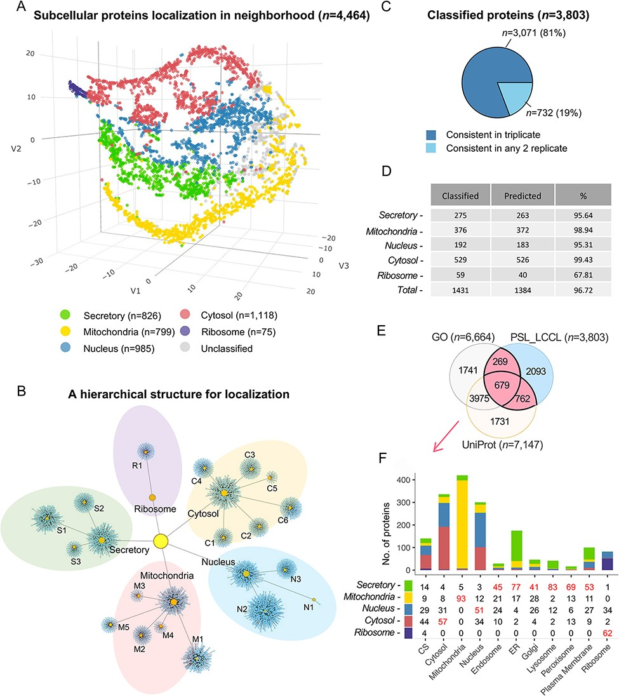
Figure 4. Subcellular localization of the identified proteins (n = 4464) at the neighborhood level. (A) A projection of ...
Notes:
Figure 4. Subcellular localization of the identified proteins (n = 4464) at the neighborhood level. (A) A projection of all identified proteins in a three-dimensional space at the neighborhood level. (B) A hierarchical network of the classification at both cluster and neighborhood levels. (C) The consistency of the classified proteins in replicate. (D) The classification accuracy of marker proteins at the neighborhood level. Classified: the number of marker proteins retained at each neighborhood level after threshold filtering; predicted: number of marker proteins correctly predicted. (E) The overlap of single-neighborhood-classified proteins and proteins annotated with a single location in GO and UniProt. (F) Evaluation of single neighborhood classified against proteins with single subcellular localization annotation from GO or UniProt.
Unless provided in the caption above, the following copyright applies to the content of this slide: © The Author(s) 2022. Published by Oxford University Press.This is an Open Access article distributed under the terms of the Creative Commons Attribution License (https://creativecommons.org/licenses/by/4.0/), which permits unrestricted reuse, distribution, and reproduction in any medium, provided the original work is properly cited.

Slide 5
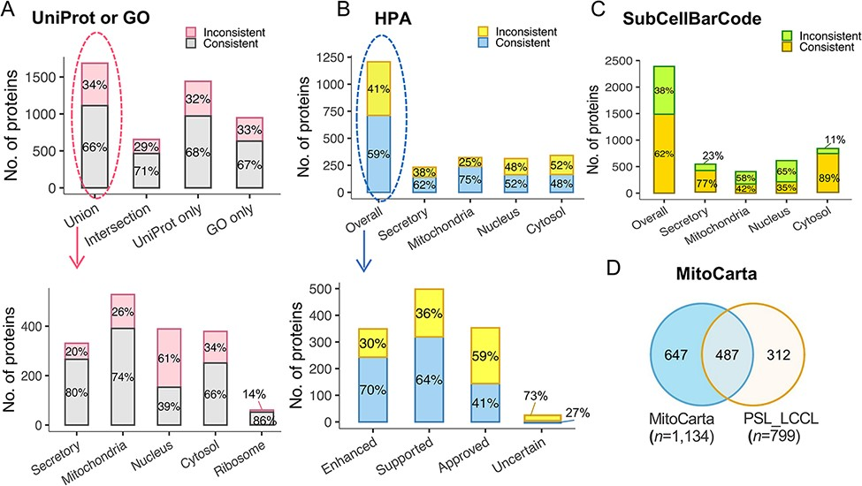
Figure 5. The evaluation of subcellular protein localization in PSL-LCCL against the public databases. (A) An agreement ...
Notes:
Figure 5. The evaluation of subcellular protein localization in PSL-LCCL against the public databases. (A) An agreement of neighborhood-based classification of proteins in PSL-LCC with proteins having unique localization annotated in UniProt or GO (upper). An agreement between PSL-LCC classifications and UniProt and GO single-location proteins of each neighborhood (below). Union, the union of UniProt and GO; Intersection, the overlap proteins in UniProt and GO. (B) An agreement of the neighborhood-based classifications in PSL-LCCL and proteins having unique localization annotated in Human Cell Atlas (upper) and their corresponding reliability score (below). (C) An agreement of the neighborhood-based classification in PSL-LCCL and proteins localized in SubCellBarCode Orre et al. (8). (D) An agreement of proteins localized in mitochondria in PSL-LCCL with MitoCarta Rath et al. (28).
Unless provided in the caption above, the following copyright applies to the content of this slide: © The Author(s) 2022. Published by Oxford University Press.This is an Open Access article distributed under the terms of the Creative Commons Attribution License (https://creativecommons.org/licenses/by/4.0/), which permits unrestricted reuse, distribution, and reproduction in any medium, provided the original work is properly cited.

Slide 6
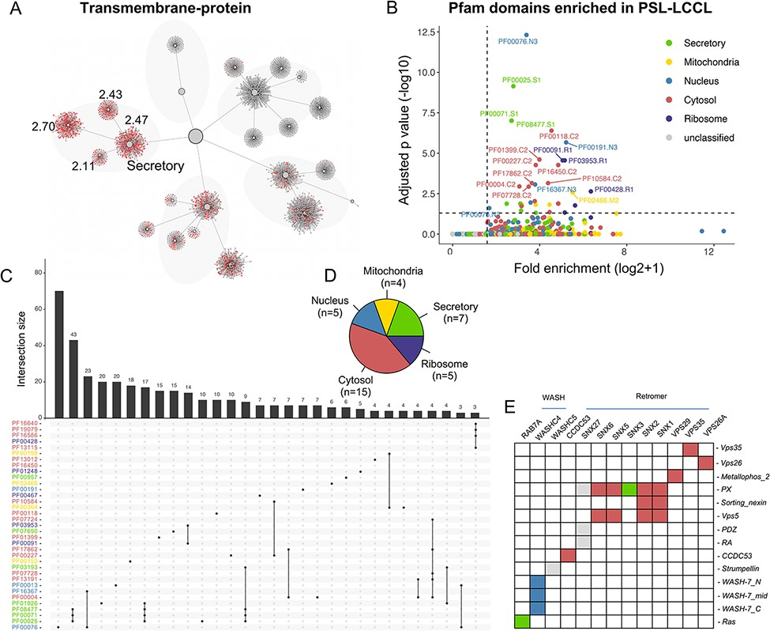
Figure 6. The effects of domains on subcellular proteins localization. (A) The localization of proteins with ...
Notes:
Figure 6. The effects of domains on subcellular proteins localization. (A) The localization of proteins with transmembrane domain in the hierarchical structure. Enriched locations (P < 0.05) are indicated. (B). Enrichment analysis for Pfam domains in our neighborhoods. The cutoff for fold enrichment was two (*adjusted P-value* < 0.05). (C). Protein domains significantly enriched in PSL-LCCL. (D) The number of protein domains that are significantly enriched in neighborhoods. (E) The domain of the retromer complex.
Unless provided in the caption above, the following copyright applies to the content of this slide: © The Author(s) 2022. Published by Oxford University Press.This is an Open Access article distributed under the terms of the Creative Commons Attribution License (https://creativecommons.org/licenses/by/4.0/), which permits unrestricted reuse, distribution, and reproduction in any medium, provided the original work is properly cited.

Slide 7
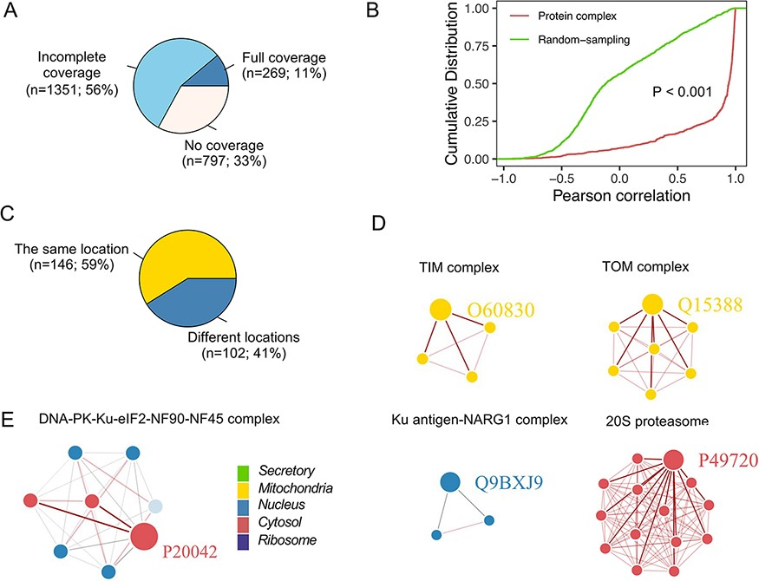
Figure 7. Subcellular localization for the protein complex. (A) The coverage of CORUM complexes in PSL-LCCL. CORUM: the ...
Notes:
Figure 7. Subcellular localization for the protein complex. (A) The coverage of CORUM complexes in PSL-LCCL. CORUM: the comprehensive resource of mammalian protein complexes; full: all the protein complex members were present in our data; no coverage: members in the protein complex were not identified in our study. (B) A cumulative plot of the correlation for the protein complex members in CORUM. Random sampling was from a random sampling of correlations for nonprotein complex members. (C) The consistency of the localization of the protein complex members. (D) Examples of members of protein complexes located in the same neighborhood. (E) Examples of members of protein complexes located in different neighborhoods.
Unless provided in the caption above, the following copyright applies to the content of this slide: © The Author(s) 2022. Published by Oxford University Press.This is an Open Access article distributed under the terms of the Creative Commons Attribution License (https://creativecommons.org/licenses/by/4.0/), which permits unrestricted reuse, distribution, and reproduction in any medium, provided the original work is properly cited.

