Slide 1
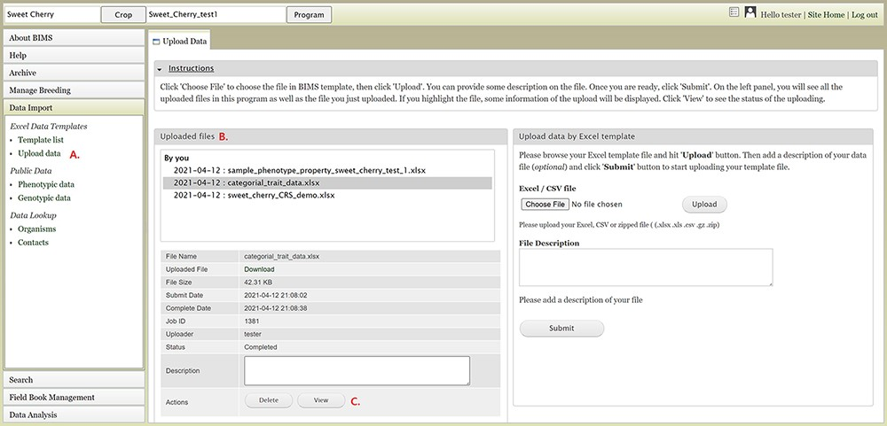
Figure 4. BIMS interface for uploading data in templates. A. Upload data link under Data Import section. B. Uploaded ...
Notes:
Figure 4. BIMS interface for uploading data in templates. A. Upload data link under Data Import section. B. Uploaded files section In the Upload Data tab that shows the name of the files that have been submitted or uploaded. C. View link that opens a new tab that shows the progress of an upload job.
Unless provided in the caption above, the following copyright applies to the content of this slide: © The Author(s) 2021. Published by Oxford University Press.This is an Open Access article distributed under the terms of the Creative Commons Attribution License (http://creativecommons.org/licenses/by/4.0/), which permits unrestricted reuse, distribution, and reproduction in any medium, provided the original work is properly cited.

