Slide 1
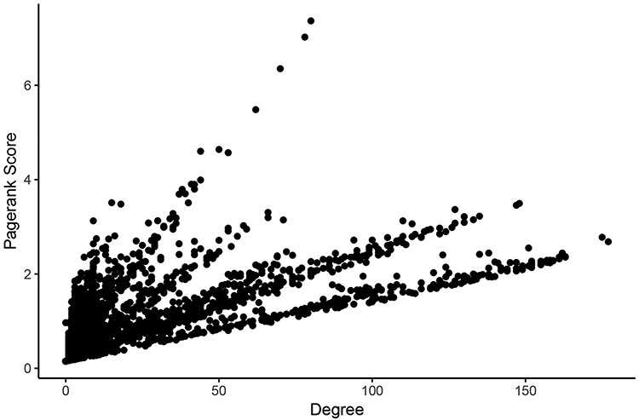
Figure 3. Comparison of measures of centrality in the LUAD tumor network. In the normal lung co-expression network, ...
Notes:
Figure 3. Comparison of measures of centrality in the LUAD tumor network. In the normal lung co-expression network, seven of the 10 nodes with the highest Pagerank scores were zinc finger transcription factors (Table 1). The other three genes encode trinucleotide repeat-containing gene 6A protein (TNRC6A), transmembrane protein-encoding gene KIAA1109 and nuclear mitotic apparatus protein 1 (NuMA-1).
Unless provided in the caption above, the following copyright applies to the content of this slide: © The Author(s) 2020. Published by Oxford University Press.This is an Open Access article distributed under the terms of the Creative Commons Attribution License (http://creativecommons.org/licenses/by/4.0/), which permits unrestricted reuse, distribution, and reproduction in any medium, provided the original work is properly cited.

