Slide 1
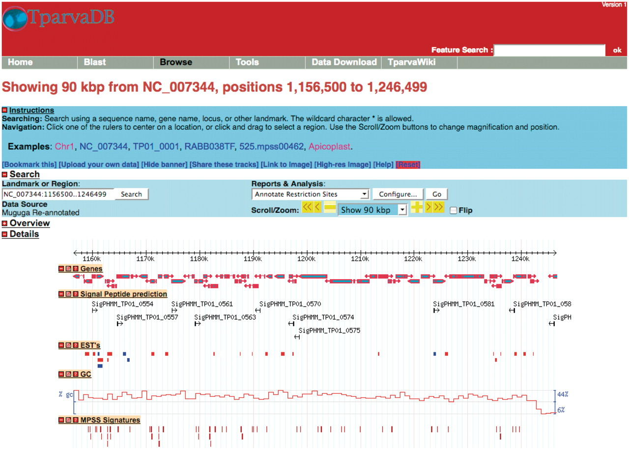
Figure 2. A representative example of the GBrowse interface. Tracks display information on annotated genes, predicted ...
Notes:
Figure 2. A representative example of the GBrowse interface. Tracks display information on annotated genes, predicted signal peptides, mapped ESTs, %GC content and MPSS signatures in a region of Chromosome 1.
Unless provided in the caption above, the following copyright applies to the content of this slide: © The Author(s) 2011. Published by Oxford University Press.This is Open Access article distributed under the terms of the Creative Commons Attribution Non-Commercial License (http://creativecommons.org/licenses/by-nc/2.5), which permits unrestricted non-commercial use, distribution, and reproduction in any medium, provided the original work is properly cited.

