Slide 1
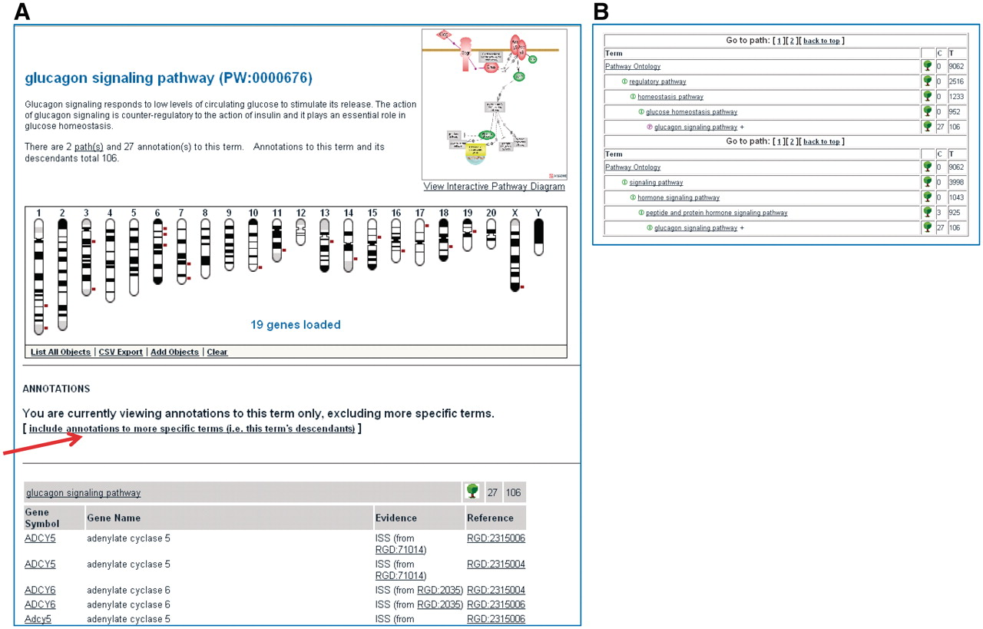
Figure 4. Shows a partial view of the Ontology Report page for the ‘glucagon signaling pathway’ (A) and the path(s) to ...
Notes:
Figure 4. Shows a partial view of the Ontology Report page for the ‘glucagon signaling pathway’ (A) and the path(s) to the ‘glucagon signaling pathway’ term within the ontology (B).
Unless provided in the caption above, the following copyright applies to the content of this slide: © The Author(s) 2011. Published by Oxford University Press.This is Open Access article distributed under the terms of the Creative Commons Attribution Non-Commercial License (http://creativecommons.org/licenses/by-nc/2.5), which permits unrestricted non-commercial use, distribution, and reproduction in any medium, provided the original work is properly cited.

