Slide 1
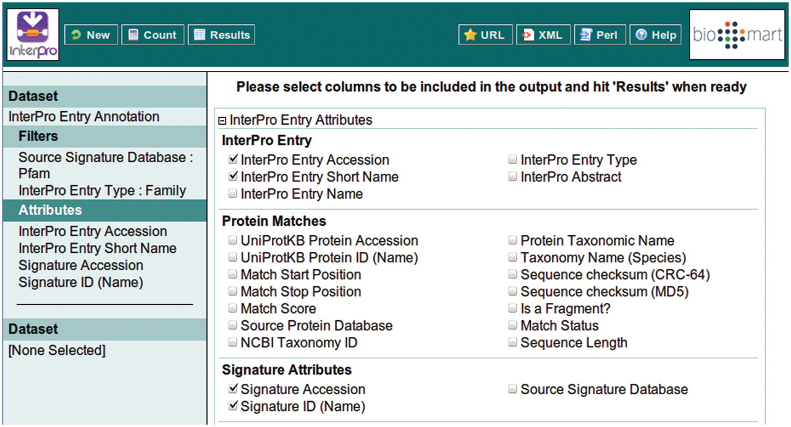
Figure 5. Selecting the attributes to be included in the BioMart output (equivalent to the columns of a spreadsheet). ...
Notes:
Figure 5. Selecting the attributes to be included in the BioMart output (equivalent to the columns of a spreadsheet). The ordering of the columns is determined by the order in which the attributes are selected.
Unless provided in the caption above, the following copyright applies to the content of this slide: © The Author(s) 2011. Published by Oxford University Press.This is Open Access article distributed under the terms of the Creative Commons Attribution Non-Commercial License (http://creativecommons.org/licenses/by-nc/2.5), which permits unrestricted non-commercial use, distribution, and reproduction in any medium, provided the original work is properly cited.

