Slide 1
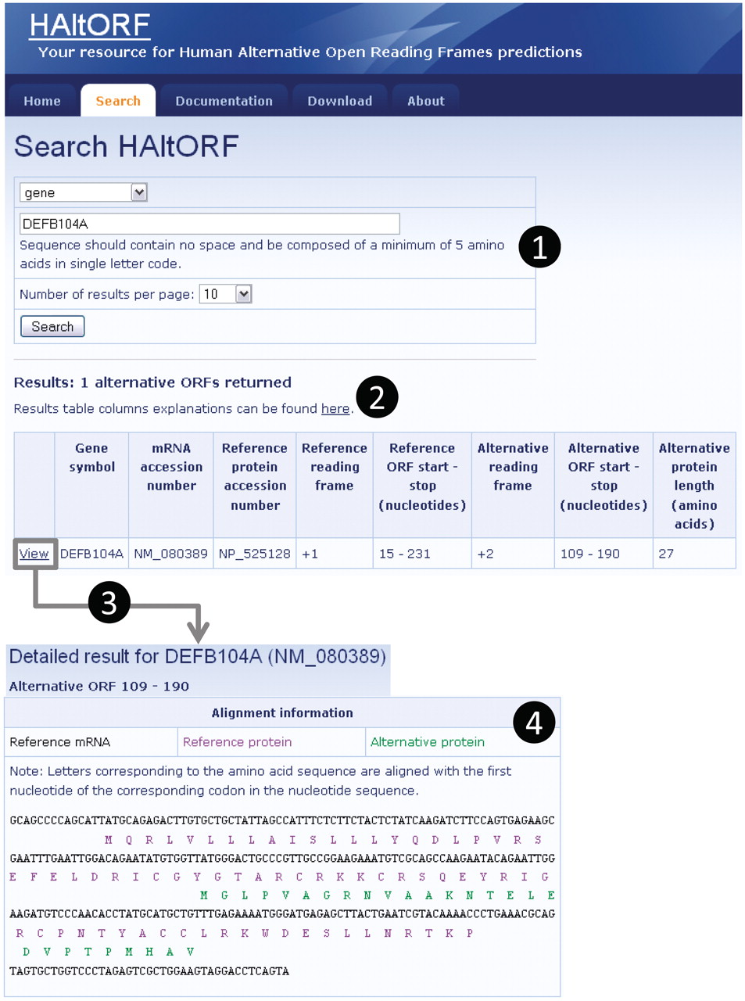
Figure 2 Snapshot of a typical search and associated results pages. (1) Search by gene (DEFB104A, which encodes the ...
Notes:
Figure 2 Snapshot of a typical search and associated results pages. (1) Search by gene (DEFB104A, which encodes the β-defensin 104 protein). (2) The number of corresponding AltORFs is indicated, and details on each AltORF are summarized in a table. Although this is not the case for this particular example, note that for a single gene, all AltORFs present in each transcript variants would be listed. The reference ORF is by definition in the +1 frame, and the alternative ORFs is in the +2 frame in this example. The nucleotide numbers indicating the location of the ORFs are the first nucleotide of the start codon, and the first nucleotide of the stop codon, respectively. (3) A detailed result page is available for each AltORF through the ‘View’ link. (4) In the detailed result page, basic information on the gene and mRNA of origin as well as the associated reference protein are displayed along with links to GenBank for each of these items (not shown). An alignment of the reference (blue letters) and alternative (green letters) protein sequences on the reference mRNA sequence (black letters) is provided.
Unless provided in the caption above, the following copyright applies to the content of this slide: © The Author(s) 2012. Published by Oxford University Press.This is an Open Access article distributed under the terms of the Creative Commons Attribution Non-Commercial License (http://creativecommons.org/licenses/by-nc/3.0), which permits unrestricted non-commercial use, distribution, and reproduction in any medium, provided the original work is properly cited.

