Slide 1
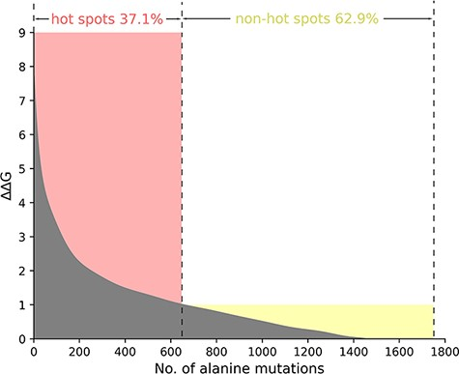
Figure 2. The ΔΔG range of hot spots (red, ΔΔG >1.0 kcal/mol) and non-hot spots (yellow, ΔΔG <1.0 kcal/mol) is ...
Notes:
Figure 2. The ΔΔG range of hot spots (red, ΔΔG >1.0 kcal/mol) and non-hot spots (yellow, ΔΔG <1.0 kcal/mol) is indicated. The section where ΔΔG is less than 0 is excluded in the picture.
Unless provided in the caption above, the following copyright applies to the content of this slide: © The Author(s) 2021. Published by Oxford University Press.This is an Open Access article distributed under the terms of the Creative Commons Attribution License (http://creativecommons.org/licenses/by/4.0/), which permits unrestricted reuse, distribution, and reproduction in any medium, provided the original work is properly cited.

