Slide 1
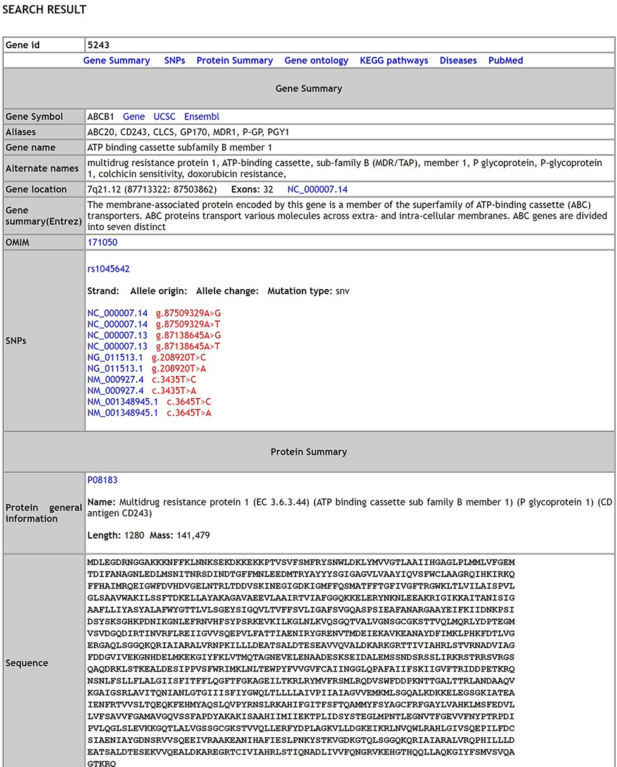
Figure 1. The Search results page of MIK.
Notes:
Figure 1. The Search results page of MIK.
Unless provided in the caption above, the following copyright applies to the content of this slide: © The Author(s) 2021. Published by Oxford University Press.This is an Open Access article distributed under the terms of the Creative Commons Attribution License (http://creativecommons.org/licenses/by/4.0/), which permits unrestricted reuse, distribution, and reproduction in any medium, provided the original work is properly cited.

Slide 2
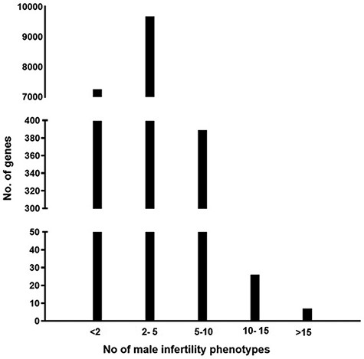
Figure 2. A graph representing the number of genes associated with multiple male reproductive disorders leading to ...
Notes:
Figure 2. A graph representing the number of genes associated with multiple male reproductive disorders leading to infertility.
Unless provided in the caption above, the following copyright applies to the content of this slide: © The Author(s) 2021. Published by Oxford University Press.This is an Open Access article distributed under the terms of the Creative Commons Attribution License (http://creativecommons.org/licenses/by/4.0/), which permits unrestricted reuse, distribution, and reproduction in any medium, provided the original work is properly cited.

Slide 3
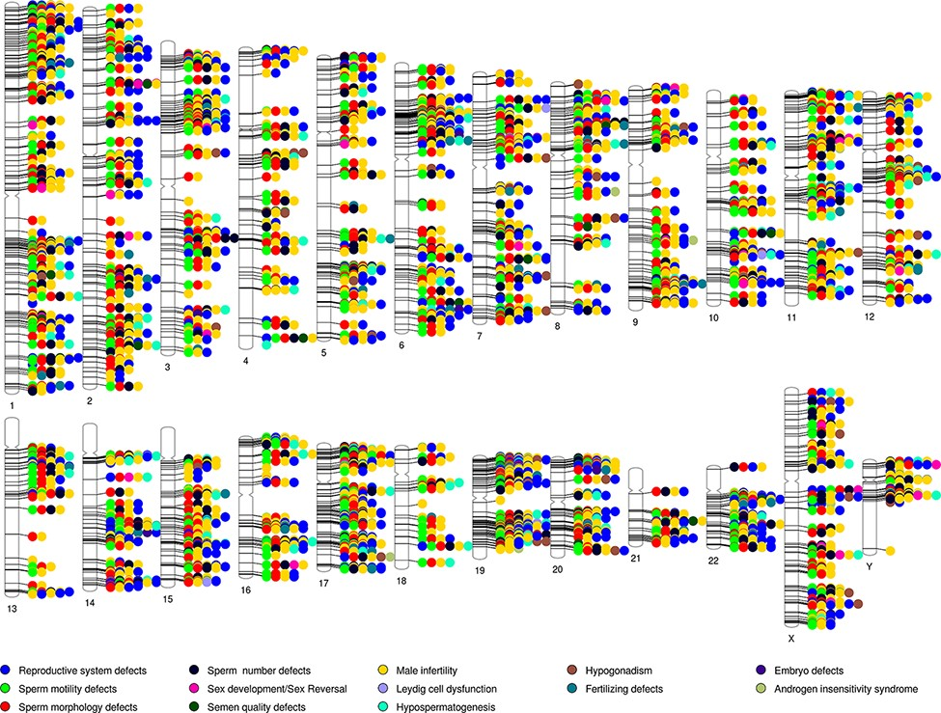
Figure 3. Phenogram showing chromosomal location of genes associated with the different male reproductive diseases in ...
Notes:
Figure 3. Phenogram showing chromosomal location of genes associated with the different male reproductive diseases in MIK.
Unless provided in the caption above, the following copyright applies to the content of this slide: © The Author(s) 2021. Published by Oxford University Press.This is an Open Access article distributed under the terms of the Creative Commons Attribution License (http://creativecommons.org/licenses/by/4.0/), which permits unrestricted reuse, distribution, and reproduction in any medium, provided the original work is properly cited.

Slide 4
Figure 4. A heatmap representing the association (in red) and no association (in blue) of genes with the different ...
Notes:
Figure 4. A heatmap representing the association (in red) and no association (in blue) of genes with the different reproductive disorders indexed in MIK.
Unless provided in the caption above, the following copyright applies to the content of this slide: © The Author(s) 2021. Published by Oxford University Press.This is an Open Access article distributed under the terms of the Creative Commons Attribution License (http://creativecommons.org/licenses/by/4.0/), which permits unrestricted reuse, distribution, and reproduction in any medium, provided the original work is properly cited.

Slide 5
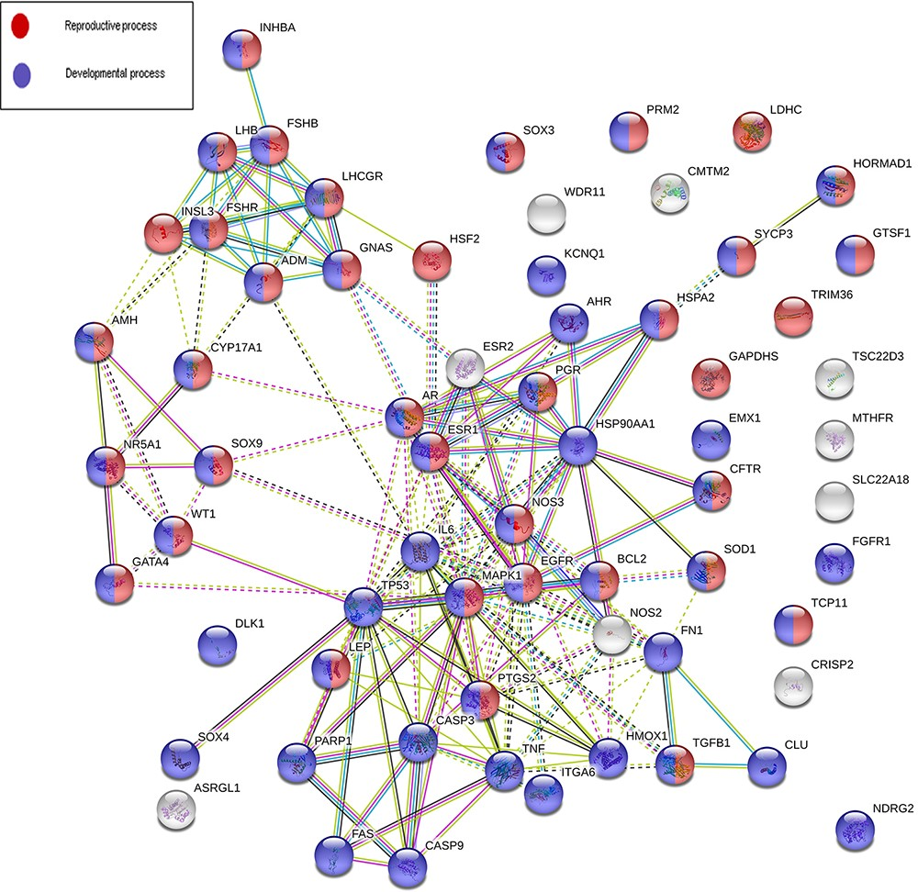
Figure 5. An interaction network on gene products associated with five or more reproductive conditions leading to male ...
Notes:
Figure 5. An interaction network on gene products associated with five or more reproductive conditions leading to male infertility.
Unless provided in the caption above, the following copyright applies to the content of this slide: © The Author(s) 2021. Published by Oxford University Press.This is an Open Access article distributed under the terms of the Creative Commons Attribution License (http://creativecommons.org/licenses/by/4.0/), which permits unrestricted reuse, distribution, and reproduction in any medium, provided the original work is properly cited.

Slide 6
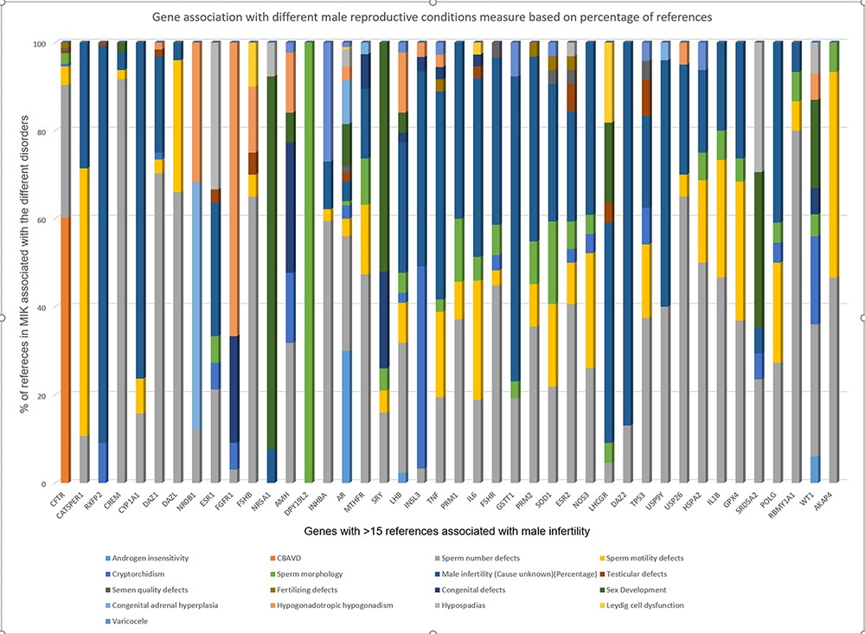
Figure 6. Strength of gene association with different male reproductive conditions based on percentage of references ...
Notes:
Figure 6. Strength of gene association with different male reproductive conditions based on percentage of references present in MIK.
Unless provided in the caption above, the following copyright applies to the content of this slide: © The Author(s) 2021. Published by Oxford University Press.This is an Open Access article distributed under the terms of the Creative Commons Attribution License (http://creativecommons.org/licenses/by/4.0/), which permits unrestricted reuse, distribution, and reproduction in any medium, provided the original work is properly cited.

Slide 7
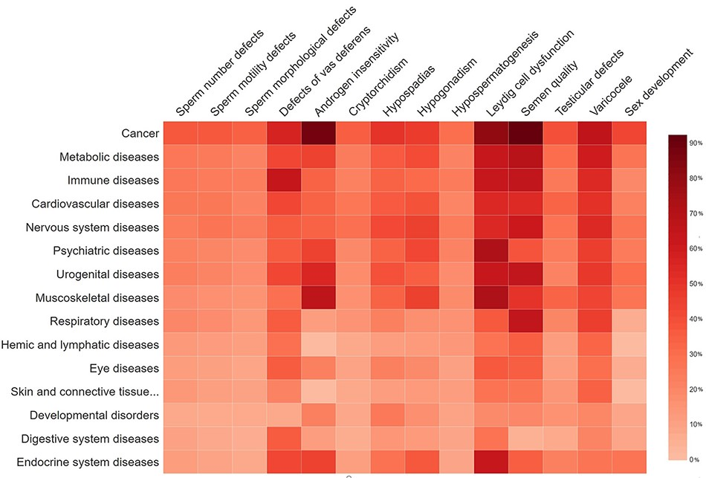
Figure 7. The percentage of gene overlap between disease subgroups in MIK and other disease classes.
Notes:
Figure 7. The percentage of gene overlap between disease subgroups in MIK and other disease classes. Higher the percentage of the gene overlap the darker the shade of red.
Unless provided in the caption above, the following copyright applies to the content of this slide: © The Author(s) 2021. Published by Oxford University Press.This is an Open Access article distributed under the terms of the Creative Commons Attribution License (http://creativecommons.org/licenses/by/4.0/), which permits unrestricted reuse, distribution, and reproduction in any medium, provided the original work is properly cited.

