Slide 1
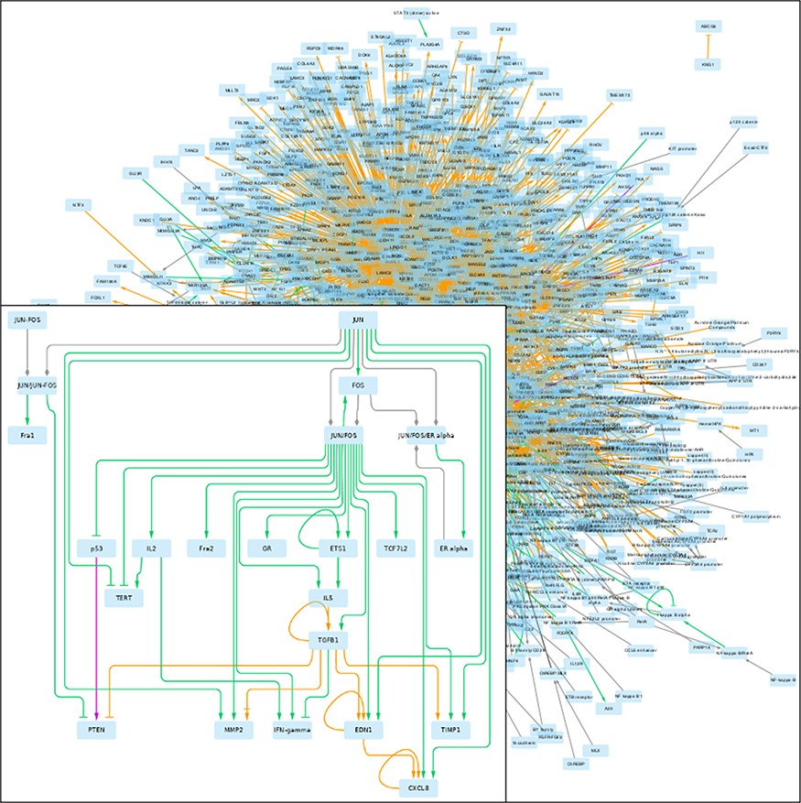
Figure 2. GRN returned by pyBRAvo. The color code of the edges gives their provenance: orange for CTD, purple for ...
Notes:
Figure 2. GRN returned by pyBRAvo. The color code of the edges gives their provenance: orange for CTD, purple for Panther, green for PID, red for Reactome and gray for the expansion of protein complexes. The edge tips depend on the interactions type: triangle for an activation, bar for an inhibition, arrow with bar for an unknown interaction type and diamond for a complex composition. This graphical export was made with Cytoscape 3.7 (13), following the instructions of Supplementary Methods G.
Unless provided in the caption above, the following copyright applies to the content of this slide: © The Author(s) 2021. Published by Oxford University Press.This is an Open Access article distributed under the terms of the Creative Commons Attribution License (http://creativecommons.org/licenses/by/4.0/), which permits unrestricted reuse, distribution, and reproduction in any medium, provided the original work is properly cited.

