Slide 1
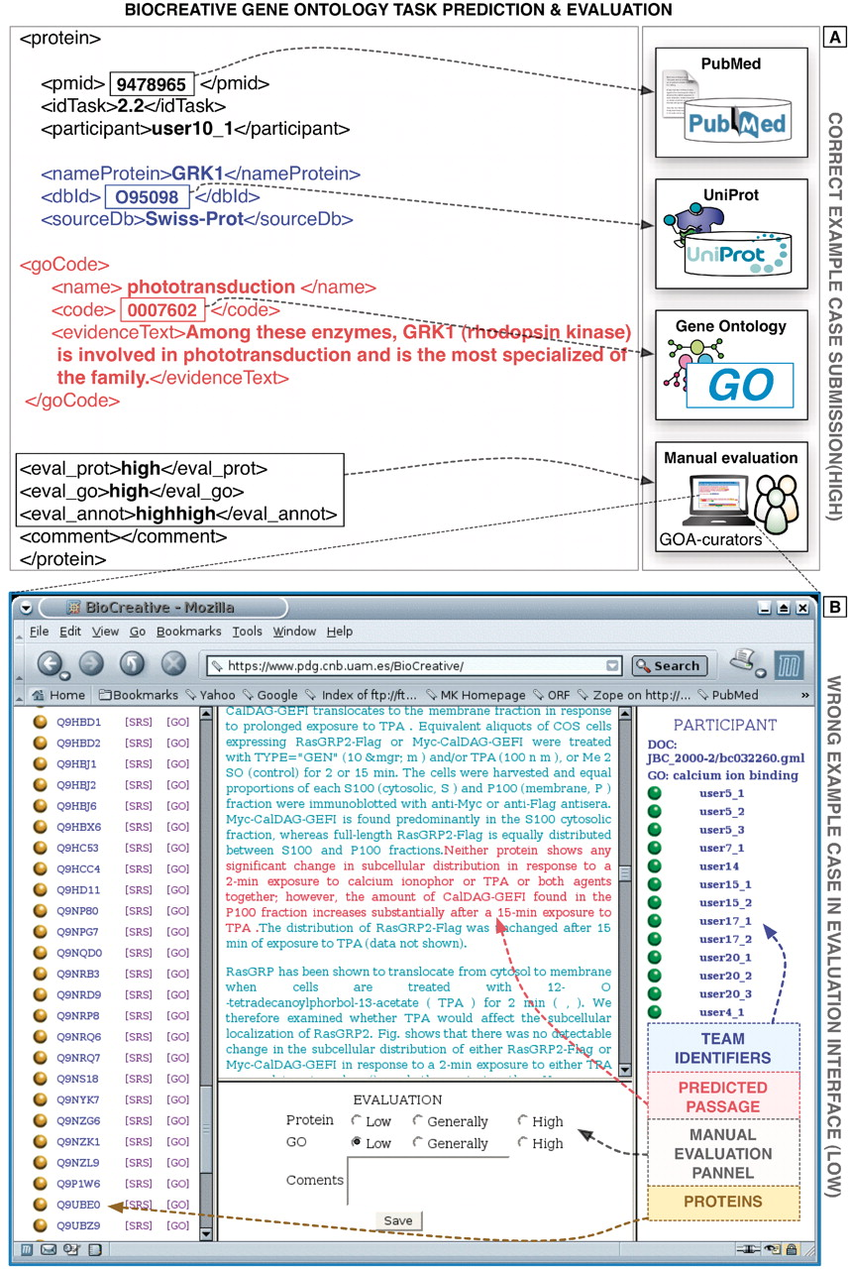
Figure 4. Example predictions of the GO task of BioCreative I. (A) Here a correct prediction is shown, containing the ...
Notes:
Figure 4. Example predictions of the GO task of BioCreative I. (A) Here a correct prediction is shown, containing the information on the corresponding document, protein and GO term as well as the supporting evidence text passages extracted automatically from the full-text article. (B) Example prediction (wrong) showing a screen shot of the original evaluation interface developed at the time for this task (based on Apache/PHP). The original evaluation application is not functional anymore and was implemented specifically for this task. Proteins and GO terms were defined unambiguously through corresponding standard identifiers. The database curators manually evaluated both the correctness of the protein as well as the GO terms.
Unless provided in the caption above, the following copyright applies to the content of this slide: © The Author(s) 2012. Published by Oxford University Press.This is an Open Access article distributed under the terms of the Creative Commons Attribution Non-Commercial License (http://creativecommons.org/licenses/by-nc/3.0), which permits unrestricted non-commercial use, distribution, and reproduction in any medium, provided the original work is properly cited.

