Slide 1
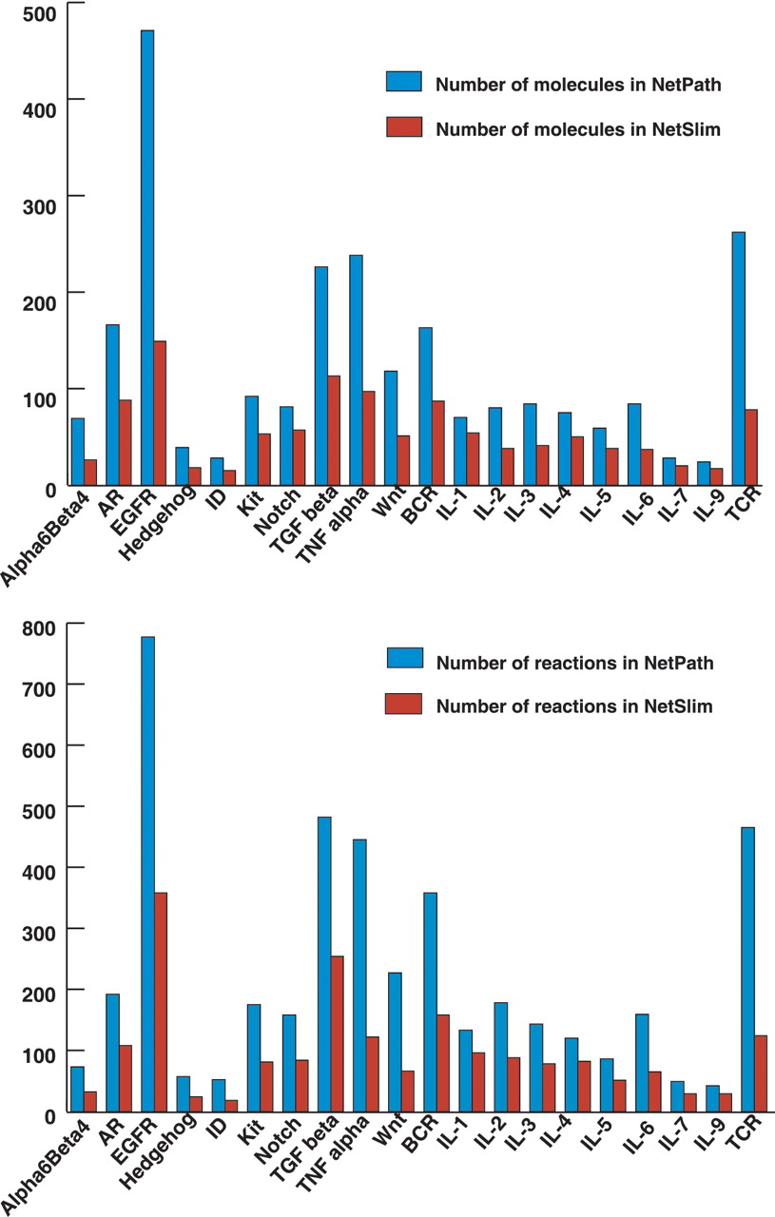
Figure 4. Comparative statistics of molecules and reactions in NetPath and NetSlim. The bar diagram represents the ...
Notes:
Figure 4. Comparative statistics of molecules and reactions in NetPath and NetSlim. The bar diagram represents the total number of molecules (A) and reactions (B) in signaling pathways in NetSlim and NetPath.
Unless provided in the caption above, the following copyright applies to the content of this slide: © The Author(s) 2011. Published by Oxford University Press.This is Open Access article distributed under the terms of the Creative Commons Attribution Non-Commercial License (http://creativecommons.org/licenses/by-nc/2.5), which permits unrestricted non-commercial use, distribution, and reproduction in any medium, provided the original work is properly cited.

